Slide 1
Agenda
Good morning. The brief starts at 0730
My contact information
Access to resources at training
Phone calls from Soldiers
Reception
Basic Training
Letter Writing
Sandboxx App
Address Example
Graduation
Mandatory Return Date (STO 1 Warriors only)
Tricare Reserve Select
Officer brief
End of Brief
Family picture time (10 minutes)
SFC Adam Reinschmidt, (572) 247-7723, adam.d.reinschmidt.mil@army.mil

Slide 2
RSP NCOIC – MSG Andrew Bryiant
State IADT Manager- SFC Adam Reinschmidt
Officer Branch – 1LT Joseph Hacker
SFC Adam Reinschmidt, (572) 247-7723, adam.d.reinschmidt.mil@army.mil

Slide 3
IADT Manager/ Guard Liaison (LNO)
SFC Adam Reinschmidt
State IADT Manager & National Guard Liaison
(572) 247-7723
SFC Adam Reinschmidt, (572) 247-7723, adam.d.reinschmidt.mil@army.mil

Slide 4
While at BCT & AIT
Today your Warriors are on Title 10 Active-Duty orders for the duration of their Initial Active-Duty Training.
National Guard Liaison: This person coordinates with the IADT Manager about your Warrior’s issues, if any.
Medical: Tricare Prime Medical Insurance Coverage
Chaplain: Choice of religious event attendance
SFC Adam Reinschmidt, (572) 247-7723, adam.d.reinschmidt.mil@army.mil

Slide 5
Phone Calls
Your Warrior will have access to their cell phone until they reach reception tonight.
Once they arrive to Reception, they will be required to put their cell phone away.
The last day of Reception your Warrior will be able to make a short phone call to relay the address.
After that time, you will not hear from your Warrior for approximately 2 – 4 weeks via cell phone.
SFC Adam Reinschmidt, (572) 247-7723, adam.d.reinschmidt.mil@army.mil

Slide 6
Reception
This is where your Warrior is received and in-processed into the Active-Duty Training Site.
Reception lasts 5 – 10 days. This depends on the training location your Warrior is attending.
Uniform and Equipment Issue
Medical Inspection (Dental, Vision, Hearing, Height & Weight)
Each Warrior receives an Eagle Cash Card” (pay advance. Males $350/Females $756)
SFC Adam Reinschmidt, (572) 247-7723, adam.d.reinschmidt.mil@army.mil

Slide 7
Basic Training
10 weeks long
Warrior will have to provide address.
  IADT personnel cannot get address.
First 2 weeks of BCT is Red Phase. It is the hardest part of Basic Training. Your Warrior is learning to operate as a member of a team.
Will have to earn phone privileges.
  Graduate RED Phase.
Phone privileges are on Sundays for 30 minutes.
SFC Adam Reinschmidt, (572) 247-7723, adam.d.reinschmidt.mil@army.mil

Slide 8
Letter Writing
There are two ways to write letters to your Warrior.
(1) Normal Letter Writing or small care packages
  Toiletries
  Photos
  “Mole-Skin” or “Baby Wipes”
  Please do not send any form of cash or prepaid cards.
  Please do not send contraband (knife, guns, alcohol, clothing or any other kind of “unauthorized” items)
  This list of approved items can be received from your Soldier at their 2nd phone call.
(2) Sandboxx App (This app requires payment to be used)
SFC Adam Reinschmidt, (572) 247-7723, adam.d.reinschmidt.mil@army.mil

Slide 9
Letter Writing
The Warrior gets their address at Reception and will have to provide it to the family.
The Sandboxx is an app that will print, send, and track your letter to any military base. Additionally, the app will send weekly updates of what your recruit is doing at basic training. It also gives family day and graduation information.
Sandboxx https://www.sandboxx.us/
SFC Adam Reinschmidt, (572) 247-7723, adam.d.reinschmidt.mil@army.mil

Slide 10
Letter Writing
  Address Example
    Rank(PVT, PV2, PFC, SPC) Last name, First name
    Roster Number
    X Co., X-XX BN (Inf. Regt.)
    Street address
    Fort Benning, GA XXXXX
**** Facebook search the Warrior’s Battalion and training location for social media updates.
SFC Adam Reinschmidt, (572) 247-7723, adam.d.reinschmidt.mil@army.mil

Slide 11
Graduation
Blank envelope will be given to each Warrior to address and send. It will contain all the information on the date/time, hotels in the area, graduation ceremony location, and where to park.
Fort Benning & Fort Jackson visitors need to arrive 2 hours early due to the amount of people attending graduation.
Fort Leonard Wood pre-register a week in advance. This information is given to each Soldier to send back to family.
Use Google to locate each Visitor Center at each training location and their rules.
No limit to number of people to attend.
SFC Adam Reinschmidt, (572) 247-7723, adam.d.reinschmidt.mil@army.mil

Slide 12
BCT & AIT Graduation Visitors pass
Starting August 1, 2026 all visitors must have a valid pass to enter Military Installations for Basic Training and AIT graduations
The pass can be applied for at the below link
  https://pass.aie.army.mil/
SFC Adam Reinschmidt, (572) 247-7723, adam.d.reinschmidt.mil@army.mil

Slide 13
Mandatory Return Date (STO 1 Only)
This section applies to Soldiers who are only attending Basic Training without any follow up training until after the next year of school
Warriors must return by their MRD
If a Warrior will be held over to complete training, permission must be approved by both the parents and the school
Bring back high school letters for AIT seats
72 hours to physically report back to RSP
SFC Adam Reinschmidt, (572) 247-7723, adam.d.reinschmidt.mil@army.mil

Slide 14
Tricare Reserve Select
Upon return from training your Soldier will qualify for Tricare Reserve Select (Tricare West) Health Insurance. This is one of the best benefits the OKARNG has.
Please go to https://Tricare.mil for more information.
Prices as of 22 October 2025:
$53.80 for Member Only
$274.48 for Member and family
SFC Adam Reinschmidt, (572) 247-7723, adam.d.reinschmidt.mil@army.mil

Slide 15
Red Cross
Red Cross Message is a way to get “immediate” information to your Soldier about a critical incident (family death or major injury) information to your Soldier. Please refer to the information link for more details about what qualifies for a Red Cross Message.
Step 1: Call the Hero Care Center (Toll Free) 877-272-7337
Step 2: Have the following information ready: Full name, Rank, Branch of Service, Social Security # or Date of Birth, Military Unit Address, Unit details (Unit name, Unit ID Code, or Base Name)
Further information can be found at:
https://www.redcross.org/get-help/military-families/hero-care-network/emergency-communication.html
SFC Adam Reinschmidt, (572) 247-7723, adam.d.reinschmidt.mil@army.mil

Slide 16

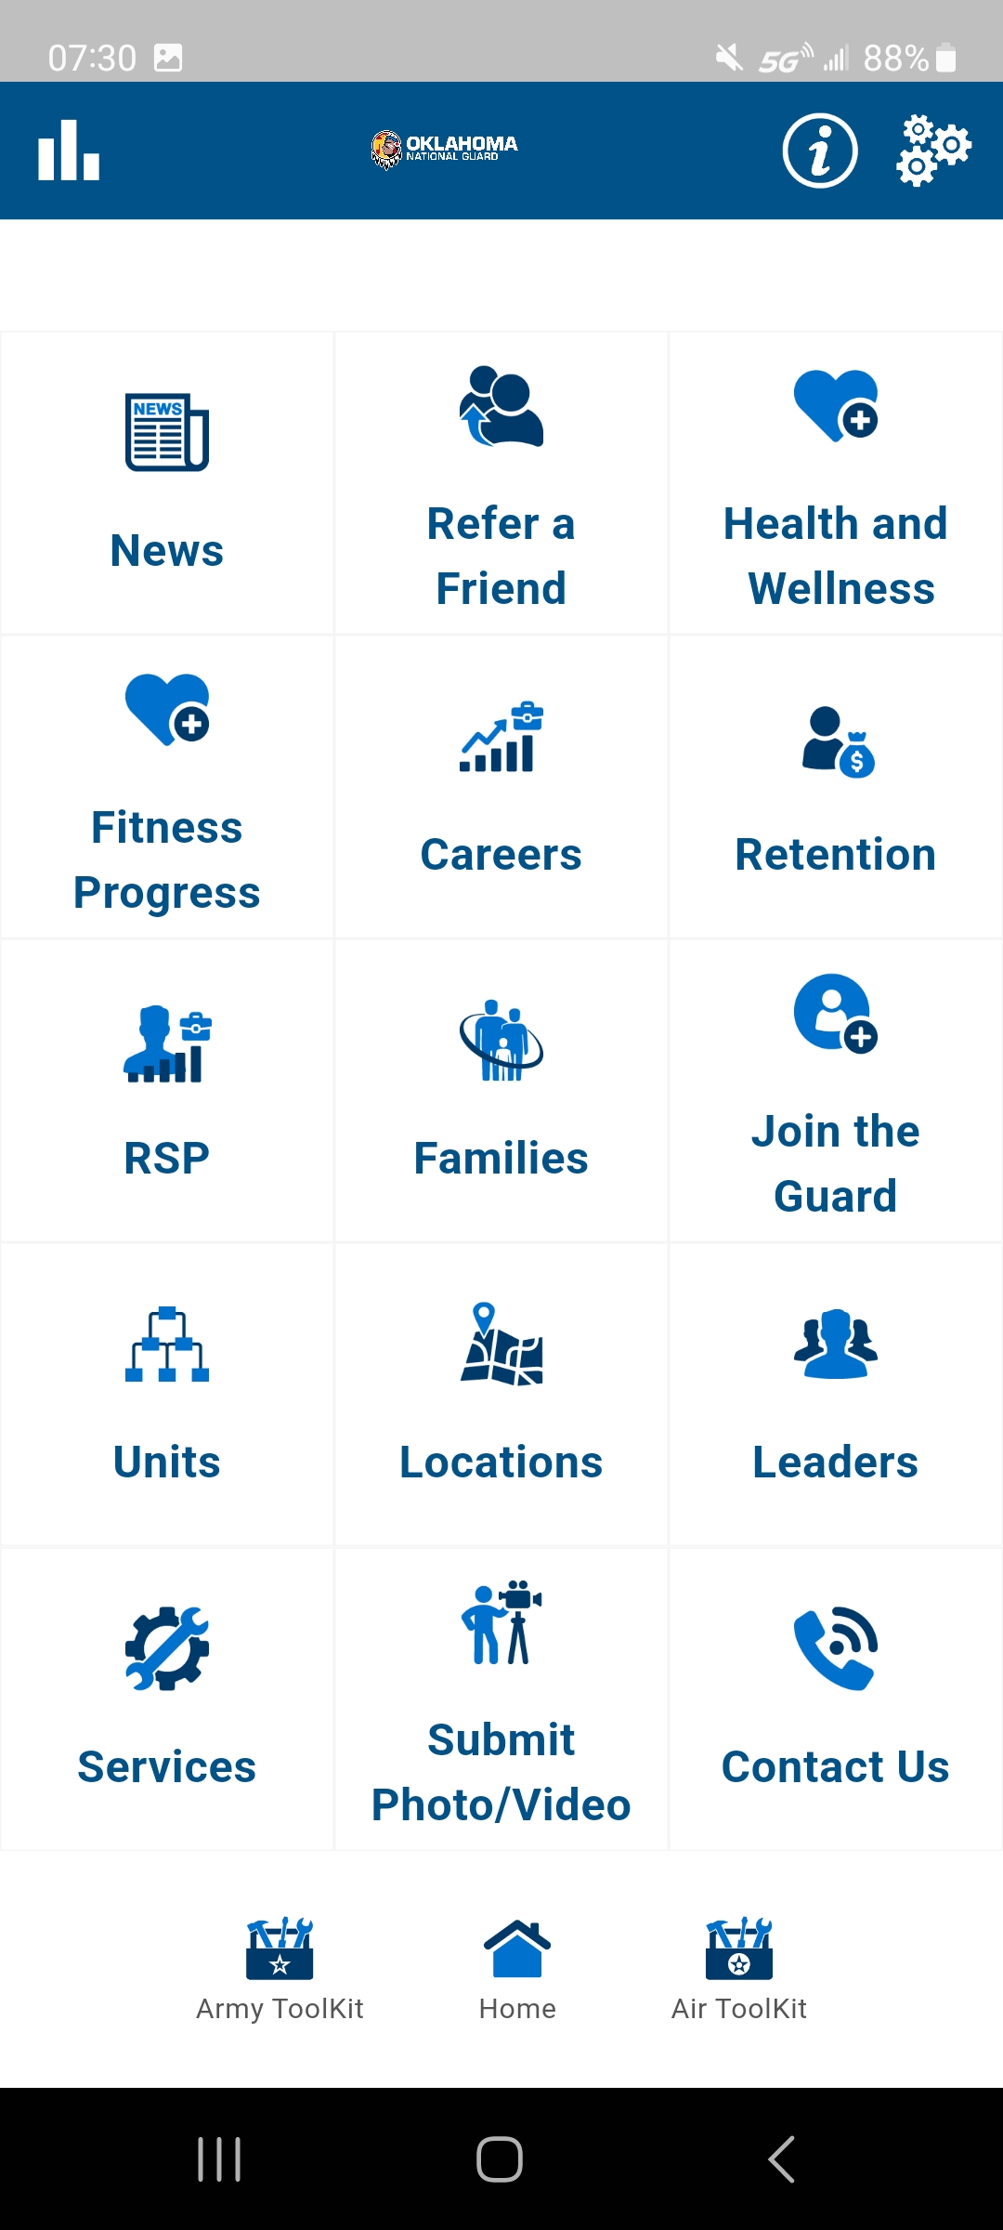
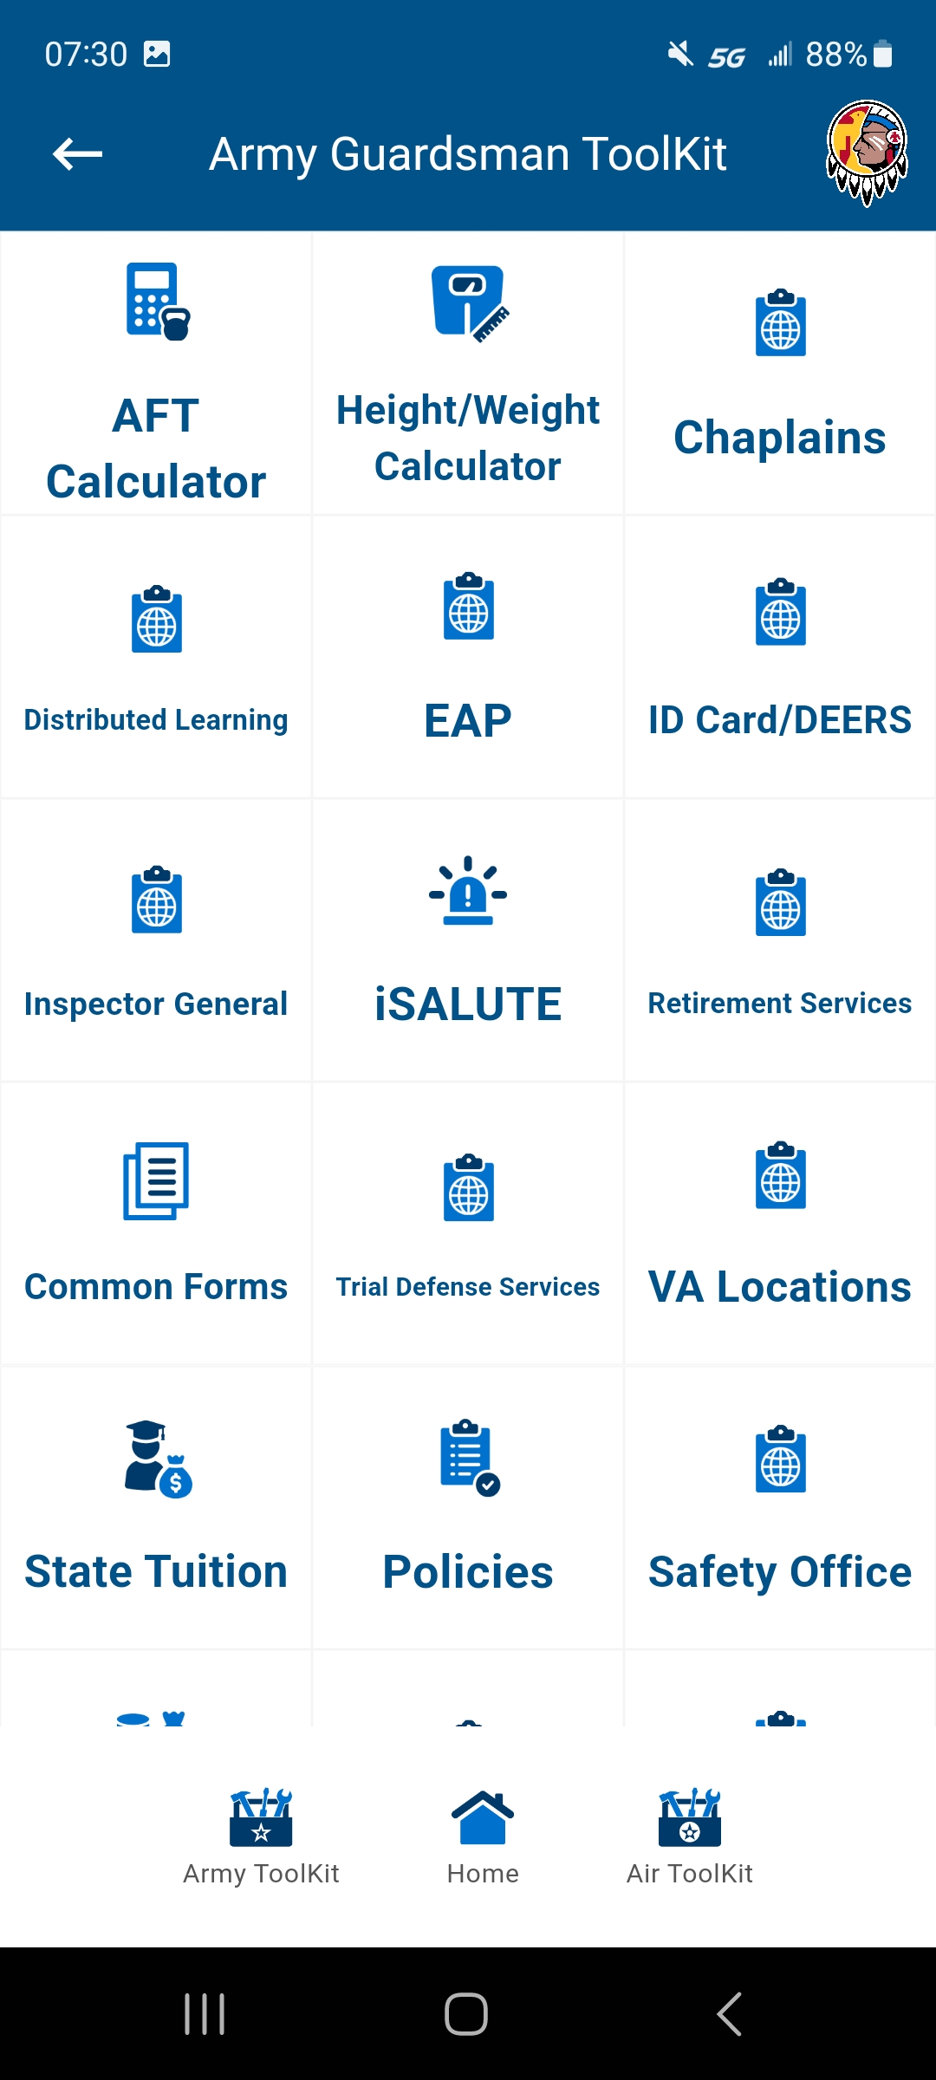
EAP
Step 1
Download OKGuard App
Step 2
Click “Army Toolkit”
Step 3
Click “EAP”
SFC Adam Reinschmidt, (572) 247-7723, adam.d.reinschmidt.mil@army.mil

Slide 17
Questions

Slide 18
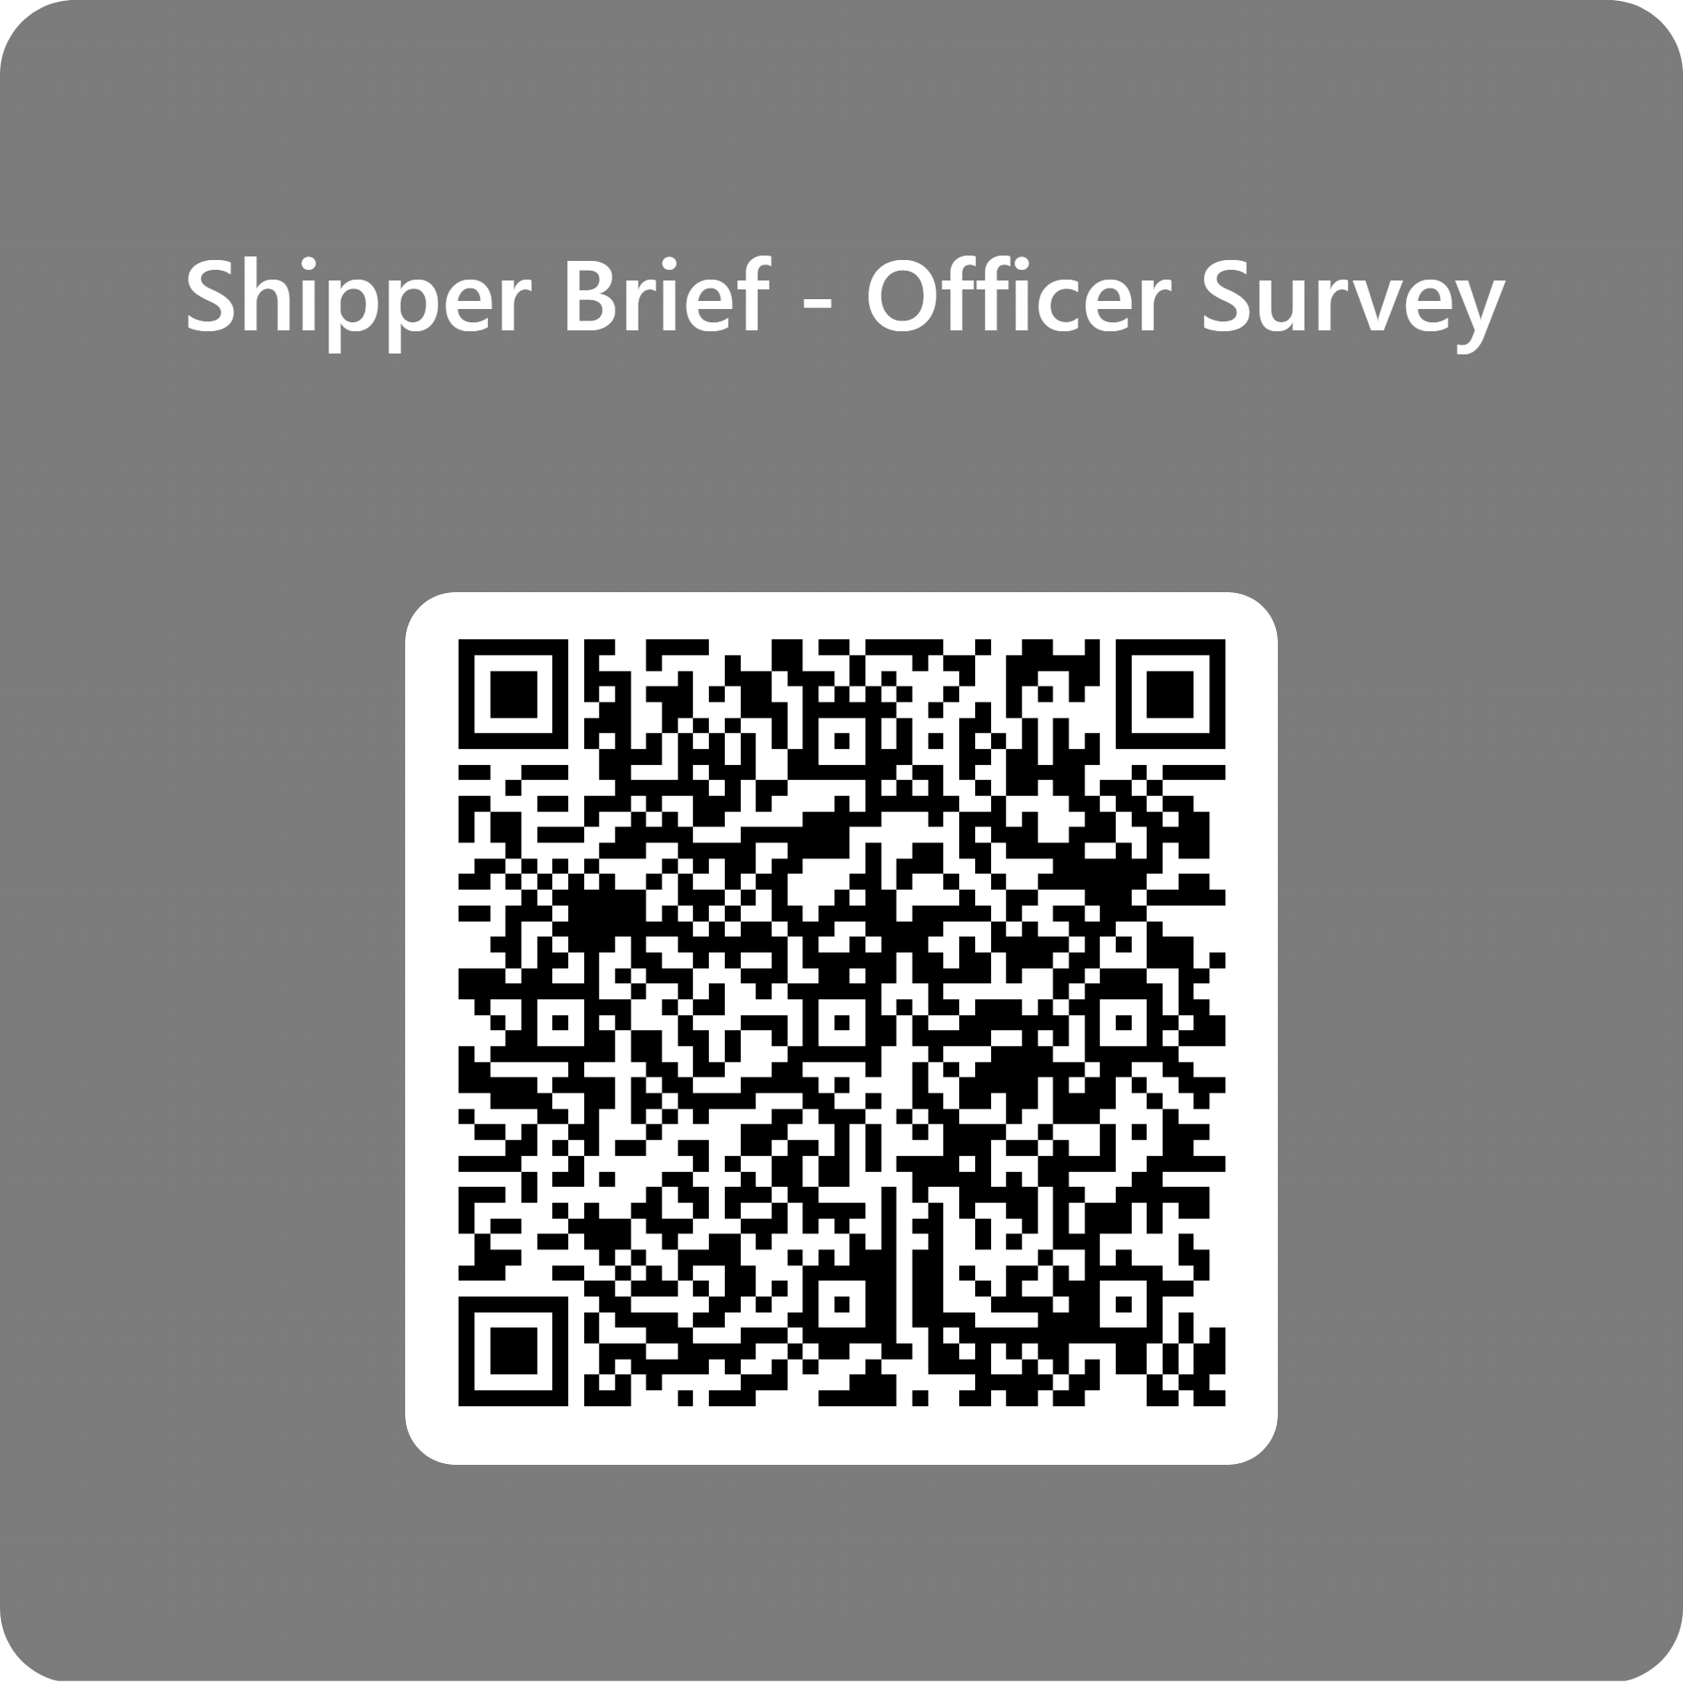
Officer Strength Management
ROTC
Cameron University, Lawton
Northeastern State University, Tahlequah
Oklahoma State University, Stillwater
University of Central Oklahoma, Edmond
University of Oklahoma, Norman
GOLD (OCS)
East Central University, Ada
Rogers State University, Claremore
Southwestern Oklahoma State University, Weatherford
Southeastern Oklahoma State University, Durant
Shippers - Please Scan and Complete the Survey
SFC Adam Reinschmidt, (572) 247-7723, adam.d.reinschmidt.mil@army.mil

Slide 19
Financial Incentives
ROTC
GOLD (Guard Officer Leader Development)
Contracting Incentives (Sophomore Year)
$1600 per month (stipend, drill pay, GI Bill, Kicker)
Non-Deployable while contracted
Scholarships – subject to funding
    $6,600 (or more) per semester
    Guarantees you to the Guard
Educational Assistance Program – free tuition and fees
GI Bill - $493/mo
GI Bill Kicker - $350/mo
Educational Assistance Program
  free tuition and fees
Campus Scholarships Available
  RSU offers free room & board
Drill on campus – 4hr labs
Increased drill pay senior year as 2LT
Non-Deployable while in the GOLD program
SFC Adam Reinschmidt, (572) 247-7723, adam.d.reinschmidt.mil@army.mil

