Slide 1
The Dangers of Distracted Driving
Notes:
Introduction
Personal testimony as to why YOU are talking to students about this topic.

Slide 2
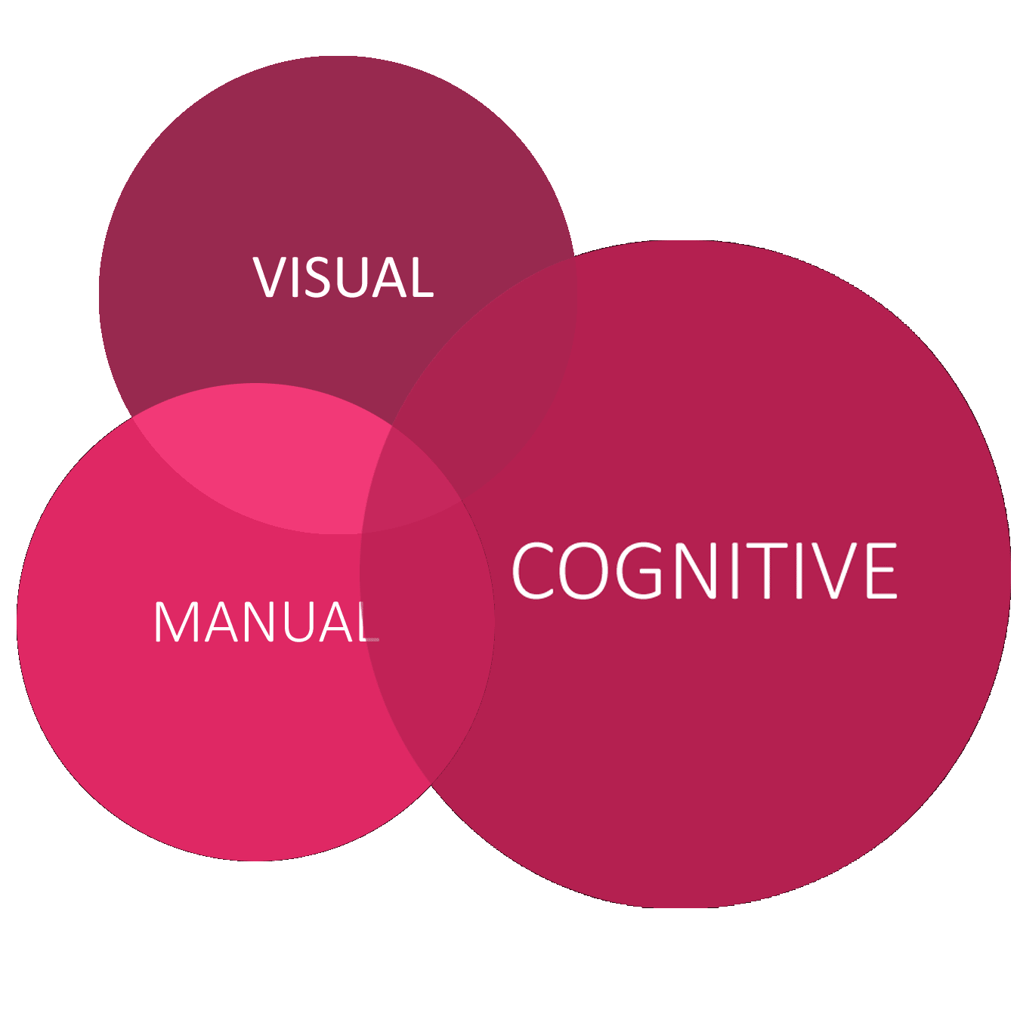
THERE ARE
THREE TYPES
OF DISTRACTION
• Manual
• Visual
• Cognitive
Notes:
It’s useful to consider the 3 types of distractions that we face when we drive.
What is an example of a manual distraction?
What is an example of a visual distraction?
What is an example of a cognitive distraction?
You need to change the radio. You reach for the dial taking your hand off the wheel, or maybe texting you need to take both hands off the wheel – manual distraction.
You look down to see what station you're tuning in, or to scroll through a play list taking your eyes off the road – visual distraction.
You think about what kind of music is playing or what kind of music you'd like to be playing, or you think about what to send or answer in a text, actually just thinking about anything other than driving – cognitive distraction.
Remember –even with your eyes on the road and your hands on the wheel, if your mind is not on driving you can still be distracted-cognitive distraction.
You see that the cognitive distraction circle is larger and overlaps the other circles—That’s because understanding cognitive distractions is so important to being a safe driver and more often that not it is not just one distraction at a time, but several going on at once.
How many of you have ridden with a distracted driver? OK - most of the room….How many of those distracted drivers were your parents or grandparents? YOU can be a better driver than them. I am going to show you how.
How many of you know someone who has been directly effect by distracted driving?
I want to share a story about an Oklahoma family who lost loved ones due to a 17-year-old texting driver. Watch this video.

Slide 3
Notes:
After this video:
Sad, huh? You don’t want to have this happen to you or your family, but you REALLY don’t want to be that 17 year old who killed 3 people. We all know it is dangerous and yet, we still do it.

Slide 4
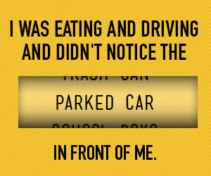
Notes:
As we just learned there are many types of distractions. All of them keep you from seeing everything around you. So we know you aren’t going to drive distracted anymore, right? RIGHT? Make a promise to yourself that you will drive distraction-free.

Slide 5
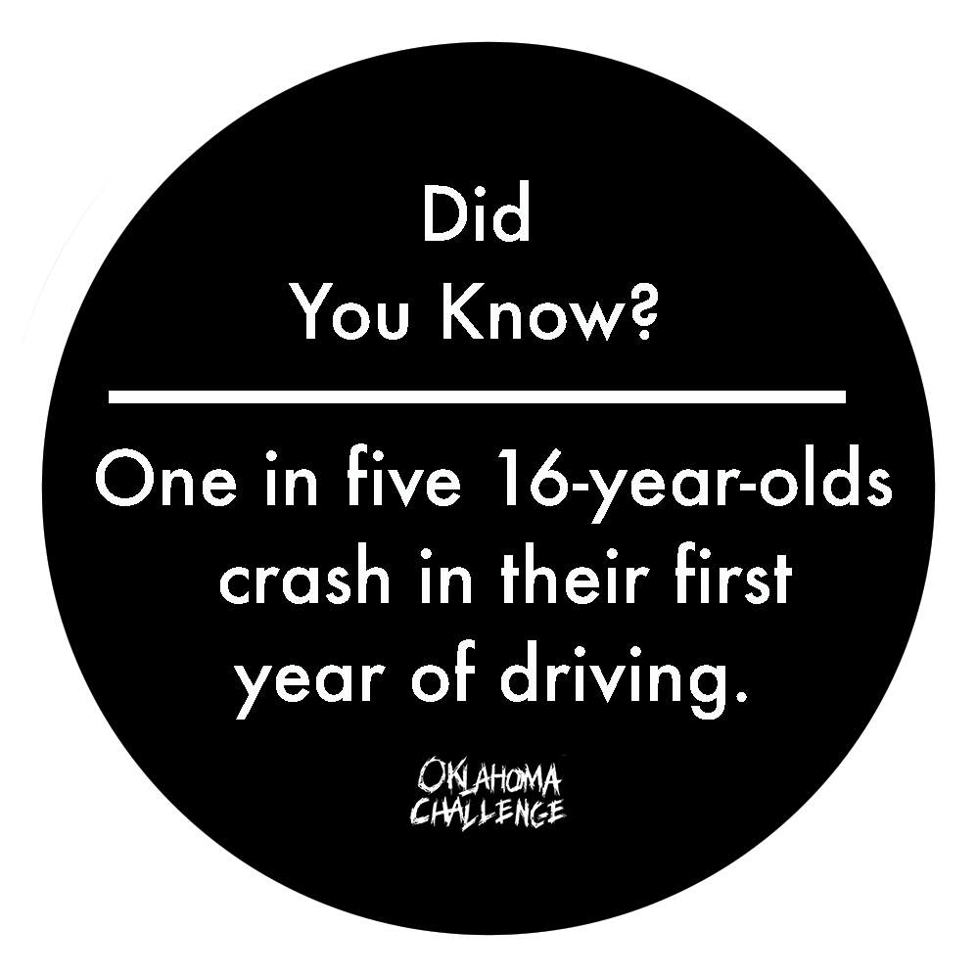
Notes:
This CAN happen to you! With distracted driving, these numbers are increasing. You CANNOT do multiple things at once. Let’s look at this video to learn about Inattention blindness.

Slide 6
Notes:
We all understand that if we look away from the road at our smartphones to text or snapchat we can’t see what is going on and react to traffic conditions or emergencies. But scientists are showing that even if we are looking at the road we can still be distracted, meaning lose our mental focus, if we are trying to do more than just driving. This is often called “Inattention Blindness.” That phrase doesn’t mean there’s anything wrong with our vision—what is happening is that we are overloading our brains, so we do not process what we see.
If the information is not able to be processed by our brains we can’t, as drivers, react to what is happening. For example, a car can pull out suddenly in front of us or slam on its brakes, making it essential we react quickly. However, with inattention blindness, we might see it but don’t react because we are concentrating on activities unrelated to driving. It is a result of trying to do more than one thing at a time.

Slide 7
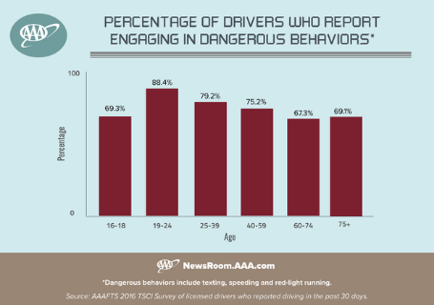
Who’s Driving Distracted?
Notes:
Teenagers get a pretty bad rap as being the ones doing the most texting and driving.
Have you ever said, “I can text and drive just fine. It’s others who can’t.”
If you look at these survey results – adults 19-24, 25-39 and even 40-59 – admit at a higher level to engaging in dangerous driving, including texting. These are self-reported numbers, so we’re relying on what those drivers tell us. And it’s from 2016 . . . So do you think in 2018, these would be higher or lower?

Slide 8
Notes:
YOU can be the role model for driving in your family. Younger siblings, cousins and friends are watching you!

Slide 9
In 2018 in the U.S., 2,841 people died in motor vehicle crashes caused by distracted drivers . National Highway Traffic Safety Administration
Notes:
Let’s look at some of the numbers on the impact of distracted driving and but them in perspective. Every day in the U.S., an average of 9 people are killed and more than 1,000 injured due to crashes involving distracted drivers, according to the National Safety Council.

Slide 10
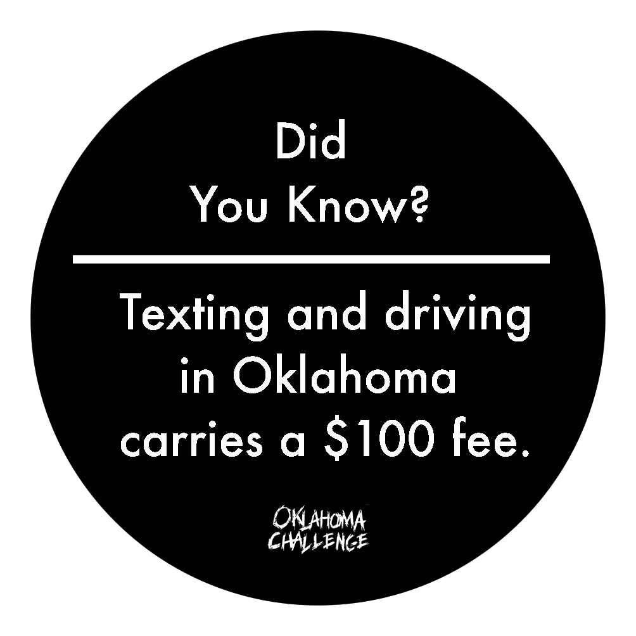
Notes:
So, what are the consequences of distracted driving? If you’re lucky, it’s a $100 ticket. That’s a lot! Plus possible court costs….plus, you may not get to drive again for awhile. However, sometimes, the price can be much, much higher. Are you willing to risk your life, and that of others, just to use your social media? We tell ourselves - Nothing bad will happen and It’s just a few seconds.

Slide 11
FRIENDS DON’T LET FRIENDS DRIVE DISTRACTED
78% of teen drivers say they’re likely not to text and drive if friends tell them it's wrong.
44% say that they would be thankful if a passenger complained about their texting while driving.
90% say they’d stop if a friend in the car asked them to.
You can keep your friends safe!
Notes:
Look at these stats. 90% sat they’d stop if asked!! By taking the Oklahoma Challenge and sharing this message with your friends and family YOU ARE THE SOLUTION! Can I hear a BIG YES? A BIGGER YES?

Slide 12
Quiz time!
Which of the following is considered texting while driving?
Sending a message
Dialing a number
Reading a message
Reading and/or typing anything on the phone
Notes:
Quiz time!! Who knows the answer to this? ALL OF THE ABOVE! First person to answer correctly gets a give away.
Have them shout it out.

Slide 13
Questions
Why do you think it’s so difficult for people to ignore their phones while driving?
1
What societal pressures exist that makes not reaching for your phone while driving a challenge?
2
How is distracted driving – especially cell phone use - more difficult to address than drinking and driving?
3
Notes:
So, now we’d like your input. Let’s break up into groups and discuss these questions. Please name a spokesperson for your group and take 5 minutes here to talk through these questions and then, we’ll share each group’s thoughts.
Break the room into groups. Let them discuss and then ask for their answers. Facilitator will need to mingle in the room to help them discuss.

Slide 14
Ready to share this message with your friends and family?
Notes:
Do YOU accept the Challenge? Will you share this information with your friends and your family?
To do this – First YOU HAVE TO BE A ROLE Model? I am talking to both the students AND the teachers here!! EVERYONE needs to be a role model.

Slide 15
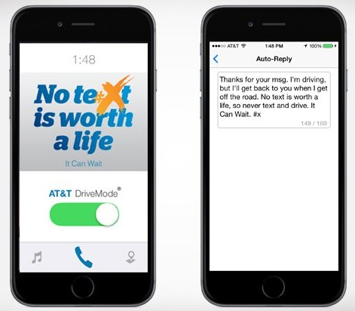
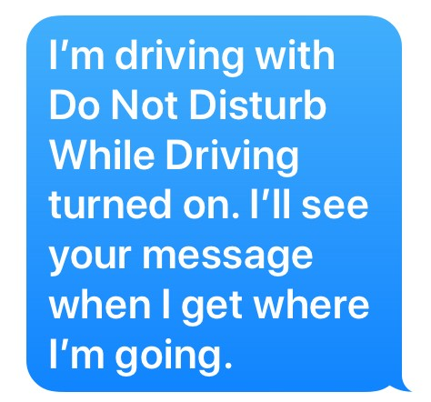
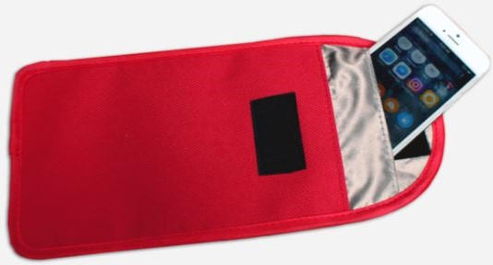
What’s Available to keep YOU safe?
Notes:
We understand that sometimes it's difficult to put our phones down so we want to tell you about a few ways that can help.
Show the cell slip – All of you will be getting these. It keeps your phone from receiving anything. Slip your phone in – no signal – no distraction.
Then, Don’t have your cell slip handy? Use the Do Not Disturb While Driving feature. It’s easy. This prevents drivers from seeing messages and call notifications displayed on the screen, with automatic responses able to be sent back to the sender warning that the user is driving. Features like CarPlay, navigation, and music playback will continue to work as normal. Turn this on! Stop those texts from coming through!

Slide 16
Notes:
Here is a similar app for androids. Remember, all of these apps and features allow you to still play music and use your gps. Fix all of that BEFORE you start driving and you are good to go!

Slide 17
In a public opinion poll conducted by the National Safety Council, 82% of Americans said they felt the most pressure from their families to use phones while driving. Even teen drivers report feeling pressure from families, as well as friends.
Notes:
In a public opinion poll conducted by the National Safety Council, 82% of Americans said they felt the most pressure from their families to use phones while driving. Even teen drivers report feeling pressure from families, as well as friends.
Any of you feel pressure to answer your phone or return a text while driving….if it is one of your parents reaching out to you?
If so, what will you do?

Slide 18
“Let me send that text for you.” “I can answer the phone.” “We are not in a hurry-pull over so you can use your hands to eat.” “Let me make sure your little sister is buckled up! She’s important!”
SOLVE THE PROBLEM BY
OFFERING A SOLUTION
Share Responsibility with the Driver
Notes:
Solve the problem by offering a solution-sharing responsibility with driver
· “Let me send that text for you” BE THE DESIGNATED TEXTER!
· “I can answer the phone”
· “We are not in a hurry-pull over so you can use your hands to eat”
Role play up front – have 2 people do a role play Have them say ugly things to each other and see how that works – you are a terrible driver, you suck at driving, I am NEVER going to ride with you again.
Then have them be respectful and caring….I care about you, I want you to stop so you are safe, etc.
Then ask the group to roleplay in 2’s. Pick the person it is MOST difficult to say no to (often parents or grandparents) ….and practice pretending to talk to that person.
After a few minutes, ask them to share what that was like? Why was it difficult? If they ask a question you can’t answer ask the group to help with the answer.

Slide 19
WHAT WILL YOU CHOOSE TO DO?
• Drive without reading or sending texts, snapchatting, using the internet, Facebook or social media of any kind.
• Call/text before I start driving to let parents, friends and others know when I’ll arrive.
• Pull over to a safe location to check texts, social media, or listen to voice mail.
Notes:
You don’t want to be the teen driver that causes this kind of crash. Do you? You know, I am still tempted to use my cell phone to text or check e-mails when I drive—because I did it all the time-it was a habit—It has been a challenge to stop driving distracted—You will be tempted to drive distracted also—you will need to commit to driving safer-you will need to commit to a plan if you want to drive safer.
We are now not just thinking about being safe drivers we are choosing to be safe drivers and making a plan to do so. AND, a plan to NOT ride with a distracted driver!!

Slide 20
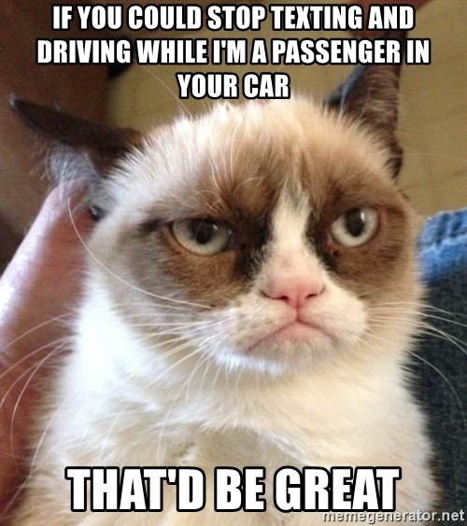
Notes:
We have a PSA from everyone's favorite Cat

Slide 21
Social Media
Social media is a great way to tell others about the dangers of distracted driving and the importance of seat belts.
Go to our website: OklahomaChallenge.org
Follow Us:
Twitter: @OK_Challenge
Instagram: oklahomachallenge
Facebook: @OKChallenge
Notes:
**** Will need to update this slide with your social media info and possible incentives for them to “react” to social media both NG and OK Challenge post.
Remember, this happens in a flash. It can happen to you just like this. (Next slide, video)

Slide 22
Notes:
It only takes a second or two. Please, promise now to put your phone down!

Slide 23
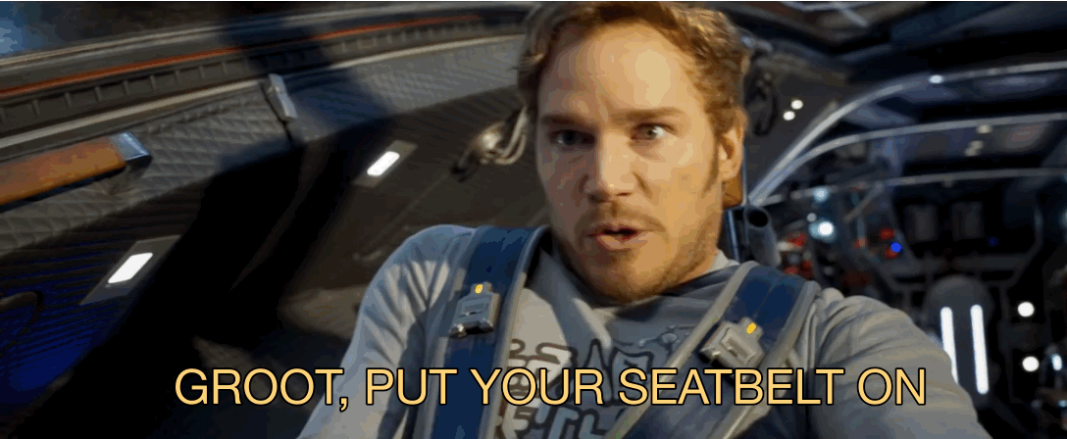
Notes:
You have to wear your seatbelt too! EVERY TIME you are in the car, and no matter wear you are sitting in the car!

Slide 24
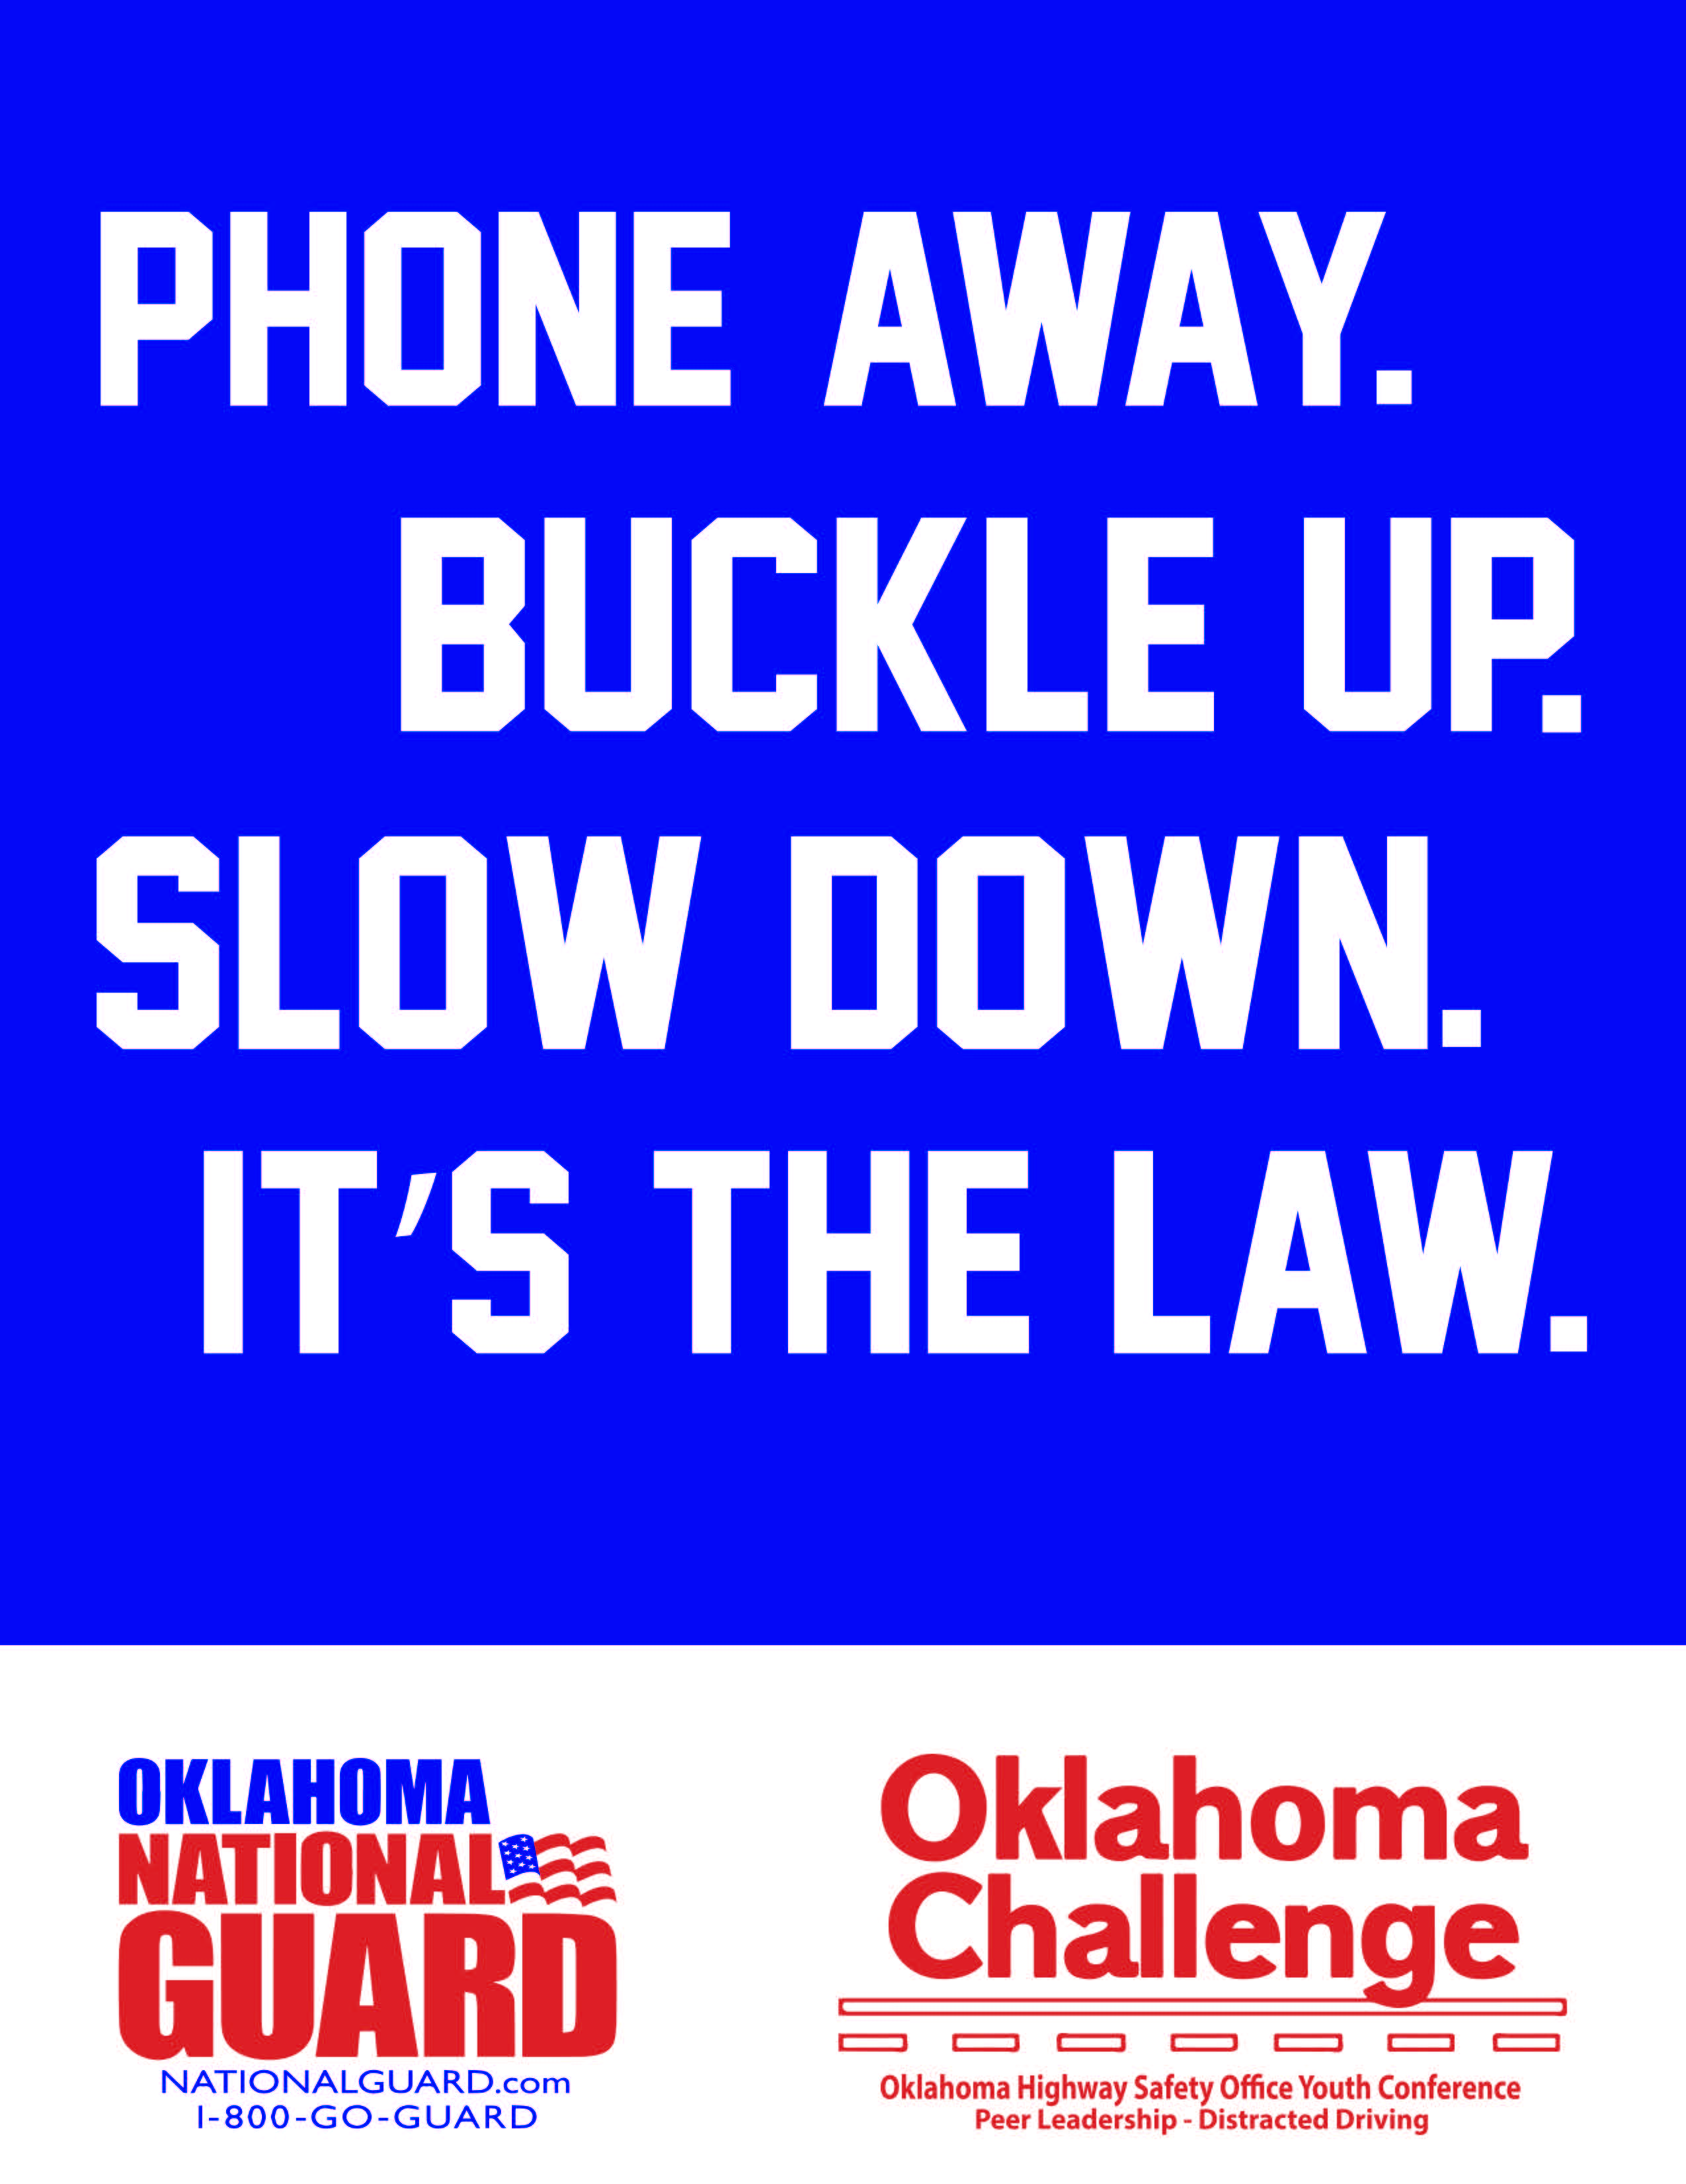
Notes:
Thank you for listening today. Share this message on social media and with your friends and family. You can save a life, today!!

Slide 25
LargeTruck Safety
Notes:
Add this video into your presentation if you have more time.
Driving around trucks, especially in Oklahoma with all the many trucks on the road, can be dangerous. Let’s watch this video to learn more about truck safety.

