Slide 1
Notes:
This is a place holder as students enter. On mouse click, the video will start on the next slide.
General Instruction Tips:
Use the Sample Script (indicated by bold type in the notes) to learn the teaching points for each slide.
Avoid reading the slide or the sample script to the class. Use your own words.
Involve the class as much as you can by asking questions and asking for volunteers. Reward participation. Never make a student feel foolish – keep the class positive and the students focused.
For This Presentation:
Before the presentation, visit www.careertrain.com to register the school and learn best practices. Click on ARNG Rep and enter the authorization code “cdguard” to enter the site. To access the online Resume Tool, students need the school’s password (created when you register the school).
Stamp, or label with a business card, the booklets with your personal contact info – see back cover.
Save the CD2 presentation on your laptop hard-drive. The video files must be in the same folder to work.
Make sure your audio is turned up for video and audio clips within the slideshow.
To begin your presentation, click for “Slide Show” view and click your mouse. A 20-second video will set the stage for the workshop. After the video runs once, advance to the next slide.
When the CTC logo appears at the bottom left , you have reached the last animation. Use this prompt to help keep you on track with the teaching points of each slide.
Scheduling:
If one 50-minute period is available, you can teach steps 1-6, 16, and collect the student feedback forms.
If one 90-minute period is available, you can teach steps 1-6, most of the job-getting skills, 16, and collect the student feedback forms.
If two 90-minute periods are available, teach steps 1-6 on day 1 and 7-16 on day 2.
For three 50-minute periods, teach steps 1-5 on day 1, steps 6-10 on day 2, and steps 12-16 on day 3. (Step 11 is an exercise to help students prepare for the online resume tool. The teacher may want to encourage students to complete the exercise as an assignment prior to step 8 (resume building).
Whatever part you do not cover in the class can be completed by the teacher as a follow-up assignment, because students will have their workbooks to use later.
Make sure students complete and turn in the student feedback form!

Slide 2
CTC Logo: Balance your career and personal life to achieve success.
Slide 2 | Page 4
Notes:
Introduce yourself and thank the teacher.
I’m ________________, and it is really a pleasure for me to present this program to you. Thank you, Mr./Ms. _______________.
Today, we are going to spend time talking about you, about your priorities, your interests and abilities, your personality, and your goals for your future. We are going to use the CD2 program to help you develop your plan for career satisfaction and success.
Have the students flip their workbooks over and write their names in the space at the top of the back cover.
This will help you get started quickly on days 2 and 3, if you have collected the workbooks at the end of the class.
Please open your workbook to page 4.
Notice the logo.
What do you think it means to have a balanced career and personal life?
Let a couple of students answer.
To enjoy career success, you need a healthy balance between your career and your personal life.
By the way, notice the page number on the lower left corner of each slide. This will help you follow along in your workbook.

Slide 3
What’s Important to You?
Success
Everyone wants to succeed.
The willingness to prepare makes the difference between failure and success.
Will you prepare for your goals?
Slide 3 | Page 6
Notes:
Consider the word success…
What does success mean to you?
Do any of you already know what you want to do as a career? (Let 2 – 3 students answer)
Ask one of the students, “What education, training, time, and money will it take for you to prepare for the career you want?” (let them answer)
Sometimes preparation for success costs money, sometimes takes time, sometimes … just plain hard work.
The question we have to ask ourselves is this:
Am I willing to do whatever it takes to prepare?

Slide 4
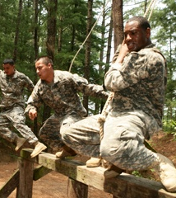
What are your career goals?
Make just enough money for bills?
A career you will enjoy?
How will you prepare?
A Job?
Military?
College or technical school?
Your choices are limitless and can include education, military, and a career all interwoven like Jill!
Slide 4 | Page 6
Notes:
You are at a point in your life where you have lots of choices.
You can choose a job you hate and “just pay the bills.”
Or, you can get the education and training required to have a career you will enjoy.
What should you do after high school to reach your goals?
Will you enter the work force?
Pursue higher education and training?
Enter the military?
Your choices are limitless!

Slide 5
››› step 1
Success requires knowing your Priorities:
What are yours? What jobs fit your priorities?
Career – Work is your “calling.”
Best job: enjoyable skills
Community – Support local causes.
Best job: worthy projects
Global Perspective – Work with all cultures.
Best job: international mission
Slide 5 | Page 7
Notes:
Success is different for each of us depending on our priorities.
Here are a few examples of things people consider important.
>Would someone read the section on “career?”
Someone will read “Work is your calling. Best job: enjoyable skills”
>Would someone read about “community?”
Let someone read.
>What about “global perspective?”
Let someone read.

Slide 6
Income – Give generously.
Best job: high income potential (Consider part-time job, too?)
Security – Gain financial independence.
Best job: benefits and long-term potential
Hobbies – Develop interests and skills.
Best job: your hobbies, or flexible schedule.
Family? Faith? – It all has to balance.
Success – personally or professionally, requires understanding your priorities.
Slide 6 | Page 7
Notes:
Income. If having a high income is important to you, you should choose a career with a high income potential or you should plan to have a 2nd part-time job.
>Would someone read the information about “security?”
Let student read.
>And what about “hobbies?”
Let student read.
>Notice – as it says in your workbook on the bottom of page 7, for many people – maybe most – all of these other priorities are also balanced and filtered by their consideration of family and their faith.
Let student read.
>Would someone read the statement in gold?
What do you think it means?

Slide 7
Understanding Personality Styles
››› step 2
Per•son•al•i•ty noun: the attributes that characterize a unique individual.
What is your personality style?
I usually move somewhat slower than others. |  | I usually move somewhat faster than others.
I usually pay more attention to processes. |  | I usually pay more attention to relationships.
or
or
Understand your personality style to understand others better.
Slide 7 | Page 8
Notes:
Now, let’s look at your personality style.
Ask a volunteer to read the definition.
Understanding your personality style will help you understand yourself and others and that will help you improve your relationships.
Here is an easy way to think about personality styles:
Would you say you like charging ahead or are you more laid back?
Are you more goal-oriented or more into nurturing relationships?
Being faster or slower paced, and process or relationship oriented doesn’t make for good or bad personality styles – just different.
In fact, to have a really effective team, most organizations realize they should include all four personality styles.

Slide 8
Pace and Preference
More Process Oriented
P
R
E
F
E
R
E
N
C
E
Somewhat
Slower
Life Pace
Somewhat
Faster
Life Pace
P A C E
More Relationship Oriented
Slide 8 | Page 8
Notes:
When you combine pace and preference, you get four basic personality styles.
Remember: Most of us exhibit a combination of these characteristics.

Slide 9
Slower-paced &
Process Oriented
Thinker – Doesn’t rush to meet deadlines.
Detail-oriented
Problem-solver
Logical and practical
Best job – Clearly-defined projects at your own pace
Communicate with a Thinker by providing facts and details, focusing on logic, being patient.
Slide 9 | Page 9
Notes:
Slower-paced and Process Oriented
(notice the top left of our graphic is shaded in yellow –
Slower-paced is to the left and process oriented is to the top)
Take a minute to read this slide.
Is anyone here a “Thinker?”
Does this slide describe you?
What are some jobs that a “Thinker” would enjoy?
Detailed-oriented careers that require concentration to complete tasks include lab-work, assembly-line work, and clerical work. Thinkers enjoy solving problems.
You communicate most effectively with a thinker by remembering to provide facts and cover all the details. Don’t rush them, be patient!

Slide 10
Faster-paced &
Process Oriented
Mover – Makes fast decisions. Likes being
in charge.
Sees big-picture
Quick-thinker
Goal oriented
Best job – Organizing & delegating projects with deadlines
Communicate with a Mover by allowing him or her to take the lead, focusing on actions and results.
Slide 10 | Page 9
Notes:
Faster-paced and Process Oriented
(notice the top right of our graphic is shaded in yellow –
Faster-paced is to the right and process oriented is to the top)
Is anyone here a “Mover?"
Does this slide describe you?
What are some jobs that a “Mover” would enjoy?
Goal-oriented careers that require quick thinking include protective and military services careers, managing and administrative positions.
You communicate most effectively with a Mover by remembering to keep it brief. They like to move fast so if you get too detailed with your request or your explanation they will begin to ignore you. Rev up to move at their pace!!

Slide 11
Slower-paced & Relationship Oriented
Helper – Prefers spending time one-on-one with another person.
Supportive and friendly
Good listener
Dependable
Best job – Listening and caring for others
Communicate with a Helper by providing suggestions and encouragement and focusing on relationships.
Slide 11 | Page 9
Notes:
Slower-paced and Relationship Oriented
(notice the bottom left of our graphic is shaded in yellow –
Slower-paced is to the left and relationship oriented is to the bottom)
Is anyone here a “Helper?"
Does this slide describe you?
What are some jobs that a “Helper” would enjoy?
People-focused careers that require patience to build relationships include counseling, customer service, teaching, and certain healthcare careers.
You communicate most effectively with a Helper by remembering to keep it about people. If you focus only on results and not on feelings they will tune you out. Be sure not to run them over by moving too fast.

Slide 12
Faster-paced & Relationship Oriented
Talker – Entertains, informs, persuades people.
Energetic, enthusiastic, fast-moving
Team player
Consensus gatherer
Best job – Working with people
Communicate with a Talker by being attentive and focusing on his or her ideas.
Slide 12 | Page 9
Notes:
Is anyone in here a “Talker?“
(notice the bottom right left of our graphic is shaded in yellow –
Faster-paced is to the right and relationship oriented is to the bottom)
Does this slide describe you?
What are some jobs that a “Talker” would enjoy?
People-focused careers that require energy and drive to lead others include managing, public speaking, and sales.
You communicate most effectively with a Talker by remembering to let them have their turn to talk also! Swapping stories is fun to them. If you focus only on results and not on feelings they will also tune you out. Remember, they move quickly, so tell your story, give your data, but don’t get all bogged down in too many details – these are big picture kind of people.

Slide 13
Understanding personality styles can help you:
Find a career that “fits you”
Work effectively with others
Reach your career and life goals
Slide 13 | Page 9
Notes:
Knowing your pace and preference will help you find a career you will enjoy.
You can work better and communicate more effectively with others.
Understanding your personality style and the styles of others is another step toward your success.

Slide 14
Your Career Interests
››› step 3
What Would You Really Enjoy Doing?
Some people love their jobs.
They are successful.
They feel “called.”
They love their work.
Note – if you take the ASVAB Finding Your Interests (FYI) it can help you zero in on what you would enjoy.
Slide 14 | Page 10
Notes:
Some people enjoy sports, others enjoy music, or being with friends.
And guess what? Some people love their jobs!
Why? Because they think their job tasks are interesting, enjoyable, and important!
If your job is your “calling” you will develop a passion for your work.
But you will never develop a passion for your work until you know what you enjoy doing.
Listen to what Jill has to say:
On the next click of your mouse, the video will play through once and then automatically advance to the following slide (17).

Slide 15
Important!
Your interests may not change much BUT
you can continually improve your abilities.
So, how do you find the right career for you?
The ASVAB FYI (Find Your Interests) can help.
Slide 15 | Page 11
Notes:
Most people find that even as they mature and experience life, their primary interests and priorities don’t change much. But you CAN continually improve your abilities.
OK, so we’ve looked at Priorities and Personality – what’s next? It is important for you to know how to identify your interests – something you would actually enjoy doing!
The ASVAB FYI can help with that (Find Your Interests). It is available free to anyone who takes the ASVAB test. Your counselor can help you arrange that if you have not already taken it.

Slide 16
Be Realistic About Your Skills
››› step 4
How Realistic Are My Choices?
We will always need:
Teachers
Health-care providers
Police, firefighters, and soldiers
BUT very few people make it to:
Pro-level sports
Hollywood
Slide 16 | Page 11
Notes:
Recognize, too, that when choosing a career, you have to consider how competitive your fields of interest are and what future needs will be for that occupation.
Not only that, but you have to really determine if, indeed, you are the world’s greatest at some particular thing or if you are like most of us – some level other than the world’s greatest.
Here are some sure bets:
As long as there are children, we will need educators.
As long as there is sickness, we will need health-care professionals.
Communities will always need police and countries will always need soldiers.
BUT very few people make it into pro sports. Injuries cause even fewer to have long careers.
Making it as a recording or movie star is a long shot, too.
Even if you are very talented you really need to consider a good back-up plan for your career – at least something that will put food on your table until you make it “big.”

Slide 17
Interest + Skill
Interest + Skill
High Interest
+ Low Skill
Frustration
High Interest
+ High Skill
Satisfaction
Low Interest
+ Low Skill Unhappiness
Low Interest
+ High Skill
Boredom
Slide 17 | Page 12
Notes:
We’ve talked about your priorities, personality, how to find your career interests. Now let’s consider how your skills and interests can be logically combined in choosing a career you’ll enjoy.
Listen to the stories of three people who learned the hard way.
Each audio clip will start with a click of your mouse or by pressing the right arrow key.
The fourth click is a summary of why this is important. Each clip is about 1 minute.

Slide 18
Personal Motivation
››› step 5
Motivation defined:
The general desire or willingness of someone to do something.
Your motivation level may be high for some actions but low for others.
Think about your general level of motivation as it relates to preparing now for your future. This exercise is intended to guide your thinking.
Slide 18 | Page 13
Notes:
Step 5 is Personal Motivation
What exactly is motivation? We hear it talked about all the time, but what does it really mean?
It is the desire or willingness to do something.
Your motivation level may be high for some actions but low for others. Most of us get pretty psyched for things we really enjoy – whether that is sports, video games, or maybe (hopefully) some of your school subjects… Hey – some people LIKE science and math (thank goodness – we need people that can actually build a building that won’t fall down. Think about that the next time you are about 20 stories up – do you really want someone who can’t add and subtract building that puppy?)
Your motivation habits now are shaping your future – whether you like it or not – your future is being shaped.
Think about your general level of motivation as it relates to preparing now for your future. This exercise is intended to guide your thinking.

Slide 19
Personal Motivation
Rate Your Motivation Level
Habits you build now…
can impact your success later!
Slide 19 | Pages 13 – 14
Notes:
On page 13, simply mark in your workbook your rating of yourself on these nine areas.
As you can see, the scale goes from
No – Some – Half the Time – Mostly – Absolutely
Be honest – otherwise you are only fooling yourself.
Hopefully, a majority of your answers are in the “green.”
If you find yourself hovering in the lower end of the scale – don’t panic, just take action. Figure out how to rev it up a bit. Your motivation level can change – you just have to find the right interests, focus, and build some good habits.
The tips below can help… (next slide)

Slide 20
Suggestions to Boost Your Motivation
1. Seek Inspiring Role Models
Consider Wes Moore – no, the other one
Muffy Davis – Gold Medal athlete
2. Get to know your School Counselor
Can help guide decisions
Can help you handle difficulties
3. Make Big Tasks into Small Tasks
Break up the big bite into chunks
Tackle each step one at a time
Slide 20 | Pages 14 – 15
Notes:
To be successful in your career, you need to start the “habit of success” now!
These tips can help:
Role Models – we hear this all the time – too often in terms of spoiled athletes or movie stars who are less than stellar role models. But here’s the deal – you get to pick your role models. No one else does that for you. Choose well!
Consider Wes Moore… nope a different Wes Moore. Two guys, had same name, came from same neighborhood, faced same difficulties. One became a respected author. The other went to jail for murder.
Muffy Davis… top ranked junior snow ski racer, headed for the Olympics until a skiing accident paralyzed her from the chest down. She had a choice to make – feel sorry for herself or learn and grow. She chose well and won gold Paralympic Medals as a mono-skier (where you sit in the ski – for paralyzed skiers). One sport mastered and best in the world.
So she had a hand-pedaled contraption made and climbed a 14,000 mountain to prove disabled doesn’t mean can’t! Second sport mastered.
Still not enough, she is now the back-to-back World title holder in Handcycling and won three more Gold Medals in London in the Paralympics.
Get to know your school counselor – he or she can provide guidance and support that will help increase your motivation. We all face stuff from time to time that isn’t pleasant – but you don’t have to deal with all that stuff on your own.
Break big tasks into small tasks and take it one bite at a time. Only a moron tries to put a whole steak in his mouth at one time – you slice it into bite-sized pieces. The same is true for projects, school papers, assembling a car, or constructing a building. You have to figure out the little steps that lead to the big success.

Slide 21
Suggestions to Boost Your Motivation
4. Reward Yourself
When you’ve worked hard and accomplished, reward yourself!
5. Participate, don’t just observe!
Extracurricular Activities
Service Projects
Apprenticeships
The way to get started is
to quit talking and begin doing.
Walt Disney
Slide 21 | Page 15
Notes:
Reward yourself when you’ve done well. Accomplishment feels good. Let it. Savor it. Enjoy it! Your team won the big game? Allow yourself to sleep late (assuming the coach doesn’t have you back on the court at dawn for practice). Make an A on the test? Treat yourself to a nice break or something you enjoy.
Participate in extracurricular activities, service projects to help others, or some sort of work-study program. When you engage in something that is not all about you it does good stuff for your spirit. You will like you for it. So, don’t always spectate – participate!
Walt Disney made this point when he said, “The way to get started is to quit talking and begin doing.” He could have said, “quit talking and spectating and begin doing!”

Slide 22
Training & Education - Sources
››› step 6
Additional Training and Education Sources
On-the-Job Training (OJT)
Employers teach you the skills you need.
Apprenticeship programs:
Plumbing
Electrical
Welding
Slide 22 | Page 16
Notes:
There are basically four sources for education/training. Your career goal will determine which source is best for you.
For many jobs, the best way to prepare is “On-the-Job Training.” Your employer actually teaches you exactly how to do the job you have been hired for.
Or, in some jobs, you can go to work as an apprentice where you will learn from someone whose skills you admire.
While On-the-Job Training and Apprenticeships are advantageous because you can earn an income while you learn a job, often, they are not geared toward long-range career development like other training and education opportunities may be.

Slide 23
Technical, Trade, & Business Schools/Colleges
Two years or less to prepare for a specific career.
Administrative/Secretarial
Accounting
Dental Hygiene
Computer Programming
Slide 23 | Page 16
Notes:
Most people are surprised to learn how many different kinds of schools there are. Culinary schools, art schools, beauty schools, schools for mechanics, schools for medical technicians, schools for almost anything you can imagine! These type colleges teach specific career skills and usually require two years or less to complete.

Slide 24
Military Service Schools
Train for 100+ different jobs
Get paid while you are trained
Leadership development
Grow your people skills
Get money for college
Slide 24 | Page 16
Notes:
Did you know you can learn jobs skills AND serve our country at the same time? Many young people choose to join the military. If you think you are interested, I’ll be happy to talk to you after class.
Listen to Jill Stevens as she talks about the training she received as a member of the National Guard.
Click and the video will play through once and then the slide will advance.

Slide 25
Two-year Junior or Community Colleges
Live at home and reduce the cost of education. Many courses will transfer to four-year college or university.
Associate’s Degree
Certificate of Completion
Diploma
Slide 25 | Page 16
Notes:
A two-year or community college can be a great way to start your education and save money. That’s because tuition is often lower and most students find living at home saves money, too.
They offer an associate’s degree, certificate of completion, certification in a particular field, or a diploma.

Slide 26
Four-year College or University
2,000+ four-year colleges and universities throughout the U.S.
Bachelor’s Degrees
Master’s Degrees
Doctoral Degrees
Higher-level degrees can lead to higher income.
Slide 26 | Page 16
Notes:
When most people think of education beyond high school, they think of a two-year or four-year college. Usually their minds go to the state university in their state.
For many occupations, a college degree is required.
College degrees are very marketable. College graduates, on the whole, are likely to earn higher salaries than non-college graduates.

Slide 27
Is Education Worth It?
Average estimated monthly earnings for people who have:
Professional Degree
$6,980
Master’s Degree
Bachelor’s Degree
$4,624
Associate Degree
$3,276
High School Diploma
$2,768
No HS Diploma
$2,016
Source: Bureau of Labor Statistics
Slide 27 | Page 16
Notes:
Money isn’t everything, yet it does take money to live!
Look at how earning potential increases with the level of education.
The average income for a high school dropout makes for a very tight budget!
But the money you could earn as a doctor or lawyer would provide for lots of extras!
The point is this: pick the career you want, and get the education you need to be successful. Of course there are always exceptions to the rule.
Check out https://www.bls.gov/emp/ep_chart_001.htm to learn more.
(Note: The numbers change as new averages are computed by the Census Bureau, but what has not changed is the pattern. Higher degrees average higher income. The Census Bureau does not compute this type of information every year.)

Slide 28
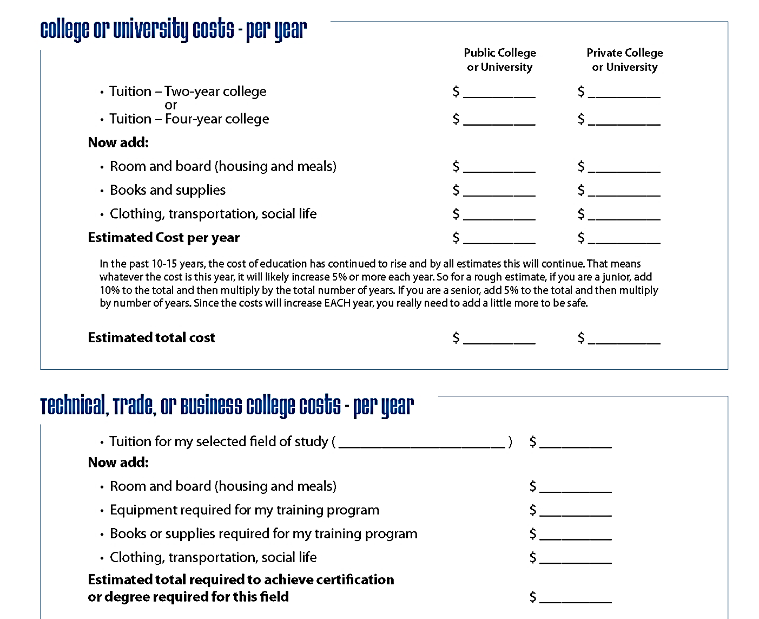
Training & Education Expense Worksheet
Do some homework and estimate your costs
Slide 28 | Page 17
Notes:
You can get the costs for your preferred schools by visiting their Websites. You will find there is a lot of difference between public and private college costs. But, you can make your education affordable.
Students should choose a college or training program that’s a good fit. Examples: campus culture, degree of academic support, location
Of course, students should talk to their families about higher education and training and what they can afford.
But you should not be totally blown away by these figures. The actual “net” price the average undergraduate pays for a college education is considerably lower than the published tuition and fees because financial aid helps pay part of the cost if you make sure to arrange it.
A majority of college students do receive some form of financial aid or scholarships.
According to https://trends.collegeboard.org/student-aid/highlights,
In 2016-17, undergraduate students received an average of $14,400 per Full Time Equivalent student in financial aid, including $8,440 in grants from all sources, $4,620 in federal loans, $1,280 in education tax credits and deductions, and $60 in Federal Work-Study (FWS).
The average national cost for a Two-Year Trade School program was $33,000 (reported October 2017, total for two years). (The Simple Dollar)

Slide 29
Remember
When you estimate your college costs:
It takes 5.6 years for the average college student to earn his/her Bachelor’s Degree.
Source: U.S. Census Bureau
Slide 29 | Page 17
Notes:
Use the chart on page 17 to calculate the expenses you can anticipate as you prepare for your career. But, you can’t just take one year’s figure and multiply it by four to get the total you will need. Why not?
College costs rise every year with inflation.
Also, most students don’t graduate from four-year colleges in four years.
Also, keep in mind that if a student has to take non-credited (remedial) courses before enrolling in classes that count toward graduation, this will cost additional time and money.
When some people see how much their education will cost, they throw up their hands and say, “Never mind! I can’t afford that!” But other students will take on the challenge. They will never give up!
A good source to calculate college costs can be found online at
https://bigfuture.collegeboard.org/pay-for-college/college-costs/college-costs-calculator

Slide 30
How Will You Pay for Your
Education and Training?
No matter how high the cost of education the price of ignorance will be higher!
Slide 30 | Page 18
Notes:
Yes - education is expensive.
But consider the alternative! Not getting education or training will cost you far more in your life due to lost income.
Do you really want to spend your life in a job you hate because you didn’t get the training you need?
You NEED to get the appropriate education and training to be successful in the career that is right for you.
Money is available. Let’s look at the sources:

Slide 31
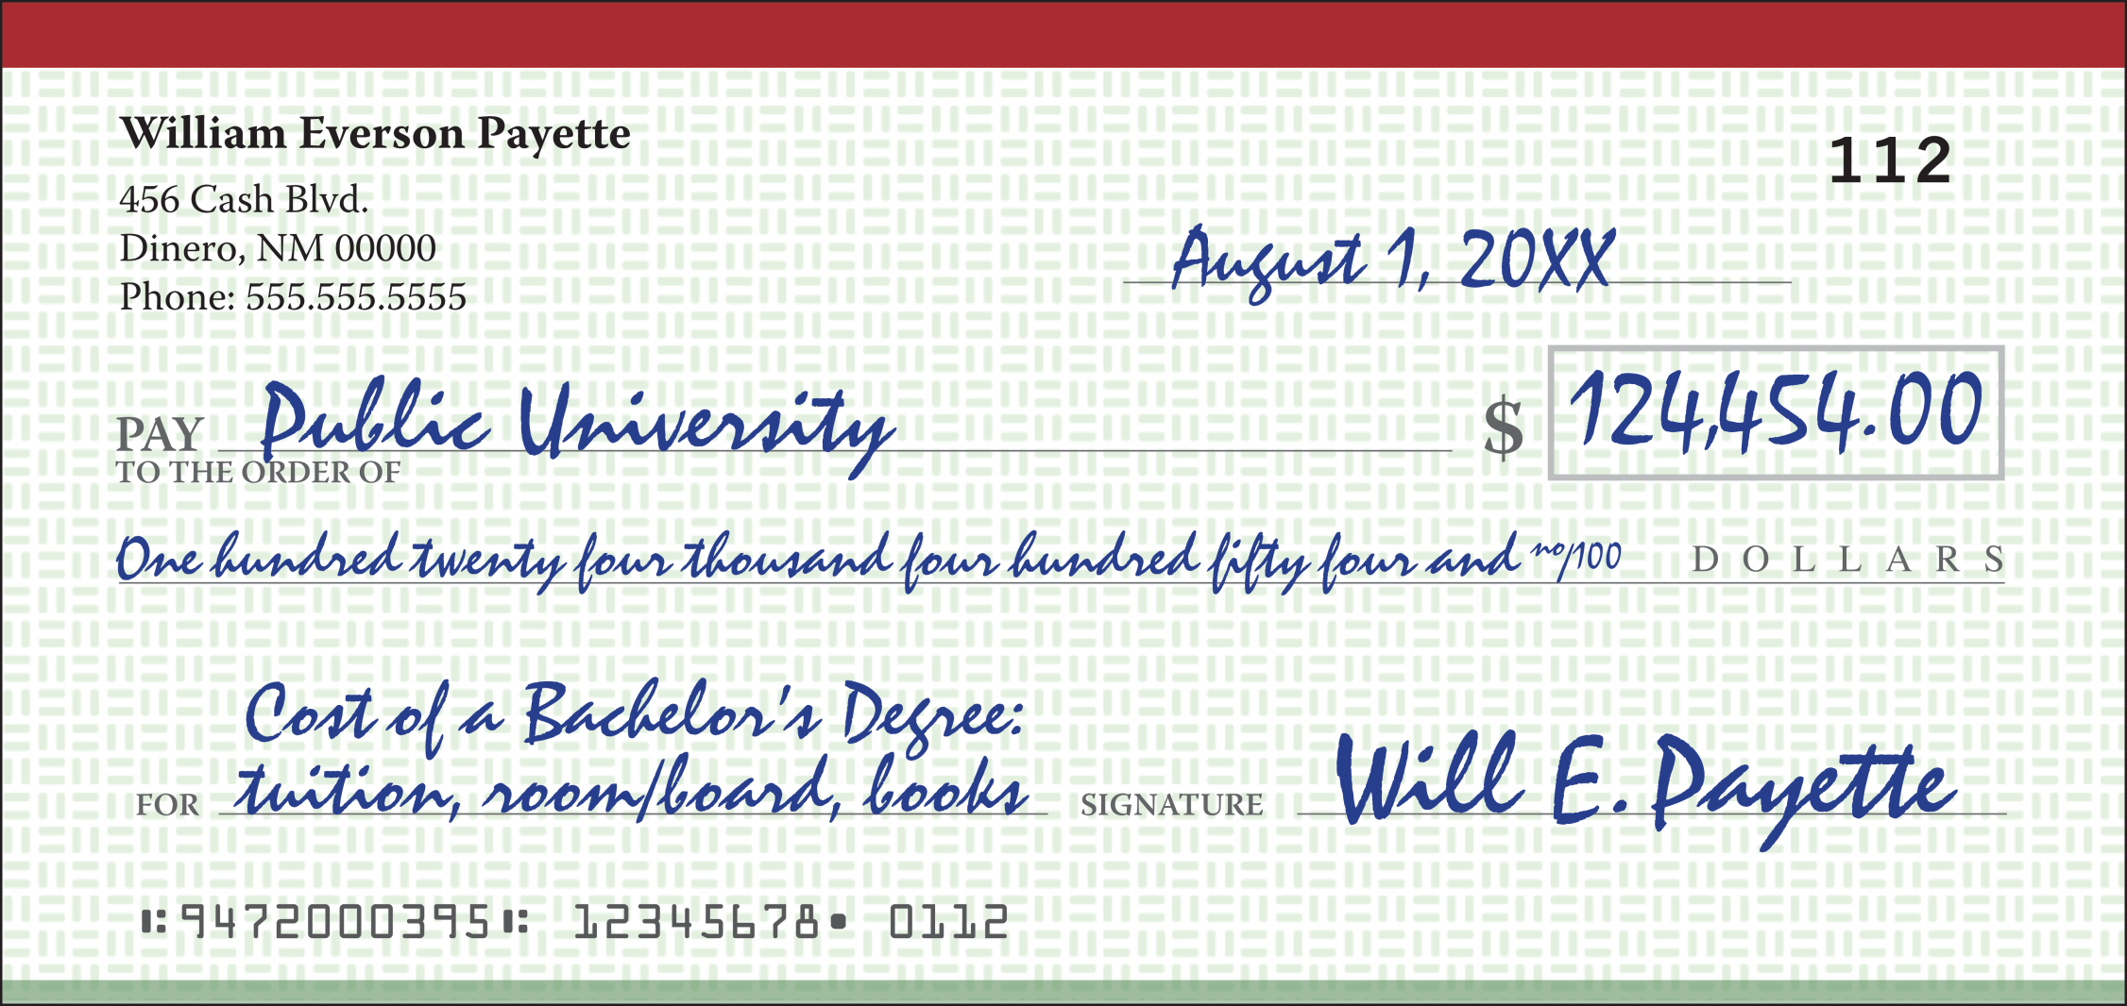
Sources of Financial Aid
Parents
Source: BigFuture.CollegeBoard.org
Slide 34 | Page 18
Notes:
Some students’ parents are willing and able to pay the full amount, but most students need to pay for at least part of their education.
The projected cost for 5 years of college at an average in-state public university, beginning Fall 2018, is $124,434 including tuition and fees, room and board, additional fees, books and supplies calculated with a 5% annual inflation rate.
Source: https://bigfuture.collegeboard.org/pay-for-college/college-costs/college-costs-calculator
(Note: Average costs include all expenses – tuition and fees, books and supplies, room and board, as noted by clicking on the tiny question mark next to “annual college costs in today’s dollars.” )
So, how do you figure that whole 5% thing? If you are a junior now, then the tuition amount shown on the schools website is for this year – but you’re not there.
You will need to add 5% to that for next year’s tuition estimate. Uh-oh, you won’t be there then either, so you have to add another 5% to estimate what it will actually cost by the time you arrive.
Then you’ll need to add that 5% again for your sophomore year,
another 5% for your junior year,
another 5% for your senior year…
and oh, if you don’t stay on pace, then you’ll have to add another 5% for your next senior year. Get it?

Slide 32
Full or Part-time Jobs
Balance work and study schedules to meet your career goals.
Slide 32 | Page 18
Notes:
Some students work part-time in summers and on weekends. In fact, the vast majority of students in the United States have a part-time job at least sometime during the year in order to help cover their own education or training costs.
Others have the challenge of balancing full-time work with school.
Another source of funding is the federal government.

Slide 33
Federal Student Programs
Grants do not have to be paid back
Loans do have to be paid back – with interest
Note the image of the publication on the bottom of page 18. This is a great resource for paying for education or training.
Slide 33 | Page 18
Notes:
There’s a difference!
Grants do not have to be repaid, but loans do, plus interest. Several are listed in the workbook.
Federal Grants include:
Federal Pell Grant
Federal Supplemental Educational Opportunity Grant
Loans have to be repaid with interest.
Federally Backed Loans include:
Federal Perkins Loan
Federal Stafford Loan
PLUS Loan (for parents)
Note the image of the booklet on the bottom of page 18. This is a great resource for learning about options for paying for education or training.

Slide 34
College Work-study Programs
Part-time job
Gain experience, often in your field of study
Network with faculty
Slide 34 | Page 18
Notes:
Some colleges offer “work-study” programs. The college helps you find a part-time job, sometimes on campus, sometimes not.
Co-op Programs - In some cases, you work alternating quarters or semesters for a company in your field of study. Many students go on to full-time employment with these same employers after graduation.

Slide 35
Military Educational Assistance Programs
Montgomery GI Bill
Post-9/11 GI Bill
Tuition Assistance
Part-time income
ROTC Simultaneous Membership Program
Student Loan Repayment Program
Possible college credit for some military training
Slide 35 | Page 18
Notes:
The National Guard can help you with education costs in several ways:
The Montgomery GI Bill
Part-time income every month
ROTC Simultaneous Membership Program
Student Loan Repayment Program
You can even earn college credit for some of your military training!

Slide 36
Scholarships can be based on:
Academic or athletic ability
Financial need
Often the words Scholarship and Grant are used interchangeably. However, a Grant is generally need-based and a Scholarship is usually merit-based.
Go after financial aid aggressively.
Be your own “Financial Aid Director.”
Slide 36 | Pages 18 – 19
Notes:
Scholarships… According to The College Board, most scholarships are merit based. This means that they are awarded to students with certain qualities, such as proven academic or athletic ability. Many scholarships have rules — maintaining a certain GPA, for example — that you have to follow to continue receiving aid.
Most grants [on the other hand] are need based. This means that they are usually awarded based on your or your family’s financial situation.
Millions of scholarship dollars go unclaimed each year.
If you need financial aid, be your own “Financial Aid Director!” There are several good scholarship search websites on the Career Direction “Helpful Links” page. Finaid.com and Fastweb.monster.com are two popular ones.

Slide 37
Tips to Reduce Education Costs
Earn college credits while in high school
Learn a trade and become your own boss
Take courses at the local community college
Take the maximum number of courses allowed
Pass your courses!
Buy used textbooks
Consider living at home
Slide 37 | Page 19
Notes:
How can you reduce some of your costs even more?
AP classes in high school
Dual enrollment
Take your core courses at a local community college and save tuition and housing costs.
Taking a full course load will save you money, too.
Pass! Failing a course is a complete waste of money!
Buy used textbooks – even the ones that have been highlighted or scribbled in --- if the previous owner was a top student, those scribbles can give you an edge!
Consider living at home. Even if your parents charge you some rent – it may be less than trying to live on your own.

Slide 38
FAFSA
Free Application for Federal Student Aid
Deadline to submit each year is June 30th
Can be submitted as early as October 1st
Amount of aid your are eligible to receive is based on your and your parent’s income
Tip: Fill out a printed version of the FAFSA form and check for errors before completing the online version.
Slide 38 | Page 19
Notes:
How do I apply?
For scholarships to a specific school – see that school’s financial aid director.
For Federal Grants and Aid complete the FAFSA
Deadline to submit each year is June 30
Can be submitted as early as October 1st each year
Amount of aid your are eligible to receive is based on both yours and your parent’s income
Tip: Print out the form, complete it, then go online.

Slide 39
Finding a Job
››› step 7
Some openings are never advertised
Advertised Positions
Newspaper
Online – Monster.com, CareerBuilder.com, etc.
Invisible Positions
Research organizations
Build a network
Slide 39 | Page 20
Notes:
Finally – it’s time to go to work – Finding a Job
After all the education and training – eventually, you will probably need to find a job. Finding a job can be a job in itself!
Some positions are advertised – for these all you have to do is check the newspaper or search online and then apply and upload your resume online. BUT - because the jobs are advertised, you will have a lot of competition.
Other positions are “invisible” – not advertised. Employers often hire people they know or referrals from people they trust. Sometimes employers will actually create a job for someone they want to hire. In fact, it is estimated that at least 2/3 of jobs are filled “invisibly”.
There are two strategies for uncovering an “invisible” job.
Research an organization you are interested in working for
Build of network of people who will help you find a job

Slide 40
Networking with People You Know
Networking – Build Your List
Family
Friends
Parents of friends
Neighbors
Teachers
People you know from hobbies, place of worship, etc.
Slide 40 | Page 20
Notes:
To build a network, the first thing you need to do is make a list of people you know, the more people you can list, the better.
Consider these categories shown on the screen…

Slide 41
Networking – Get the Word Out!
Ask your contacts for their help
Don’t ask the person you are meeting with for a job – but be sure they know you are looking, the idea is to get a referral.
Ask for more contacts who may know of openings
Eventually, somebody will know someone
who needs you!
Slide 41 | Page 20
Notes:
Next, get the word out!
The idea of Networking is get advice and referrals to eventually find someone who will offer you a job… but not necessarily the person you network with.
Make phone calls, send emails, or letters, but whatever you do, tell the people on your list that you need a job and you need their help.
Ask your contacts if they know of any openings in your area of interest.
If not, ask them to please provide you with names of people they know who may be able to help you in your search.
As you grow your network, your chances of finding a position improve.

Slide 42
Fact-Finding Appointments
Ask for an in-person appointment to:
Interview people in the career field you are interested in.
Learn about industry trends.
Get suggestions for entry-level jobs that will help prepare you for your career.
Slide 42 | Page 20
Notes:
To research an organization you think you’d like to work for, you need to arrange a “fact-finding appointment.”
Call the organization and ask for an “in-person” appointment with someone in the type job you think you’d like to eventually have.
Explain you are not asking him/her for a position, but gathering information to help you be more effective in your search.
State a main purpose for wanting to talk to him/her specifically:
Interviewing people in the field you are considering.
Learning about future trends in the industry
Seeking suggestions for entry-level positions that would prepare you for your career.

Slide 43
Fact-Finding Appointment
Introduce yourself.
Describe your career objective.
Explain you are just asking for advice.
Ask who else they know that could help you.
Be sure to send a thank-you note!
Slide 43 | Page 20
Notes:
At your fact-finding appointment, be careful not to waste the other person’s time.
Be brief.
Introduce yourself and describe your career objective.
You are not asking him/her for a job, but looking for advice.
Ask for referrals of others who could help you.
Send a thank-you note afterwards.

Slide 44
Resumes
To beat the competition, you need strong
job-getting skills.
The resume is the first impression
that an employer has of you.
Make sure it is a good one!
Slide 44 | Page 21
Notes:
Whether you find a position that is advertised or “invisible,” you will need strong job-getting skills to beat the competition and land the job you want.
You need a professional-looking and effective packet including your:
Resume
References
Cover letter
Thank-you letter

Slide 45
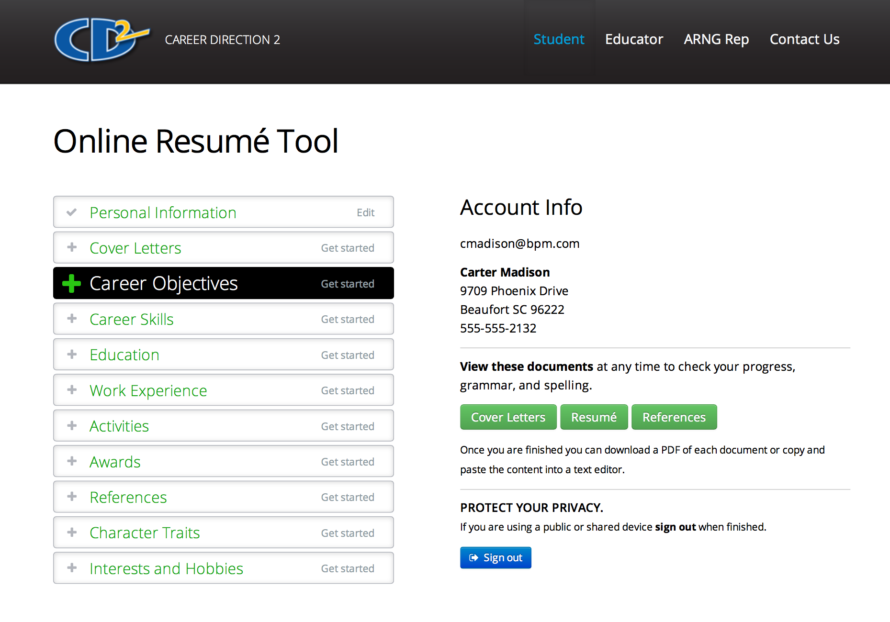
Career Direction Online Resume Tool
››› step 8
Create your online profile.
Accessible only by you
Password protected
Documents are stored 2 years
Pages 29-31 will help you complete the online Resume Tool. www.careertrain.com
Slide 45 | Page 21
Notes:
CTC has a FREE online tool for you to use in your job search. Go to www.careertrain.com, choose “Student” and then follow the instructions.
Your information is only available to you.
This tool stores your information for 2 years, so by law, you have to be over 13 years old to use it. To protect your privacy, your information is password protected with a password you create.
Once you enter your information, you can create your letters and resumes for different jobs and different companies.
Be sure to copy the contents of these documents into a word processing program (like Microsoft Word) and proofread for spelling and grammar before printing.
Always use high quality paper for these documents.

Slide 46
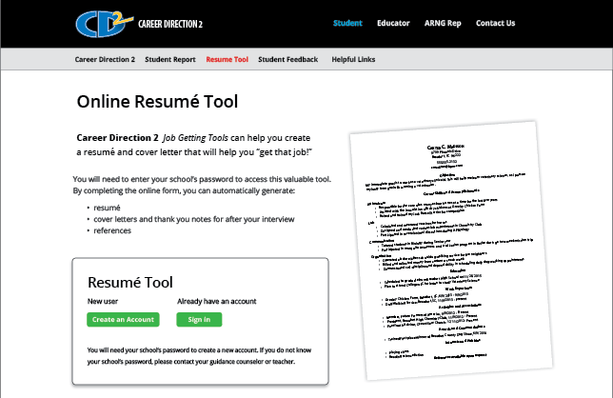
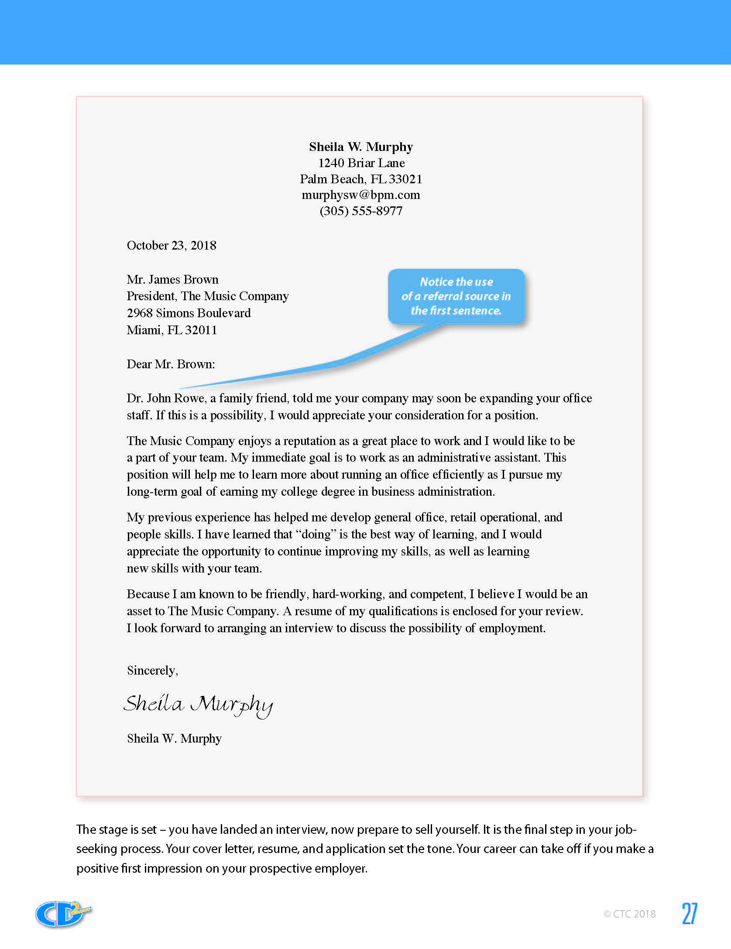
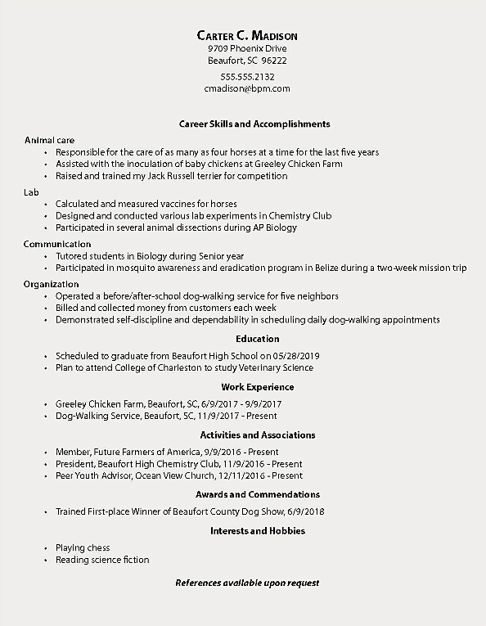
Resume, Cover & Thank You Letters, References
Create your online profile to generate:
Functional Resume
Cover Letter
References (Ask permission first!)
Thank You Letter
Copy and paste in a Word document first to proofread.
Slide 49 | Page 21
Notes:
Your resume, cover letter, and job application are often your potential employer’s first impression of you! Make them work for you , NOT against you!
By the way, be sure to ask your references for permission to share their contact information. The last thing you want is for your reference to be caught off guard by a phone call about you!

Slide 47
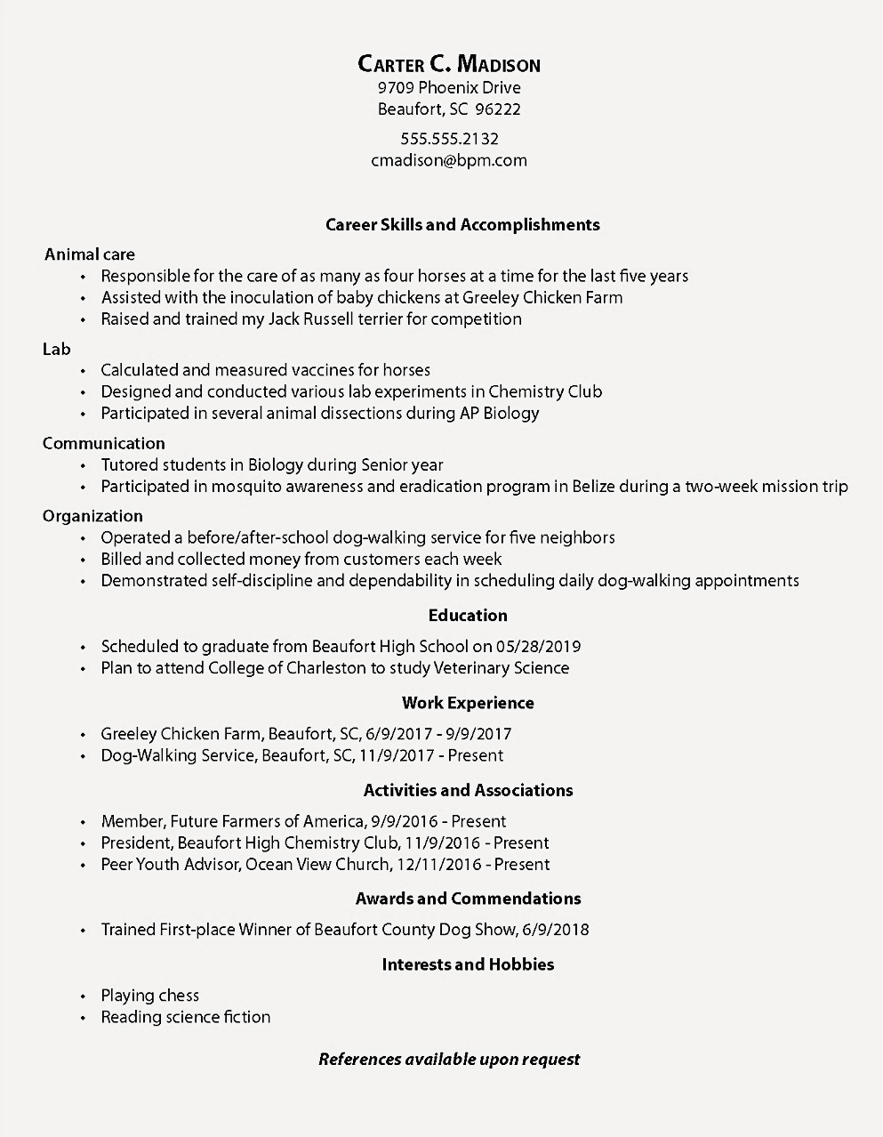
Functional Resume
The
Functional
Resume
The focus is on your Skills and Accomplishments
Slide 50 | Pages 22 - 23
Notes:
Sometimes, the “Functional Resume” may be more effective for you to use because it stresses your skills and accomplishments instead of your employment history. This may especially be true for students or younger applicants.
Include skills you have used in school, in clubs and organizations, and in your hobbies, as well as part-time jobs. The basic elements required for a Functional Resume are the same as for a Chronological Resume.
To get started, make a list of the skills required for the position you are seeking. Then, under each skill, list your experiences demonstrating your competency in that skill area.
Look at the resume on page 23 of your workbook. See how the career skills are the focal point of the page?
Even though this applicant has never had a “paying job” he gives a solid professional impression.
Create an email address with a business format. For example “first initial last name at whatever dot com.” Having an email address like “lazy1@yahoo.com” or “hotbod@msn.com” may be funny, but it could cost you a job offer!

Slide 48
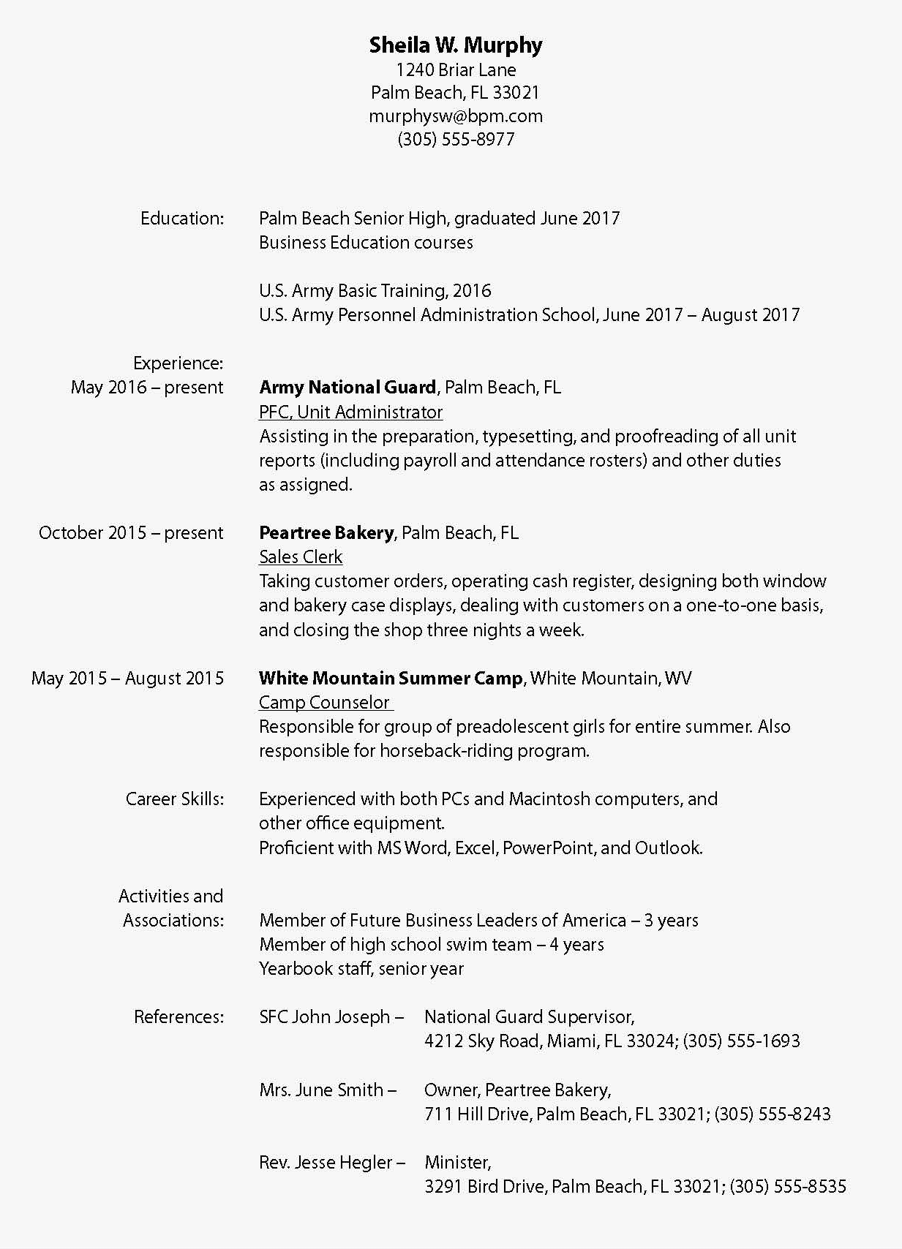
Chronological Resume
The
Chronological
Resume
The focus is on your Work History
Slide 51 | Pages 24 – 25
Notes:
A Chronological Resume is based on your work history. Follow along with me on page 25 of your workbook. Look under Peartree Bakery.
Would someone read her duties?
Notice how Sheila described her duties. She could have just said “sales clerk” but this is much more descriptive. It clearly shows she can work with customers, be trusted to handle money, is creative, can solve problems, and has the responsibility to be trusted to properly close at night.
Listing your references is optional. But it can’t hurt (as long as they are really good references)!
Some career guidance counselors recommend writing “References available upon request” and having an extra page available rather than including references on the main resume. Take note, if you do this, then you completely eliminate the chance that the employer and your reference know each other.
Either way, be sure to get permission before you give out your references’ names and addresses.

Slide 49
The Cover Letter
››› step 9
Be sure it sells you!
A referral gives credibility
Address a specific person
Keep it short
Make it neat
Proofread it
Enclose or attach your resume
Slide 52 | Pages 26 – 27
Notes:
A good opening sentence is very important.
Experts absolutely suggest using the name of a referral source – someone who the recipient of this letter knows – in your first sentence. That almost always guarantees your letter will be read!
Notice in this example, the letter begins with the name and title of the reference.
The cover letter is usually the first impression you make. Whether you mail it or drop it off at a business, it will either help or hurt your chances of getting the job you want!
Do not send your cover letter “To Whom it may Concern.”
The cover letter can be:
mailed with the resume
sent as an email attachment with the resume
sent as the message of an email message with the resume attached
Take the trouble to find out who it concerns –
or it won’t concern anyone!

Slide 50
The Thank-You Letter
››› step 10
Very few people bother to send a thank-you letter, card, or email.
It moves your resume to the top of the stack!
Mail it immediately!
Slide 53 | Page 28
Notes:
A thank-you letter, card, or email will set you apart from most of your competition because hardly anyone will bother to send one.
If your letter arrives while the interviewer is still trying to arrange other interviews, the odds are decent that fewer additional people will even get called for an interview.
Hmm, if they only interview 5 people instead of 10, that just improved your odds from 1 in 10 to 1 in 5.
If none of the others had a professional resume or didn’t send a thank you note – your odds just may make you the top pick!
Make the odds work for you instead of against you!

Slide 51
Resume Online Tool Worksheet
››› step 11
CD2 Online Resume Tool Worksheet
www.careertrain.com
The worksheet on pages 29 – 31 will help you complete the online Resume Tool.
The Resume Tool will create your resume, cover letters, thank-you letters, and references pages!
Stored online – accessible only by you, password protected.
Slide 51 | Pages 29 – 31
Notes:
Before you go online to the Resume Tool, you may want to complete the worksheets provided on pages 29-31. It will save you a lot of time.
Then, when you enter the information online, you will be able to generate the documents you will need for your job search.
Again, your information is stored online for 2 years. After that time, you will be notified by email to see if you want to keep it online for another 2 years.
Your information is accessible only by you – it is password protected.
_______________________________________________________
Recruiter Note:
Students will not have time to complete the resume outline on pages 29-31 in class unless you have extended class periods, but they can work on it later.
Many teachers like giving this as an assignment. Of course, every time a teacher gives an assignment in material you provide - the Guard presence is known.

Slide 52
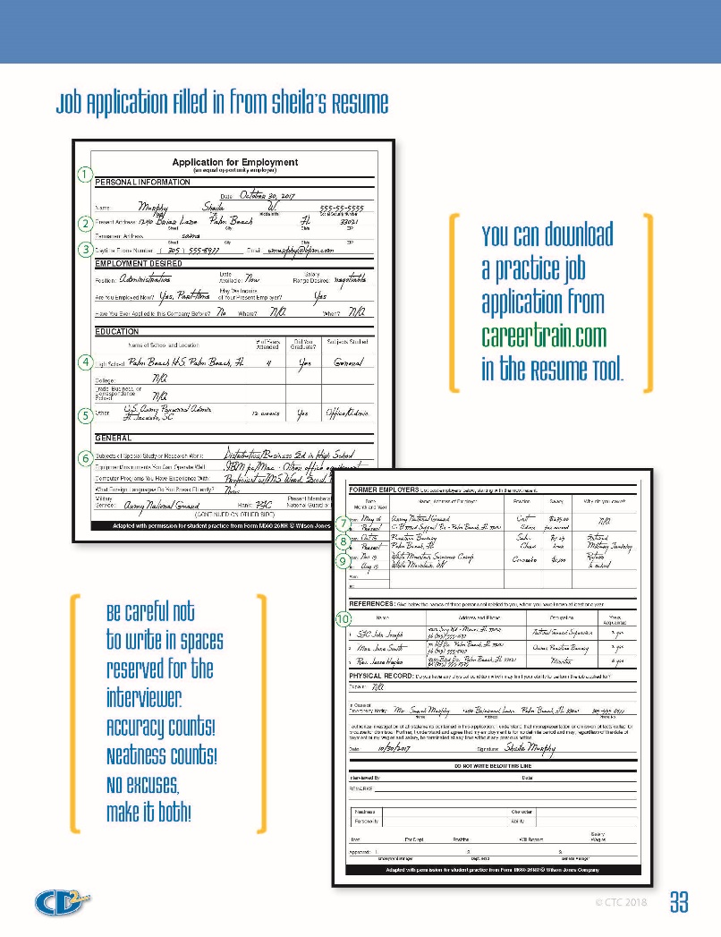
The Job Application
››› step 12
All the information you need is on your resume
Download a practice application from our Resume Tool section at www.careertrain.com
Slide 55 | Pages 32 – 33
Notes:
Once you have prepared your resume, filling out job applications will be very easy.
Look on pages 32-33 to see how information for a standard application can be taken right from your resume.

Slide 53
Interviewing Strategies
››› step 13
Your purpose is simple –
Get an offer!
It will build your confidence, even if you don’t accept the job.
Slide 53 | Page 34
Notes:
If your cover letter, your resume, and your application have worked, the next step will be the interview.
Remember this: the purpose of the job interview is to get a job offer.
Once the offer is made, you can determine if it is the right one for you, but the first step is getting offered the job!

Slide 54
Prepare for the Interview
Research:
Products and services?
Locations?
Growth potential?
Who’s who in the organization?
What’s the dress code?
Who are their competitors?
Slide 54 | Page 34
Notes:
Before you interview for a position, you are expected to know a good bit about the organization.
How can you do your research?
(Check the organization’s Web page, stop by and pick up brochures, do a fact-finding interview with someone who works for that organization or in that same industry.)

Slide 55
Interviewing Strategies
Be sure to have your:
Resume and references (with addresses)
Two forms of legal identification
Your appearance:
Most companies have appearance standards you will have to meet.
Dress like the job level you are seeking.
Avoid detracting from your qualifications.
Slide 55 | Page 34
Notes:
Before you even leave home, you need to gather a couple of things:
your resume and references (be sure you have their addresses, phone numbers, and email addresses)
Two legal forms of I.D. (just in case they offer you the job)
Current federal laws require you to provide driver’s license, birth certificate, Social Security card, or military I.D. You will also have to complete a form certifying your citizenship status.
Your appearance should be neat, clean, with clothing that is not too baggy or not too tight fitting. Try to dress like people working at the level of the job you are seeking. Bottom line, don’t let your appearance detract from your qualifications for the job.

Slide 56
Likely Questions – Be Ready
You should have answers in mind…
Tell me about your strengths and weaknesses…
What are some of your goals?
What are some of your hobbies?
What were your best and worst jobs? Why?
What qualities will help you succeed in this job?
Tell me about yourself.
Slide 56 | Page 34
Notes:
Before your interview, spend time thinking about how you would answer hard questions like those listed on page 34 of your workbook.
Recruiter Note:
Some Recruiters say this is their favorite part of the program! They ask students to come to class dressed for an interview.
One Recruiter we know of records the interviews and lets students critique each other. Another brings in business people from the community to interview students.
Be creative! But be careful – don’t ever do anything in the class to make a student look foolish! It will backfire on you!

Slide 57
Selling Yourself During the Interview
Be early!
Proper, firm handshake.
- Smile and make eye contact.
- Stand until you are asked to sit.
Turn off your phone!!!
Answer questions honestly.
- No mumbling, rambling, or negativity.
Wait until the end to ask about salary range and when to expect a decision.
Thank the interviewer with a handshake.
Slide 57 | Page 35
Notes:
When you go into the interview, assume the company will hire you if you meet the qualifications. Go in by yourself (don’t drag your buddy along for moral support). Get to the interview early, greet the interviewer with a smile and a handshake.
Recruiter Note: You may want to teach students how to shake hands. Not too firm, not too soft.
Tips:
Stand until you are invited to sit. Don’t smoke or chew gum.
Turn off your phone!!!!!
Be honest. Lying will never help you get ahead!
Speak clearly.
Don’t ramble.
Never criticize a former employer or co-worker.
Don’t discuss personal problems.
Practice answers to likely interview questions before you get there!
Ask intelligent questions about the company and your potential.
It is okay to ask about pay near the end of the interview but be realistic about your requests. It is better if the employer brings it up.
Try to get some idea ahead of time of the appropriate pay range for the position you are applying for… what do they usually pay new hires for that job?
Ask when you may call to find out the decision.
Thank the interviewer with a handshake.

Slide 58
After the Interview
Following Up:
Immediately send a thank-you letter.
Call to find out the decision. Persistence pays!
Not hired?
Ask how you can improve.
Ask for other potential employers.
Evaluate Yourself:
Was my appearance similar to the employees?
Did I make a good impression?
How can I improve?
Slide 58 | Page 35
Notes:
As soon as you leave the interview, write a short thank-you note and drop it in the mail – at a minimum, send an email thank you. This will keep your name in front of the interviewer!
Always follow up by calling to find out the decision. It shows that you are truly interested.
Evaluate the interview. Ask yourself:
Did I talk too much?
Did I sell myself well?
What did I leave out or forget?
How can I improve for next time?
Next, we’ll watch 4 interviews. See if you can spot their strengths and weaknesses.

Slide 59
Evaluate an Interview
Evaluate J-Ball
Strengths?
Weaknesses?
Slide 59 | Page 35
Notes:
Let’s watch these four interviews and look for strengths and weaknesses. You can make notes on page 35 of your workbook.
We’ll discuss them after we’ve watched all four interviews.

Slide 60
Evaluate an Interview
Evaluate J@y Tek
Strengths?
Weaknesses?
Slide 60 | Page 35

Slide 61
Evaluate an Interview
Evaluate Jay Cool
Strengths?
Weaknesses?
Slide 61 | Page 35

Slide 62
Evaluate an Interview
Evaluate Jason Wright
Strengths?
Weaknesses?
Slide 62 | Page 35

Slide 63
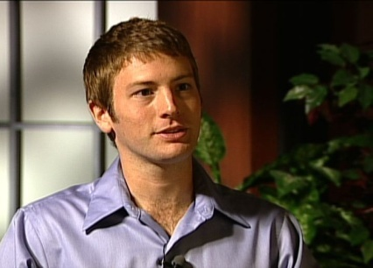
Video Interview Discussion
Did the applicant’s appearance meet company standards?
What kind of impression did he make?
How can he improve?
J-Ball
J@y Tek
Jay Cool
Jason Wright
Slide 63 | Page 35
Notes:
Lead students in a short discussion of the four interviews.

Slide 64
Keeping Your Job
››› step 14
Business Protocol – the rules at work
Introductions:
Stand. Smile. Make eye contact. Offer handshake.
Customer service (with co-workers also):
Smile. Offer assistance.
Call bosses and customers Mr. or Ms.
Say please, thank you, and you’re welcome – not, “no problem.”
Good business protocol can help you move up!
Slide 64 | Page 36
Notes:
Once you have a good job, your challenge is to KEEP it! “Play by the rules” and the rules include “business etiquette” or in plain English – “manners.”
When you are introduced to someone, stand up, smile, make eye contact, say hello and offer a proper handshake.
As you deal with customers and co-workers, be helpful. Smile and offer assistance whenever you can.
Call your bosses and your customers by Mr. or Ms. unless they ask you to use their first names.
Saying “please, thank you,” is important! Get in the habit – please!
And instead of “no problem” say “you’re welcome” or “my pleasure.”

Slide 65
Telephone:
Answer clearly – don’t rush:
Company name
Your name,
May I help you?
Learn to transfer calls.
Listen. Don’t interrupt.
Write names and numbers. Check for errors.
Always say “thank you” and “good bye.”
Slide 65 | Page 36
Notes:
In a work setting the rules for talking on the phone are very different from personal calls.
Would someone show me how you should answer the phone at work?
Part of the point of this discussion is recognizing that there are far too many businesses you can call on the phone and the person answering talks so fast you cannot understand them or even the name of the company. The pace of your “phone voice” as well as the clarity matters.

Slide 66
Written Correspondence:
Use bullets and lists
Avoid long sentences and paragraphs.
Avoid typing in
Use spell-check.
Save text speak
“4 L8R”* ALL CAPS and WILD COLORS
ALL CAPS and WILD COLORS!
All written correspondence should be concise and grammatically correct.
*4 L8R = for later!
Slide 66 | Page 36
Notes:
If you will be writing anything at work, make sure you are concise and grammatically correct.
Always proofread before sending written correspondence.

Slide 67
Meetings:
Be on time.
Pay attention.
Take notes.
Silence cell phones.
Texting, taking a phone call, or using a computer is rude.
Slide 67 | Page 36
Notes:
Showing respect to the group is very important during meetings.
By staying focused, meetings will be more productive and take less time.

Slide 68
Internet at Work:
Avoid sending non-business messages.
Don’t use your work computer for personal use:
Blogging
Browsing
Personal email
Instant messaging
Remember:
Once something is online, it is there forever!
Slide 68 | Page 37
Notes:
Your work computer is for work! Not pleasure, not personal business.
Companies often monitor computer usage, so there are no secrets when it comes to your computer at work.

Slide 69
Workplace Neatness:
Your work area
Break room
Restroom
Don’t overload workspace with personal items.
Slide 69 | Page 37
Notes:
You’ve probably already figured this out: Nobody is going to clean up after you at work, so if you leave a mess at work, expect to be in hot water with your co-workers.

Slide 70
The choices you make tonight can hurt your job tomorrow.
Online reputation
Credit problems
Your driving record
Law violations
Dating a co-worker = risky
Your boss may see your online activities (including pictures taken of you).
Slide 70 | Page 37
Notes:
What you do outside the workplace can get you fired. You may feel it is unfair, but it is true. Let me give you a few examples:
Your online reputation – your opinions, your photos, these can really hurt you. Be careful!
Many employers run credit reports on perspective employees – those with credit problems are often considered “risky.”
Your driving record and law violations are public record and can get you fired.
Does dating a co-worker sound romantic? Check company policy, in many companies it will get you fired. The other challenge is if you have a fight or split up.
To sum it up, after hours actions can hurt your career success.

Slide 71
Office Talk:
Friendliness is important.
Too much friendliness can hinder work.
Avoid gossip and rumors.
Avoid foul language.
Sexually or culturally offensive behavior will get you fired!
Slide 74 | Page 37
Notes:
Let’s talk about “talking!”
How do you think being overly friendly could be a problem at work?
Why avoid gossip and rumors?
You rarely know the whole story, it is not a good use of work time, not to mention, it is just plain wrong,
Last, using foul language or behaving in a way that is sexually or culturally offensive will get you fired. Period.

Slide 72
Decision-Making Skills
››› step 15
YOU
You are responsible for your choices.
Not all your choices will be good.
People can help you make good choices.
• Parents • Teachers • Counselors
• Coaches • Ministers
Your decisions should be consistent with your priorities and the law.
Slide 72 | Page 38
Notes:
It is up to you – just you. Hopefully, by now you have an idea of how to make your future successful.
BUT you need to know about potential career blockers, choices that could derail your chances for success.
Only you can make your lifestyle choices. You will be the one to face the consequences, both good and bad.
But you don’t have to make your choices alone.
Get advice from trustworthy people who have already faced the decisions you are facing. Listen to their advice when you face hard decisions.
I’ve heard that Mark Twain said, “When I was a boy of fourteen, my father was so ignorant I could hardly stand to have the old man around. But when I got to be twenty-one, I was astonished at how much the old man had learned in seven years.”
His father hadn’t gotten smarter, Mark Twain had grown up enough to know to listen a little.
This quote has been attributed to Mark Twain, but until the attribution can be verified, the quote should not be regarded as authentic. (Reader’s Digest, September 1937.)
Your decisions should reflect your priorities and be consistent with the law.

Slide 73
Managing Risks
Decision-Making: Consider the Risks
Informed Decisions:
Potential for gain?
Potential for loss?
Is the potential for gain worth the risk?
Uninformed Decisions:
Living for the moment.
No thought of risk.
Can have lifelong (or life-short) consequences.
Versus
To make an informed decision, you must know the facts.
Slide 73 | Page 38
Notes:
Risk Management
It is why McDonalds has a carpet mat right inside the door on a rainy day. They minimize the risk of you falling, of you getting hurt, of them getting sued.
You can apply this principle in your decisions.
If you consider the consequences of the choices you face, you can make choices you will be proud of.
You need to answer three questions:
What are the potential gains?
What are the potential risks or losses?
Is the potential gain worth the potential risk?
Listen to what happened to Eric Krug when he made a decision without thinking through the consequences.

Slide 74
Slide 74 | Page 38
Notes:
Play Eric Krug’s video
Note:
When you click, the video will begin.
The voice synthesizer is soft spoken, so make sure your audio is turned up. If it seems too quiet, recognize that Eric probably thinks so as well.
He would rather be heard in his natural voice.
What’s the point? Risk management – just what we were talking about. Eric made a choice that cost him and his friend – forever.

Slide 75
Effort Alone Is Not Enough
Preparation, skill, and hard work alone, can’t make you successful.
Your choices – alcohol, drugs, and personal relationships – impact your success or failure.
Slide 75 | Page 38
Notes:
Bottom line: you can derail your future success by making poor choices.

Slide 76
True / False Quiz
The Facts – Do You Know Them?
Drug and alcohol addiction is a common cause of school and career failure.
Complete the quiz on page 39.
Slide 76 | Page 39
Notes:
Move fairly quickly through the questions and answers for this portion of the program. You want to avoid seeming like you are beating them up with this information.
Why have this section on drugs, alcohol, and teen pregnancy at all?
You’ve spent a lot of time working with them on how to make good career choices. So, it is logical and necessary to spend time reviewing how they can undo all their good choices and good career preparation.
Have students complete the quiz, then quickly review the answers (next page).
Go through one question at a time.
a. Let students guess the answer.
b. Discuss it with them by clicking to the next part of the slide.
c. Use the information in the answer to guide your discussion.
“OK, on this question, what do you think?”
Click to the answer … “Here’s what the research indicates…”
You will have to work to avoid getting bogged down when discussing these answers. Don’t get into a debate with them about any of the answers. Someone may have read a document last night on the Internet that says something different on one of the questions. Don’t let that worry you. There are hundreds of studies and many diverse findings. However, the one thing that virtually every study supports is that there are detrimental effects from using drugs and alcohol. It is high risk.

Slide 77
The Answers
If you can tolerate more alcohol than your friends, you are less likely to become an alcoholic.
False: The less the effect, the greater the risk.
Tolerance of alcohol or drugs can fool users into thinking there is no need for caution.
Source: The Mayo Clinic
Slide 77 | Page 40
Notes:
You read the question.
Ask the students to raise their hands to show if they answered true or false.
Click to the answer.
You may want to ask a student to read the bold part of the answer from the workbook.
The student will read: Addicts often seem to have fewer problems with alcohol or drugs than their friends, actually making it easier to get “hooked.”
You comment: So here’s the reality: the less obvious the effects of alcohol are, the greater the risk for abuse and even addiction.

Slide 78
Dropping out of school increases your chances of being unemployed.
True: Dropouts are three times more likely to be unemployed than people with a bachelor’s degree.
Considering dropping out?
Keeping a job may be a lot harder than school ever was!
Source: Bureau of Labor Statistics
Slide 78 | Page 40
Notes:
You read the question.
Ask the students to raise their hands to show if they answered true or false.
Click to the answer.
You may want to ask a student to read the answer in gold from the slide.
You comment: Dropping out of high school will just complicate your life. Getting and keeping a job for a high school dropout can be a lifelong struggle. Statistically, the more education you get, the more secure your job outlook will be. Your income potential will increase, too.
If you think school is hard, just try getting and keeping a job without your diploma!
Source: http://www.bls.gov/emp/ep_education_training_system.htm

Slide 79
Predicting who will become addicted is easy. They seem irresponsible, selfish, and have a poor attitude.
False: Anyone can become addicted.
Many addicts were very responsible at an early age, they were:
“Little grown-ups”
Took care of little brothers or sisters
Slide 79 | Page 40
Notes:
You read the question.
Ask the students to raise their hands to show if they answered true or false.
Click to the answer.
You may want to ask a student to read the answer from the slide.
You comment: If someone never had a chance to be a child, it can create difficulties later. No one is immune from the possibility of becoming addicted.

Slide 80
STD (sexually transmitted disease) symptoms show up within 28 days.
False: Many with STDs won’t know until:
Infertility (inability to have a baby)
Cancer (both males and females)
Infecting others
21% of people with HIV don’t yet know they are infected.
Source: Centers for Disease Control
Slide 80 | Page 40
Notes:
You read the question.
Ask the students to raise their hands to show if they answered true or false.
You may want to ask a student to read the answer from the workbook.
The student will read: Many people don’t realize they are infected with an STD until it is too late for treatment. Undiagnosed and untreated STDs cause at least 24,000 women in the U.S. each year to become infertile.
STDs can lead to cancer in both males and females.
Also, about 21% of people with HIV are not even aware they have been infected.
You comment: People who aren’t aware they have been infected continue spreading the disease. Ultimately, STDs can lead to death.
Source: http://www.cdc.gov/Features/STDAwareness/

Slide 81
Peer pressure has no influence over a person who has decided not to use drugs or alcohol.
False: The longer you hang around friends who use, the more likely you will be to join them.
Prevention is the best "cure" for addiction.
Slide 81 | Page 40
Notes:
You read the question.
Ask the students to raise their hands to show if they answered true or false.
Click to the answer.
You may want to ask a student to read the answer from the slide.
You comment: Being a good influence to your friends who use is a good thing, but you’ll need non-using friends to hold you accountable.
Unfortunately, what you have always heard has some truth to it: If you sleep with a dog, fleas will pester you, too.

Slide 82
Early drug and alcohol usage can lead to substance abuse.
True: Early alcohol, cigarettes, or marijuana usage leads to abuse and addiction.
Do you want your life controlled by:
Substances
Yourself
Slide 82 | Page 40
Notes:
You read the question.
Ask the students to raise their hands to show if they answered true or false.
Click to the answer.
You may want to ask a student to read the answer from the slide.
You comment: People become addicted to the “high,” not to any one substance.
By using substances to deal with problems, teenagers lose the chance to develop effective, healthy, coping skills.
Everyone has problems and difficulties. Jogging, exercising, talking to a responsible adult – these are healthy coping methods.

Slide 83
Heart disease is the leading cause of death for teens.
False: Cause of death among 15 – 19 year olds:
Car crashes
Homicide
Suicide
Your choices have lifelong (or life-short) consequences!
Source: Centers for Disease Control
Slide 83 | Page 40
Notes:
You read the question.
Ask the students to raise their hands to show if they answered true or false.
Click to the answer.
You may want to ask a student to read the answer from the slide.
You comment: Most teen deaths result from the things we do to ourselves and to each other. The choices we make are important. Remembering that could save your life.
Source:
http://www.cdc.gov/nchs/data/databriefs/db37.htm

Slide 84
Alcohol always helps people mellow out and relax.
False: Alcohol is a significant factor in robbery, rape, assault, and murder.
Alcohol or drugs can = jail (or worse) … when you should be enjoying your life.
Source: West Virginia University School of Medicine
Slide 84 | Page 40
Notes:
You read the question.
Ask the students to raise their hands to show if they answered true or false.
Click to the answer.
You may want to ask a student to read the answer from the slide.

Slide 85
Methamphetamines always make people feel happy.
False: Meth has long-term affects on the brain altering:
Emotions (ability to feel pleasure)
Memory
Judgment
Coordination
These effects can last for more than a year.
Source: National Institute on Drug Abuse
Slide 85 | Page 40
Notes:
You read the question.
Ask the students to raise their hands to show if they answered true or false.
Ask a student to read the answer from slide.
You may want to ask a student to read the answer from the slide.
You comment: While meth may look like an easy and cheap high, the cost is more than you can imagine.
Source: www.nida.nih.gov/InfoFacts/methamphetamine.html

Slide 86
Occasional use of crystal meth is easy to control.
False: Crystal meth is one of the:
most addictive street drugs
hardest to treat
92% who try to quit on their own, can’t quit without help from others.
Source: CrystalMethFAQ.com
Slide 86 | Page 40
Notes:
You read the question.
Ask the students to raise their hands to show if they answered true or false.
Click to the answer.
You may want to ask a student to read the answer from the slide.
You comment: If you aren’t sure what crystal meth might do to you, do a little research online – the before and after pictures of users will convince you that if these people could quit, they would! Don’t start!
Additional information from the National Methamphetamine Drug Conference: Available preliminary data on treatment is discouraging. Long-term cure rates for methamphetamine may be less than 10%, and statistics show high relapse rates six months after treatment.
Source: http://www.ncjrs.gov/ondcppubs/publications/drugfact/methconf/appen-b3.html

Slide 87
A person can die from drinking too much alcohol.
True: An adult’s liver can only process about 1 drink per hour. Drinking too much, too fast can kill you.
Every year, college and high school students die from guzzling alcohol.
Source: National Institute on Alcohol Abuse and Alcoholism
Slide 87 | Page 40
Notes:
You read the question.
Ask the students to raise their hands to show if they answered true or false.
Click to the answer.
You may want to ask a student to read the answer from the slide.
You comment: Alcohol poisoning is real and it is deadly.
Additional information from the National Institute on Alcohol Abuse and Alcoholism: “Beverage alcohol (i.e., ethanol) is a psychoactive drug that changes brain chemistry and can become lethal in high doses. Alcohol poisoning is an acute toxic condition resulting from exposure to excessive quantities of alcohol within a short period of time. Ethanol is metabolized in the liver at a rate of approximately one drink per hour, with wide variation depending on conditions. Rapid consumption of large quantities of alcohol can overload the liver’s metabolic capacity, causing the blood alcohol concentration [BAC] to rise rapidly.”
Source: http://pubs.niaaa.nih.gov/publications/arh27-1/110-120.htm

Slide 88
Alcohol is a depressant.
True: Suicides attributable to alcohol and/or drug use may be as high as 19.8%.
Never drink when you are:
Angry
Upset
Depressed
Source: Centers for Disease Control
Slide 88 | Page 40
Notes:
You read the question.
Ask the students to raise their hands to show if they answered true or false.
Click to the answer.
You may want to ask a student to read the answer from the slide.
You comment: Many people think drinking alcohol will make them feel better but mellow, happy people don’t commit suicide.
Source: stacks.cdc.gov/view/cdc/11981/cdc_11981_DS2.pdf

Slide 89
Being distracted while driving is a leading cause of vehicle crashes.
True: 80% of crashes involve driver distraction.
Cell phone distraction causes:
2,600 deaths
330,000 injuries
Driving under the influence is also
an accident waiting to happen.
Sources: National Highway Traffic Safety Administration,
Virginia Tech Transportation Institute, The Human Factors and Ergonomics Society
Slide 89 | Page 40
Notes:
You read the question.
Ask the students to raise their hands to show if they answered true or false.
Click to the answer.
You may want to ask a student to read the answer from the slide.
You comment: When drivers multi-task behind the wheel, it puts all of us at risk.
Drivers who are sleepy are another danger, but the most frightening of all may be drivers who are under the influence of alcohol or drugs.
Driving a car is a privilege and a responsibility. Use good judgment by keeping your mind focused on what you are doing.
Don’t try to “text,” dial, or read while driving.

Slide 90
In a wreck, it doesn’t really matter if you are wearing a seat belt.
False: The majority of young people killed or seriously injured in wrecks were not wearing a seatbelt.
Your chances of surviving a bad car crash are better if you are wearing a seatbelt.
Source: National Highway Traffic Safety Administration
Slide 90 | Page 40
Notes:
You read the question.
Ask the students to raise their hands to show if they answered true or false.
Click to the answer.
You may want to ask a student to read the answer from the slide.
You comment: Wearing a seatbelt is easy, quick, and smart! Buckle up!

Slide 91
Teenagers are mature enough to live on their own.
False: Runaways often end up:
Homeless
Victimized
Addicted to drugs
Involved in crime/prostitution
32% of homeless youth have attempted suicide.
Help is available. Call 1-800-Runaway.
Source: Family and Youth Services Bureau
Slide 91 | Page 40
Notes:
You read the question.
Ask the students to raise their hands to show if they answered true or false.
Click to the answer.
You may want to ask a student to read the answer from the slide.
You comment: Tragically, there are situations where students are unsafe in their homes, but running away from home is not the answer.
If you need a place to go, find a reliable adult to help you, or call 1-800 Runaway – they can find a safe place for you to stay.
Source: http://www.nrscrisisline.org/news_events/third.html
Let’s listen as Richard, a former drug user who learned the importance of good decisions, wraps up this section of CD2:
On your next click the video will begin.

Slide 92
If any of these high risk behaviors is a problem for you:
Take responsibility.
Get help!
Slide 92 | Page 40
Notes:
The choices we have been discussing can affect more than your career success or failure; they can mean the difference between life and death.
If any of the high-risk behaviors described you, find a way to get help.

Slide 93
Your Plan of Action
››› step 16
A goal without a plan is a dream.
A dream without action is a fantasy.
Completing the steps outlined on pages 41 – 42 will ensure your career plans are real.
Slide 93 | Pages 41 – 42
Notes:
We have helped you examine:
Your priorities – what is important to you.
Your Interests – and the possible jobs that would be a good fit for you.
Education and Training sources – to prepare you for a successful career.
Job getting Skills – so you can land the job you want.
Informed Decision-making Skills – so you can avoid falling into a trap that derails your future.
So consider your options.
Which path will you choose?
On pages 41-42 you have the format to begin creating your own plan of action. This booklet can be a very valuable resource if you work your way through these questions and use the guide to help you formulate your plan – the plan that can lead to success by your definition.
With any path you choose, you will face obstacles and challenges, but I want to tell you about someone who faces obstacles every day…

Slide 94
The National Ability Center
“If I can do this, I can do anything.”
Greg Shaw’s spine ends at his waist.
He overcomes challenges every day
He is one of America’s greatest student athletes
He’s won a Silver, a Bronze and three Gold Paralympic Medals
“I will never give up!.”
What challenges do you need to overcome?
How can you help others overcome their challenges?
Slide 94 | Page 43
Notes:
Greg Shaw’s spine ends at his waist so he doesn’t have use of his legs, but he has the heart and stamina of an athlete.
Greg skis, plays sled hockey, and cycles because he loves the thrill of competition.
Greg trains 6 days a week.
Greg says he will never give up on meeting his goals. Will you?
What challenges do you need to overcome?
How can you help others overcome their challenges?

Slide 95
1-800-GO-GUARD
NationalGuard.com
Slide 95 |
Notes:
Some of you may have been thinking, “So when is this guy (lady) going to get around to pushing the Guard?”
OK, here comes my 30-second commercial.
The Guard serves your community and nation… we are citizen-soldiers who answer the call in natural disasters.
(Don’t take a lot of time here. You have already sold yourself and set the stage for the Guard. Pushing now will undo your credibility.)
Click and a short video will be launched on the next slide. You will need a current version of Windows Media Player installed on your computer.

Slide 96
The Army National Guard
We serve in peace. We serve in crisis.
We protect. We defend.
We are our Nation’s oldest military
organization, dating back to 1636.
We are proud of our service as Citizen-Soldiers.
We serve our country.
We serve our neighbors.
We Guard America.
Slide 96 |
Notes:
We are the nation’s oldest military organization.
Since 1636, we have served as Citizen-Soldiers.
We are teachers, bankers, pilots, engineers, nurses, doctors, computer technicians… all sorts of civilian jobs, but we are also Soldiers.
When duty calls, we serve – whether the need is here or around the globe.

Slide 97
1-800-GO-GUARD
NationalGuard.com
Slide 97 |
Notes:
Program wrap-up:
Thank you, Mr/Ms _____________ for having me here today. Thank you students. I have enjoyed meeting you and working with you.
It is greatly appreciated if you will fill out the Student Feedback Sheet I am passing out. I need to show my bosses I was here and presented this program to you. Your feedback will help me improve every time I present this class.
If you want info on the Guard, you can just mark that on this sheet.
If you have any questions, or if there is any way I can help you in the future, you have my number and email address. I’ve stamped it on the back of each workbook.
I wish you all career and life success.
Thank you.

