Slide 1
Building Respect and Ending Bullying
and Cruelty in Your School
HEAR 9.0 © SEP 2017 CTC
Notes:
Introduce yourself and thank the teacher.
My name is ______. I’m a Sergeant in the ______ National Guard. It is a pleasure for me to present this program to you. Thank you Mr./Ms. ______________. Today we are going to talk together about bullying and cruelty and what you can do to stop it.
Why the name HEAR?
We all want to know we are heard.
Targets of bullying need to be heard.
The person bullying needs to be heard.
Listening is one of the clearest ways we can show respect to another person.
Let’s explore how to Help Everyone Achieve Respect and consider ways to build respect and end bullying and cruelty in your school.

Slide 2
Presented by
Partnering to help make our schools safer, more productive places to learn.
Notes:
This program is presented on behalf of the Texas Army National Guard as a way of trying to help our schools become safer and more productive places for students to learn.
We all want help when things like floods, blizzards, tornados, or any disaster hits and the Guard is there.
We also need great people in the Guard and greatness is best achieved in a safe learning environment.
When we have safe and productive schools, everyone wins!

Slide 3
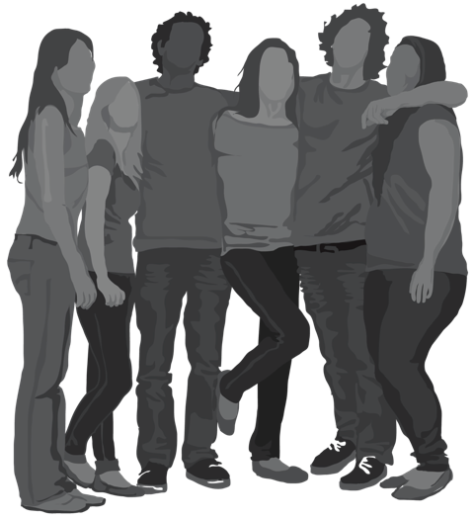
Character Attributes
Before we think about building respect in your school, let’s consider some character attributes.
Select a characteristic on page 1 and write how you feel you live it.
– Page 1
Notes:
Character defines who we are and how we are going to live.
People with strong character are looked up to by others and set an example that we all can follow.
Consider these specific character attributes (or character traits). Select at least one and jot down a few words on how you feel you live that on a regular basis.
An example – might be Loyalty – I do not gossip about my friends. I support them.
Loyalty
Duty
Respect
Selfless Service
Honor
Integrity
Personal Courage
After giving approximately 30-60 seconds to write down an answer, ask, “How many wrote something on loyalty?” Call on one student to hear his/her answer about loyalty. Then ask, “How many wrote something on duty, “ and so on. You may have to call on a couple of people to get discussion started. Call on someone you spotted writing so you know he/she already has an answer in mind. “Tell me about what you jotted down.” Allow opportunities for students’ comments on each characteristic to be expressed. Set the stage for participation and let them know that everyone's thinking is valued.

Slide 4
Character Attributes
How important is it to treat others in a manner consistent with the character traits just discussed?
Why or why aren’t these attributes important?
Who is a role model you believe exhibits these characteristics?
– Page 1
Notes:
OK, so we’ve been hearing how some of you feel you demonstrate these attributes (or traits) – how important is that?
Note: the words attribute, characteristic, trait, and value are used somewhat interchangeably in this context.
How important is it to treat others in a manner that is consistent with these character attributes we’ve just talked about?
Place a checkmark on the scale showing where you think they fall in your workbook on page 1 -
Using the IMPORTANCE scale ranging from Not at all Important to Very Important
Why or why aren’t these attributes important?
Jot down an answer or two on your own, and then we can discuss. Maybe you will have some additional points to add based on what others say. There is also a place for you to write others’ comments.
Allow 30-60 seconds for students to write their thoughts. This helps ensure that when you begin the discussion they will be more willing to speak out.
Then call on several students to hear their answers. “What did you write down on why you think these attributes are important?”
Role Model:
Before moving on to the next page… think of a role model you believe exhibits these qualities and write their name in your workbook on the bottom of page 1.
So, these attributes you’ve said are important – they are the National Guard Core Values. Let’s take a closer look at these on the next slide.

Slide 5
The attributes discussed are the National Guard
Core Values
Loyalty – being faithful and responsible
Duty – fulfilling your commitments to the best of your ability
Respect – treating others how you want to be treated
Selfless Service – assisting, protecting, defending others
Honor – acting according to your highest principles
Integrity – doing the right thing, even when no one is looking
Personal Courage – standing up for others
– Page 2
Notes:
So, these attributes are actually the National Guard Core Values, but they are important to follow everywhere: at school, at work, and in your community – not just for those in the Guard. Here’s what they mean to us:
Loyalty: Be faithful and responsible not only to your small group of friends but to all those you are connected to because they belong to your school or community.
Duty: Do what you say you’re going to do. Respect rules and authority. Fulfill your commitments to “standard” to the best of your ability.
Respect: Treat others like you want to be treated.
Selfless Service: Volunteer to assist, protect, or defend others, especially those who can’t defend themselves.
Honor: Act according to your highest moral principles and respect the dignity and honor of others, including those who are different than you.
Integrity: When no one is looking, you do the right thing anyway!
Personal Courage: Stand up for those who may not be able to stand up for themselves and work to be fair and just. This is at the heart of being a good person and citizen.
These core values are what the 350,000 men and women that are members of the Army National Guard try to live by every day – whether they are on their civilian jobs or in uniform, whether rescuing someone from a flood or overseas defending our nation. We try our best every single day to live these values. THEY ARE who WE ARE!
So, now let’s go to page 3 in your workbooks and consider what can happen when people don’t live these kinds of values.

Slide 6
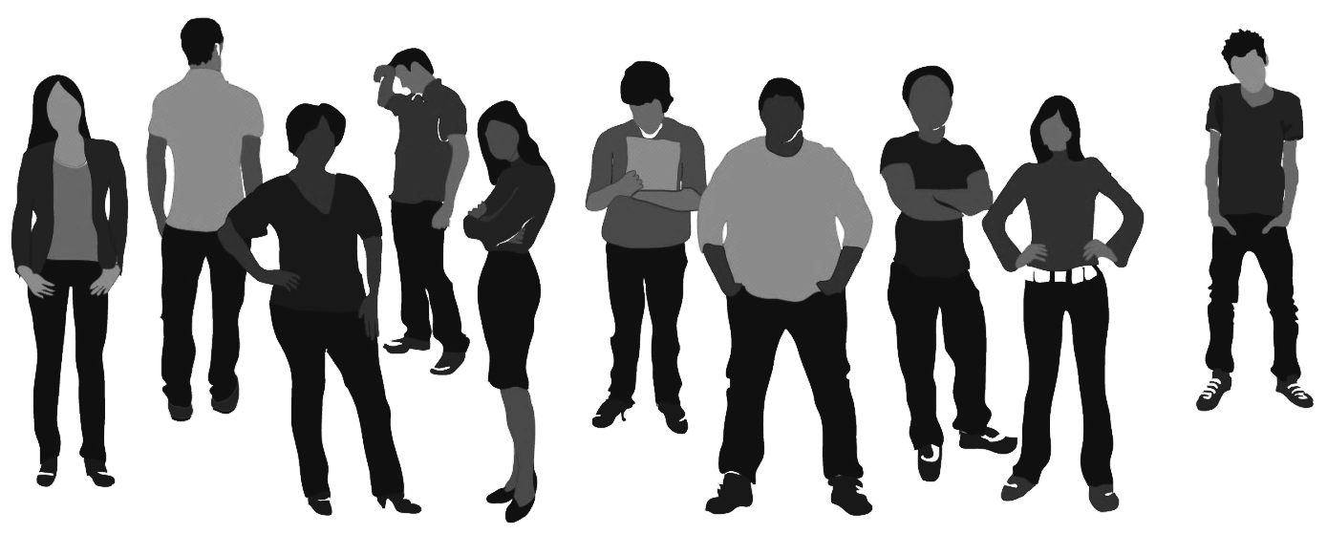
On the other hand – What is Bullying?
How do you define bullying?
Bullying has 3 main characteristics:
Unwanted harmful behavior
Imbalance of power
Happens over and over
– Page 3
Notes:
Bullying is completely different than the values we just discussed. We all have ideas about what bullying is. How do you define it? Give students a few seconds to write down their responses and then ask a few students to share.
Let’s see how your definitions compare with how experts define it. Click for the main characteristics of bullying.
There are many different definitions, but most experts agree that bullying has 3 main characteristics:
1. It’s unwanted and harmful.
2. One person or group of people tries to exhibit power over another person or group of people.
It happens again and again.
It’s a relationship problem. It affects the person targeted, the person bullying, the person being bullied, families, bystanders, upstanders, and the larger community, as we’ll see in just a minute. If you can spot a relationship – it can be impacted by bullying.

Slide 7
Repeat
When we say happens over and over…
On Monday John is targeted.
Maybe Tuesday Nicole is targeted.
Perhaps, Thursday it’s Erik.
But all three have one thing in common, the same aggressor. That person meets the definition of a person bullying others.
– Page 3
Notes:
We need to point out that it is easy to be a little confused by the definition, however. Don’t think that the bullying has to always occur between the same two people or same groups of people.
The REPEAT part of the definition refers to the PERSON BULLYING, not the PERSON BEING BULLIED.
For example:
On Monday maybe John is the one bullied.
On Tuesday, perhaps it might be Nicole.
By Thursday maybe the person bullying moved on to pick on Erik.
John, Nicole, and Erik all have one thing in common, the same person picked on them. That person meets the definition of one bullying.
And while none of these three targets experienced a repeat offense, the one BULLYING repeated the behavior.

Slide 8
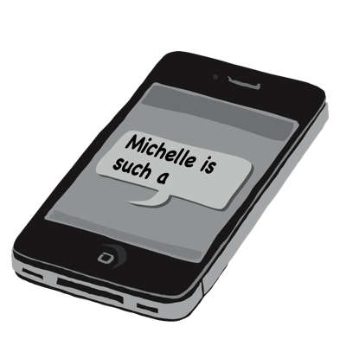
Bullying can be:
Saying or writing hurtful things
Physical
Exclusion, shaming, humiliation
When one person or a group of people picks on another person or people over and over
A behavior that can be connected to sexual harassment or discrimination
Called something else, like hazing
Cyberbullying
– Page 3
Notes:
Bullying can be:
You may ask for a volunteer to read one of these lines – then spend a moment exploring the subject. Odds are good that you’ve seen or experienced one or more of these:
Saying or writing hurtful things… name calling, threats, teasing, or inappropriate comments.
Physical attacks – These can happen inside the building or on the grounds, can’t they?
Exclusion or social isolation – Exclusion is often seen in the lunchroom. Someone can also feel alone when others shame or humiliate them, especially when this is done in public.
One person or group picking on another over and over. Repetition is one factor that determines if an action is bullying. Even picking on someone once is too much, however.
Sexual harassment or discrimination – treating different genders or different people in a discriminatory way.
Hazing – some schools have rituals or initiations that are done to freshmen or athletes or certain club members – it gets a different label, like hazing, but it is still bullying.
Cyberbullying. This type of bullying is certainly a common concern among many teenagers. How do you describe cyberbullying? Can you think of some examples? Encourage students to share their thoughts and then give a quick recap: That’s right. Cyberbullying is using technology to bully a person. This can be done by sending hurtful messages through texts, social media posts, chatrooms, and instant messaging. Other examples include rating people in mean ways on websites, revealing humiliating photos or videos online, or excluding others from joining an online game.
The whole phenomenon of cyberbullying – no one knows if there is really more bullying now, but there is definitely less escape. With social media, more people know and when you go home, it doesn’t stop.
Today we’ll talk a lot more about bullying, but we will also talk about behaviors related to bullying like harassment and cruelty. Part of what we’ll discuss is how bullying and cruelty affect everyone (including bystanders and community members) and how bullying can make everyone feel unsafe.
I am curious, however. I’m not going to ask about it or call on you, but with a quick show of hands, how many of you have ever witnessed bullying or unwanted behavior – or maybe you’ve been the one targeted – or maybe you were even the one doing the bullying? (Normally this will be almost everyone in the room – if they are being honest.)
Before we get to those topics, let’s turn to page four and think about how disrespectful behaviors, such as aggression or teasing, aren’t always defined as bullying.

Slide 9
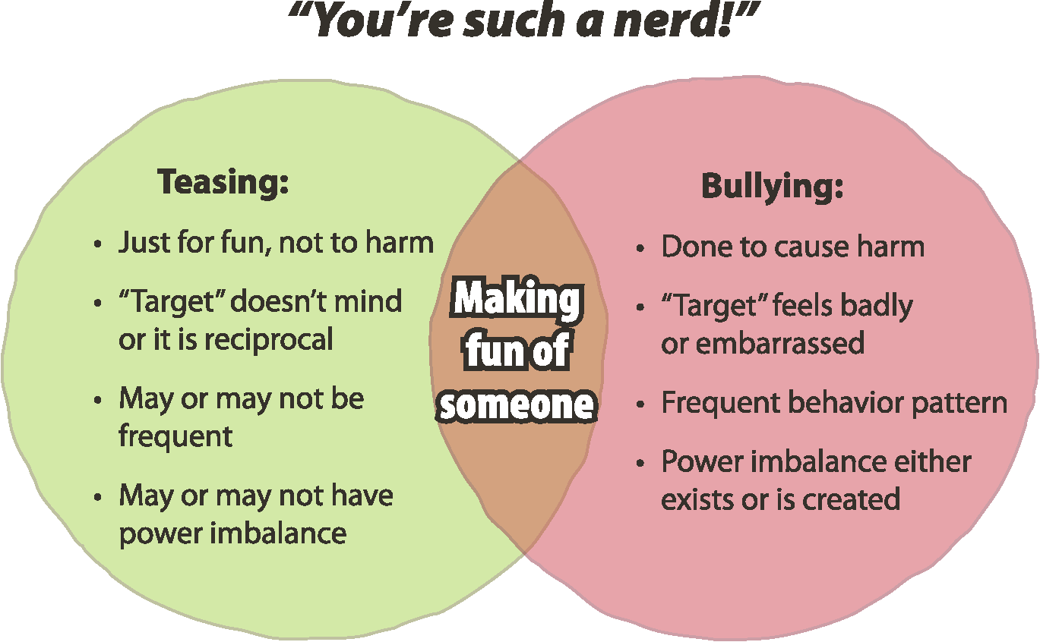
Bullying? Teasing?
Context makes a difference. Intent, power, personalities, frequency – all are relevant.
Leonard to Sheldon…
Athlete to non-athlete brilliant student
Playful or mean?
– Page 4
Notes:
Is it Bullying or Teasing?
Sometimes it is hard to tell if you may be witnessing bullying and unwanted behavior or reciprocal teasing between friends.
To get the difference you really have to understand the context.
Leonard and Sheldon constantly go back and forth teasing each other on Big Bang Theory (even if Sheldon usually fails to grasp the nuances). But when they call each other nerd or something of the like – in their world it may actually be a compliment. Even in your school, if two brilliant students call each other a nerd – they might relish it and respond with, “Yes! I nailed that test on molecular biology!”
On the other hand – what if a star athlete calls one of those brilliant students – who happens to have zero athletic ability but is desperately trying to fit in – a nerd? Odds are good, that wouldn’t be cherished by the non-athlete.
You see, there is a difference between playful and just plain mean-spirited.
This Venn Diagram may help show some of the differences friendly between teasing and bullying
Teasing:
For fun – no harm intended
Targeted person doesn’t mind – or it is reciprocal
May happen often or may not – frequency isn’t a real key in the context… unless you overdo it.
May or may not have a power imbalance – but probably not
Bullying:
Done to intentionally harm
Target person feels badly or gets embarrassed (and that is what the person bullying wanted)
It happens frequently
Power imbalance already exists or is created by the action
Okay, so how far is too far when it comes to teasing a friend?

Slide 10
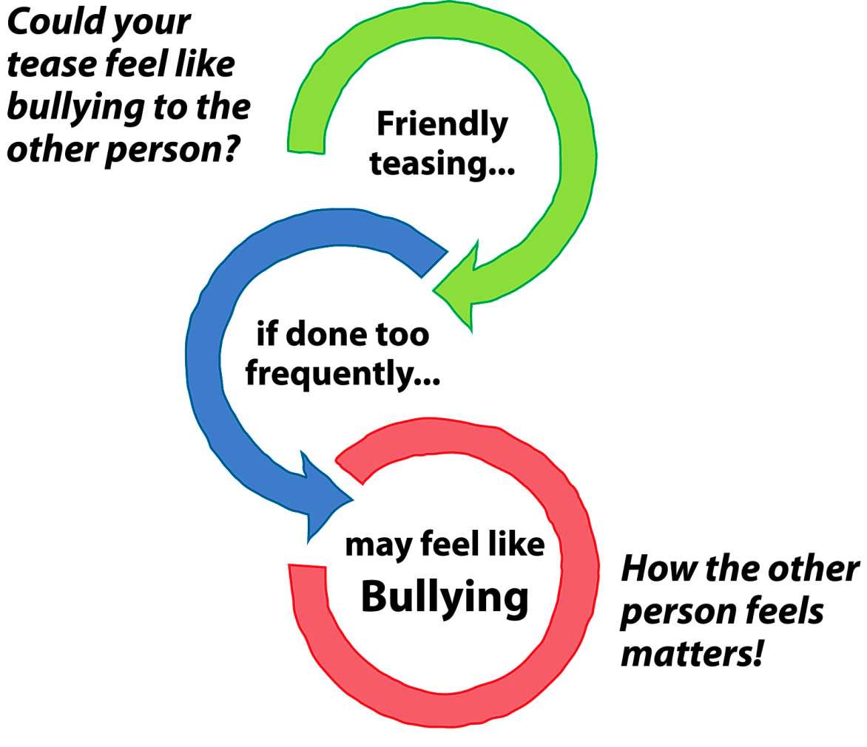
Personal Responsibility
You have the responsibility to consider not just your message or action – but also how it will be received.
Own what you say and do.
Doubt? Choose Kindness.
– Page 4
Notes:
Each of us has a personal responsibility to make sure the message we intend to send is the message the other person really hears. We have to consider not just our words or actions but also how those words or actions will be received by the other person.
If you go too far, your friendly tease (or your friend’s tease coming back at you) might sure feel a lot like bullying.
This graphic may help make the point:
Friendly teasing – just cutting up
If done too often, too frequently,
May feel just like bullying to your friend
If you have any doubt at all, choose kindness instead of a tease.

Slide 11
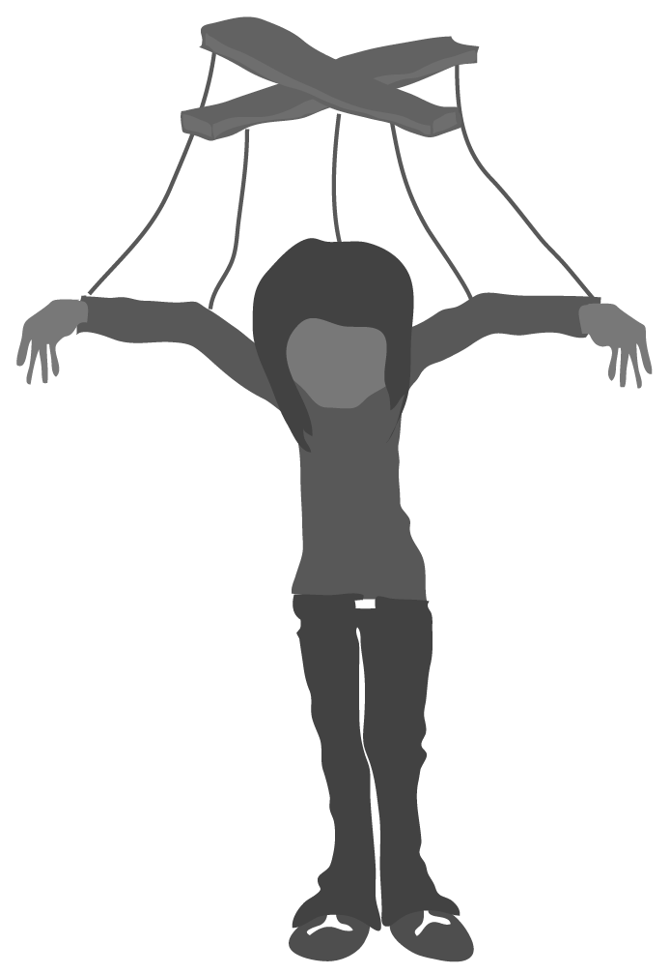
Get a Mental Picture
Don’t write it down – but think of a time when you witnessed or experienced bullying or other forms of cruelty.
Write down only the month and year.
just a puppet
Think about what happened
Think about what you did
Think about what others did
Think about how you felt
– Page 5
Notes:
Before we begin talking more about bullying, I want you to think about a time when you personally witnessed or experienced bullying or cruelty. Write down the month and year in your book.
Can you capture in your mind what happened? What did you do? How did others react? How did you feel in this moment and afterwards?
If any student(s) tells you that they have not experienced or directly witnessed a bullying situation, ask them to think about a situation that they heard about or watched on TV that affected them a lot.
Risk Zone:
Discourage students from speaking up with specific names and situations. Discourage personal stories!

Slide 12
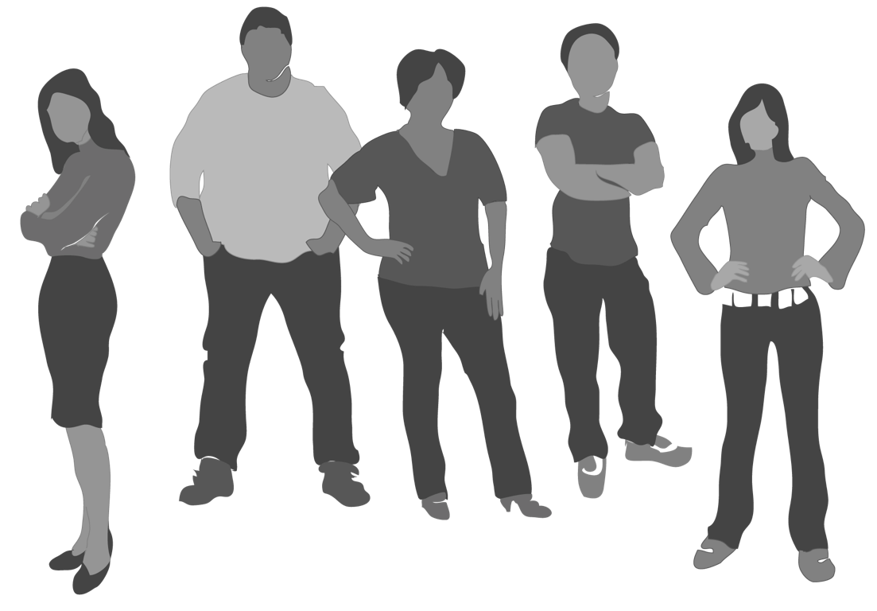
Why might people bully or be cruel to others?
What do you think?
– Page 5
Notes:
All of you just thought about a time when you witnessed or experienced bullying or cruelty – it is clearly something that is too common.
Why do you think it is so common?
What are some reasons why people might bully or be cruel to others - what do you think? We will hear some of your answers and then see how they compare to what research shows.
Give students time to write down their answers. Then, call on several people. After students have answered, move on to the next slide.
A few answers from previous groups included:
They feel inferior
Peer pressure
Gang activity – acceptance
Low self-esteem
Make sure students do not use names or begin to tell stories of bullying that happened at their school. Absolutely keep the conversation about general reasons why someone might bully others.

Slide 13
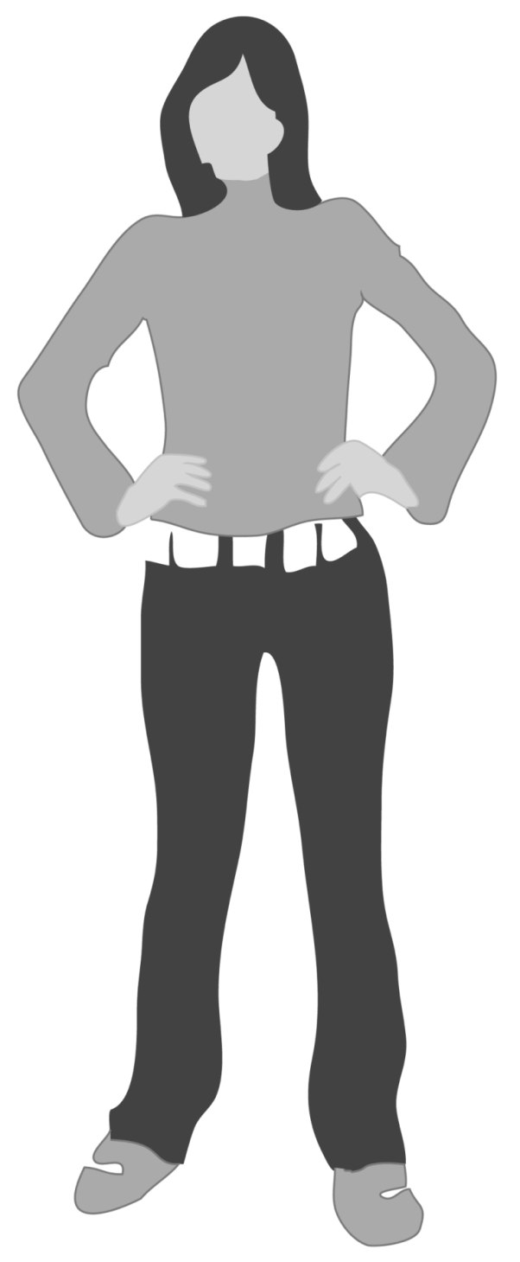
Some reasons people bully:
Insecurity
Seeking revenge
Modeling behaviors they’ve seen (at home, school, etc.)
Want to belong or be popular
Want attention
Seeking power
– Page 5
Notes:
Here are some of the reasons research indicates why people bully or are cruel to others.
If students already listed any of these responses previously, acknowledge and appreciate their contributions. Highlight any responses that students may have missed in discussion on the previous slide.
Would anyone be willing to read this slide? You may want to ask for a volunteer.
They are insecure
They are seeking revenge
They are modeling behaviors they’ve seen (at home, school, etc.)
They want to belong or be popular
They want attention
They are seeking power
If this is why people bully, then what does it look like? Let’s find out on the next slide.

Slide 14
Bullying can look different…
Many types of people can bully or be bullied at different points in life
Bullying and cruelty may look different at different ages
Bullying and cruelty can be part of any relationship (romantic, friendship, classmates, etc.)
– Page 5
Notes:
Bullying and cruelty can look and feel differently for each person and in each case.
It is important to note that anyone can be bullied, and anyone can also bully. Some people can be the one bullying in one situation and the one being bullied in another.
Bullying often looks different at different ages.
Hitting, pushing, or name calling are very popular ways to bully in elementary school.
Bullying in high school often includes things like social exclusion (leaving someone out from your lunch table or ignoring someone who needs help), cyber bullying (like sending hurtful text messages or leaving nasty, hurtful Facebook posts or Tweets), and sexual harassment (like when boys make rude comments about a girl’s body or clothing).
Bullying can be part of any relationship (including friendships, romances, and classmates).

Slide 15
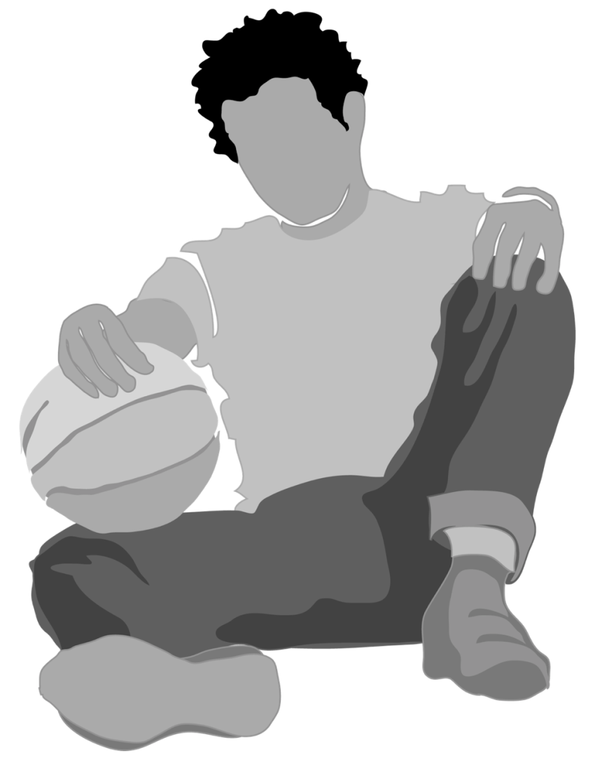
Mike’s Story
UNDERLINE examples and
CIRCLE consequences of bullying
– Page 6
Notes:
Now we are going to look at two stories - not about actual individuals, but based on real-life bullying situations. We’ll read the two short stories and then talk about the types of bullying that are happening in those stories. Ask students to turn to page 6 of their workbook and look at Mike’s story.
Give them 2-3 minutes to read the story – just like the process they have to follow on all tests like SATs where they have to read and comprehend. As they read the story, have them underline the instances of bullying and circle the consequences. Then hear these instances from the class.
Examples of bullying
Comments about Mike’s walk and dress
Gym class
Openly teased because he was not as athletic as some other students
Escalated to physical bullying when basketball was thrown at him
Whole class laughed at him
Mike definitely experienced bullying and cruelty. The bullying included being teased because he looked and dressed differently than others and being harassed in gym class because he ran slower than the other guys. At one point, the bullying even got physical when another boy threw a basketball at him in gym class. The situation intensified when many other students joined in the name calling.

Slide 16
This slide is hidden in the slide show mode.
These are additional notes on Mike’s story.
– Page 6
Notes:
We just discussed what bullying looked like in Mike’s situation, but now let’s talk about the consequences.
How will or did the bullying and cruelty in Mike’s story affect… (Let students answer)
- Mike? - His parents? - His friends? - His school?
Allow students to verbally answer each question. Students may guess or infer responses — responses don’t need to be something stated explicitly in the text. For example, a student could say Mike’s parents feel guilty for making him move, even though this is not in the story. This is exactly the kind of discussion you are hoping for and it will mean they are thinking and absorbing the information.
Consequences for Mike: felt isolated from friends, stopped enjoying school, felt embarrassed and like he didn’t fit in, missed classes, grades dropped
Consequences for Mike’s parents: Felt worried about Mike, felt helpless, felt guilty about making him move to new school
Consequences for Mike’s friends: Felt helpless, felt guilty, felt ashamed, felt frustrated/sad about situation, felt fearful that they could be next person targeted
Consequences for Mike’s school: other students felt helpless in bullying situations/felt passive, students didn’t feel safe
Specifics from the story they may circle or mention:
Mike told parents he wanted to change schools but not why
Parents worried
Hated school whereas he previously liked the school
Grades dropped
Friends were scared to stand up for and with him

Slide 17
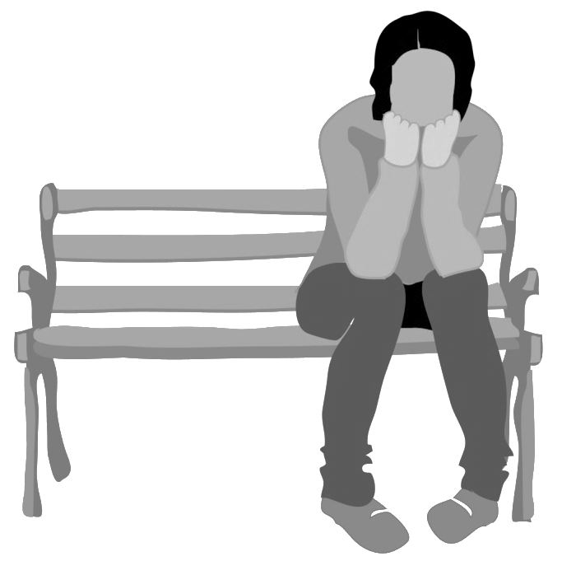
Michelle’s Story
UNDERLINE examples and
CIRCLE consequences of bullying
Can you find examples of cyberbullying?
– Page 7
Notes:
Now we are going to look at a different example in Michelle’s story. There are a few more twists in this one. Ask students to turn to page 7 of their workbook and look at Michelle’s story.
Give them 2-3 minutes to read the story – this is the process they have to follow on all tests like SATs where they have to read and comprehend. As they read the story, have them underline the instances of bullying and circle the consequences. Then hear these instances from the class.
Examples of bullying
Same friends all the way through school – abandoned her
Michelle was loyal to Erica after Craig told lies about her but then Erica betrayed her to Craig
Craig’s friends told Michelle that no one would date her
Craig and buddies harassed Michelle
Her own friends joined in laughing at her
Michelle was also sent harassing emails and text messages (cyberbullying)
Teachers tried to stop any name calling they became aware of
Michelle wasn’t the only person in this story who was treated cruelly. Who was the original person targeted? Erica was also lied about by Craig, a guy that she liked. Sometimes people don’t think of this kind of behavior between males and females as bullying or cruelty, but it is.

Slide 18
This slide is hidden in the slide show mode. These are additional notes on Michelle’s story.
– Page 7
Notes:
We just discussed what bullying looked like in Michelle’s situation, but now let’s talk about the consequences.
How will bullying and cruelty in Michelle’s story affect…
- Michelle? - Erica? - School?
Consequences for Michelle: felt isolated from friends, became depressed and anti-social, felt embarrassed and/or hurt, and had to change email address and phone number.
How do you think Michelle felt about cyberbullying? Give students a change to think and respond. Summarize students’ responses, with, She may have felt many negative emotions, such as fear, hopelessness and anxiety because she had little or no opportunity to escape from the hurtfulness. With phones, tablets and computers, we can receive messages anytime/anywhere, 24/7.
Consequences for Erica: lost good friend, potentially will lose pride and confidence if she learns the truth about Craig’s comments, may actually be ashamed of her treatment of her friend Michelle
Consequences for school: people are afraid to speak up when something is wrong, people are scared of being called names, school feels like an unsafe place
Specifics from the story that they may circle or mention:
Changed email address to try to remove herself from some attacks
Michelle couldn’t confide in her friends
Michelle became depressed and antisocial
Parents misjudged the seriousness

Slide 19
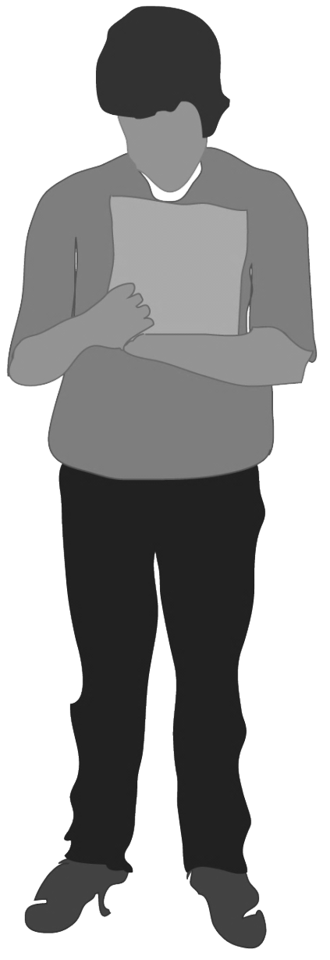
Consequences
People bullying AND those targeted
Higher levels of depression and anxiety
Poor academic performance
More school absences
Lack self-respect and self-esteem
Shame that can hurt people their entire lives
– Page 8
Notes:
OK, so we just discussed the consequences of bullying and cruelty in Michelle’s and Mike’s specific stories. But it is important to understand that the consequences of bullying vary for each person and in each situation.
Some people may respond to the exact same scenario in totally different ways; something that one person can shrug off as “not a big deal” could be a very emotional or traumatic experience for someone else. Some people have more natural resiliency and are more able to shrug things off as no big deal. Resiliency is also something that can be learned.
Although consequences vary by person, research tells us some information about how bullying generally affects those involved.
For instance,
Both the person bullying and those bullied can become depressed and anxious,
Do less well in school, and
Suffer from low self-respect and self-esteem.
Sometimes the shame from a bullying experience can hurt for a lifetime.

Slide 20
Consequences
Bystanders and Community Members
Greater feelings of helplessness
Decline in positive school and community culture and climate
Decline in academic performance
Bullying is a relationship problem.
– Page 8
Notes:
Bystanders and community members are also affected.
Again, research tells us how bullying generally affects those involved and their communities.
People that witness bullying (bystanders), or people who live in communities where bullying is common can begin to feel like the school or community, as a whole, is not a place that supports learning and healthy development.
In places where bullying and/or cruelty are common, there is normally a negative sense of community culture. People may not want to live there, move there, or have their kids in school there.
One symptom of this is people talking negatively about their school and studies clearly show a decline in academic performance and test scores when bullying is prevalent.

Slide 21
Consequences
Can you think of other ways bullying affects people?
– Page 8
Notes:
We’ve talked about many of the consequences of bullying, but I have a feeling you can think of even more ways that bullying hurts people. On the middle of page 8, jot down any other ideas that come to your mind.
Give students time to think and write, and then ask, Did you think of additional consequences?
Students may provide examples such as, “give up/lose interest in activities, loss of appetite, worry, suspension, legal consequences, drop out of school.”

Slide 22
Is Bullying Just
Normal Behavior?
Common doesn’t mean normal
Bullying doesn’t have to be accepted as normal
It hurts everyone involved – both ends of the bullying spectrum and all around
Cruelty needs to be stopped
Bullying can also be connected to cruelty in relationships
Why is so much unreported?
– Page 8
Notes:
Is bullying just normal and the kind of behavior to be expected?
Some people think bullying is just “kids being kids.”
But bullying is hurtful for everyone, including those who weren't directly involved.
Even though sometimes it may seem that there is a lot of bullying and cruelty out there, this behavior is definitely not okay or normal.
And, bullying can also be connected to or possibly lead to cruelty in relationships.
So, why do you suppose a lot of bullying doesn’t get reported? The simple answer is FEAR.
Fear of a lack of confidentiality
Fear that adults won’t do anything
Fear that adults will do the wrong thing
Fear of making it worse

Slide 23
Consider Power
It is not right for one person to exert power over another…
Trying to control someone
Telling someone who they can have as friends
Pressuring someone into doing something he or she doesn’t want to do
Taking advantage of someone who is intoxicated or drugged – inappropriate AND illegal!
– Page 9
Notes:
Let’s think a moment about the values we’ve been discussing and how they apply in relationships.
It is not right for one person to exert power over another…
trying to control someone
telling someone who they can have as friends
pressuring someone into doing something he or she doesn’t want to do
taking advantage of someone who is intoxicated or drugged can lead to life-changing consequences. This can impact everyone involved – the person targeted and the one who exerts the power or pressures!

Slide 24
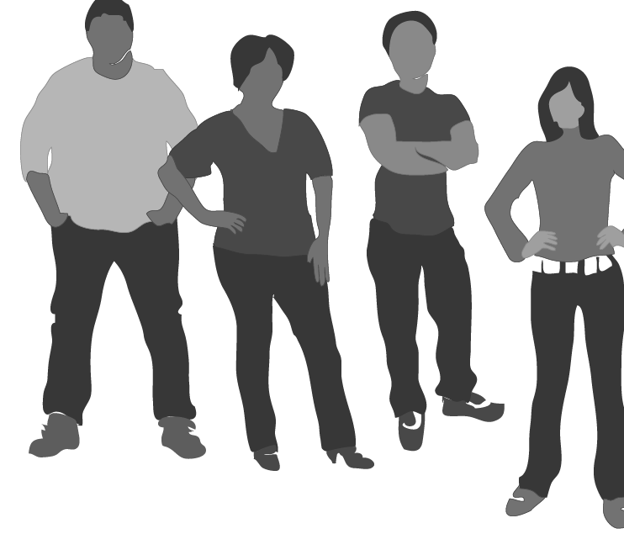
Relationships
Relationships work best when people work together, not when there’s tension
Even in romantic relationships, someone can get pressured into something
20.9% of female and 10.4% of male high school students say they’ve been targets of Teen Dating Violence in the last 12 months (CDC)
– Page 9
Notes:
Relationships work best when people work together, not when they are emotionally or physically pushing or pulling against each other.
Too often, even in romantic relationships, someone gets pressured into something they don’t want to do.
In 2013, 20.9% of female students and 10.4% of male students reported experiencing some form of Teen Dating Violence within the past 12 months. (Centers for Disease Control, 2013 national Youth Risk Behavior Survey)

Slide 25
Nationwide Survey
According to a CDC study:
48% of students experienced sexual harassment
87% of those students said the harassment had a negative effect on them
32% did not want to go to school because of it
– Page 9
Notes:
According to the Centers for Disease Control (CDC),
48% of students surveyed experienced some form of sexual harassment
87% of those students said the harassment had a negative effect on them
32% reported they do not want to go to school because of it
Think about that a moment --- that’s a huge number of students not wanting to go to school due to sexual harassment!

Slide 26
Labeling or Controlling Others
Labeling people as “good” or ”bad”
Trying to control who friends hang out with
… these actions are not consistent with living a life built around positive character attributes
You show courage and honor by standing up for others and treating everyone with respect.
– Page 9
Notes:
Labeling people as “good” or ”bad” girls, “good” or “bad” guys
Trying to control who your friends are allowed to hang out with – these actions are not consistent with living a life built around positive character attributes.
The courageous or honorable action is to stand up for others. Let’s keep that phrase in mind --- stand up for others. That’s what upstanders do.
We should be treating everyone with respect!

Slide 27
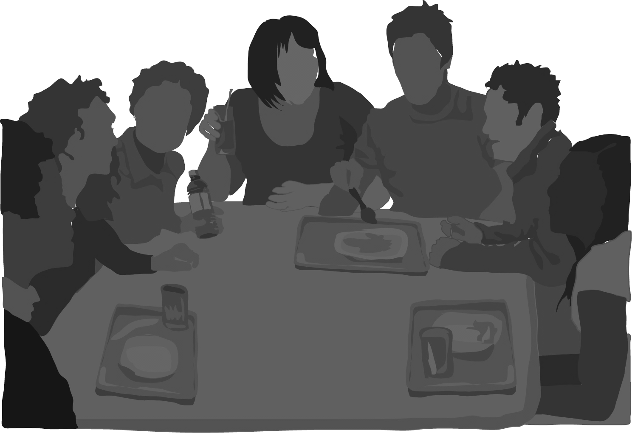
People different than you…
Do you think it is okay to make degrading comments to someone because of religion, race, culture, sexual orientation, gender, or body type?
“You’re so ______________.”
Everyone has a right to be free from harassment, free from degrading remarks. EVERYONE.
Harassing, degrading, or bullying violates the values we discussed and the principles this nation was founded upon.
– Page 9
Notes:
So what about people that are different than you – maybe a different race, body type, gender, sexual orientation, or culture?
Is it OK to make degrading comments to them just because they are different than you? Pause for only a second.
(Note – we used blanks in these quotes because the students’ minds will fill in labels or words far beyond what we could ever put in print.)
Saying things like,
You’re so ___.
You’re a ____.
You guys are all a bunch of ___.
These are offensive.
EVERYONE has a right to be free from harassment, free from degrading remarks. EVERYONE. Period.
Harassing, degrading, or bullying anyone violates the core values we discussed earlier.

Slide 28
What can you do?
Some watch. Upstanders act.
Always react in a safe way when you witness bullying or cruelty.
Don’t join in and don’t stand by. Stand up - act!
If you feel safe, tell the person bullying that this is not okay (ask a friend to stand with you)
Report it to an adult you respect
Comfort the person targeted by letting them know you care
– Page 10
Notes:
We’ve spent some time today talking about what bullying is and how it affects the people involved, but the big question is: what can YOU do about it?
You know, some people just watch and do nothing. Upstanders act. They try to make sure bullying simply does not happen around them.
Always, always, always – stay safe! Don’t do something that puts you or someone else at risk for physical harm.
Don’t join in. Don’t just stand by. Stand up - act!
If you feel safe, tell the person bullying that this is not okay (ask a friend to stand with you).
Report it to an adult you respect.
Comfort the person targeted by letting them know you care.
This slide is about simple things you can do when you actually witness bullying or cruelty. Your reaction doesn’t have to be complicated.
Let’s go to the next slide and talk specifically about cyberbullying.

Slide 29
Strategies to Stop Cyberbullying
Think before you post
Protect access to your digital world
Treat others the way you want to be treated online
Let a trusted adult know what’s going on
Don’t respond to disrespectful messages or posts
Block the person cyberbullying
Don’t spread hurtful messages or posts
– Page 10
Notes:
There is so much electronic technology out there, and with technology comes great opportunities - great tools for communication, finding information, creating presentations, designs, art and entertainment. The list of the benefits of technology goes on and on. Unfortunately, technology can also be used as a tool for causing harm. Earlier, we discussed many examples of cyberbullying. Now, let’s talk about what to do to prevent and/or respond to cyberbullying, whether it’s online threats, humiliating posts, threatening messages, or whatever.
Ask a student to read a line and then discuss.
Think before you post. Words, videos, and photos can spread quickly on social media, websites, and through texts. Once shared, they are difficult to control and delete. Think about your reputation and the reputations of others. A lot may be at stake. Your online reputation can follow you into the future – may be noticed by a college admissions committee or a potential employer.
Protect access to your digital world. What do you think we mean by this? Give students a chance to think and respond. Just be careful who can see what you post online. Are they your real friends? Set up your privacy controls so that you limit who has access to you online. Also, keep your passwords private. People have been known to set up fake profiles or post things from others’ devices that can wreak all kinds of havoc.
The golden rule: Simply treat others respectfully online, just like you would like others to treat you.

Slide 30
This slide is hidden in the slide show mode. The notes here are continuation of instructor notes on cyberbullying from previous slide.
– Page 10
Notes:
Talk to a trusted adult. People can’t help you if they don’t know what is going on. Better yet, show an adult the evidence and explain what is happening. Don’t try to handle this alone. An adult can help you come up with strategies that might work and deal with the stress and negative emotions that come with cyberbullying.
Never respond to a negative post or text message. This is what the aggressor wants -- to see your reaction to his or her actions, which can empower their sense of control.
Block the one cyberbullying. Does anyone know how to do this? Encourage students to share what they know about blocking cyberbullies. This could include blocking cell phone numbers or limiting the actions of others on social media. I want to make sure you know that many cell phone service providers or social media sites have ways to report cyberbullying and they can help. Many cell phones also have ways to allow you to block preset phone numbers.
Finally, please avoid spreading hurtful messages or posts. Think about how you would feel if a post was intended to embarrass you. Not contributing to the distribution of cyberbullying, you show loyalty to people in your community. This is also respectful, honorable and shows integrity – those core values that you checked earlier as being important. In other words, this would be a really good time to demonstrate your character and do your part to help and not hurt.

Slide 31
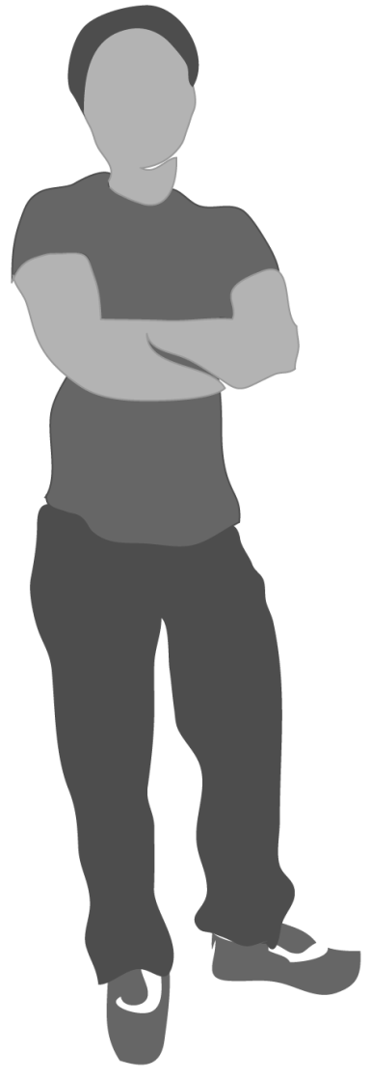
Changing the Culture
Become an upstander and change expectations.
If you realize you sometimes bully others, change your behavior – stop
Be a positive role model – setting the example of standing up for others
Be an “activist” and strengthen your school and community
Reach out – take the first step, including those regularly excluded in social settings
– Page 10
Notes:
The previous slides were about what you can do if you actually witness bullying or cruelty – even cyberbullying, but there is a lot more that you can do even when you don’t actually see bullying. Your school, community, and country need strong leaders to show people respectful ways to treat others, and to show others that bullying and cruelty are not okay.
There are lots of ways to be an activist for social change. Push for improvements in the way students treat each other like starting peer helper programs. Work collaboratively with your school and community leaders to answer questions about how you can improve your school. Later in your workbook, we’ll go over a list of questions that you can ask your school leaders.
One of the most effective ways to help is by being a role model for others.
Take the first step and go out of your way to include people that are left out, comfort those who are targets of bullying and cruelty, and be respectful, kind, and helpful to others.
Be the one who moves your chair back or scoots over for someone else to join your table at lunch.
Be the one who makes eye contact and takes a step back to open your circle in a conversation – letting someone know they can join in.
Be the one who notices and acts when someone is about to be excluded!
Be the one who sets the example of inclusiveness.

Slide 32
Make Bullying Socially Unacceptable
Would this make your school feel safer?
Bullying behavior changes if students AND teachers make it clear it is unacceptable and immature
What can WILL you do? (ex: I won’t gossip)
Think about how you can help make kind behavior more common
– Page 11
Notes:
So, if bullying were regarded as socially unacceptable, completely not cool – and that is the case in some schools…
Would that make the school feel safer – with less bullying going on?
Would that make students more likely to report bullying behaviors?
So, here’s the deal:
Many people will change their behavior if students AND teachers send a clear message that it is unacceptable and actually totally childish. The message has to be strong, clear, and consistent.
What can you do to help make this a reality and make kind behavior more the norm? Don’t spread gossip. Don’t join in. Don’t be cruel. Include others. Spread kindness.
This may be a place for the National Guard presenter to tell a personal anecdote about bullying and explain how that incident was hurtful to many people and was not respectful, honorable, or acceptable.

Slide 33
What could you have done?
What could you have done in Mike’s and Michelle’s stories?
Write your action and the associated value on page 11.
Loyalty
Duty
Respect
Selfless Service
Honor
Integrity
Personal Courage
– Page 11
Notes:
We’ve talked about general ways to respond to bullying and cruelty. Let’s think specifically what you could have done in Mike’s and Michelle’s cases and whether that action relates to one or more of the values we discussed earlier.
What could you do to respond to bullying in Mike’s story? Give a moment to jot down one thing they could have done… then ask for responses.
Follow-up question: Which of the values we discussed do you feel you could be demonstrating with that action?
Possible Examples - Mike:
Try to comfort Mike or invite him to sit with us during lunch. (Respect)
Talk to my school leaders about the places where many students don’t feel safe (in this example, many incidents happened in gym). (Selfless Service)
Do not laugh when Mike is teased, etc. (Personal Courage, Respect)
Encourage Mike to tell adults in the building or tell the adults myself. (Duty)
Possible Examples - Michelle:
Talk to Erica and her friends and try to encourage them to support Michelle. (Courage)
Tell Erica if I heard Craig say horrible names about her. (Integrity)
Comfort Michelle and be her friend. (Loyalty)
Encourage Michelle to tell her parents about what is going on. (Respect)
Talk to Michelle about ways that she could respond when approached by Craig. (Duty)
Ask school leaders about ways to promote healthy relationships in our school. (Selfless Service)

Slide 34
This slide is hidden in the slide show mode. The notes here are continuation of previous slide instructor notes.
– Page 11
Notes:
You guys came up with some really good options for dealing with these scenarios. It’s important to remember that, in the same way that bullying affects different people in different ways, there are many different ways to react to bullying and some ways might work better for certain people or in certain places. For example, it may work in Michelle’s story to simply tell Craig to stop, but that might not work in Mike’s situation.
In every bullying situation, there are many ways to make a difference, so it is sometimes hard to know what the best response is. The truth is that knowing the best response depends on the situation, on the person targeted and what he/she needs, and what you are most capable of and comfortable doing.
In Mike’s situation, some people might choose to comfort Mike or to invite him to sit at your table at lunch. For others, the best way to make a difference for Mike might be to work with school leaders to change the bullying policies at your school. These are both great ways to make a difference. Which one you choose is up to you.

Slide 35
Think Back…
You don’t need to write anything down, but think about the bullying incident you wrote about on page 5, if you could go back in time…
What would you do differently?
What would you say?
– Page 11
Notes:
On page 4, we asked each of you to think about a time that you witnessed or experienced bullying or cruelty.
We are going to spend a few minutes of today’s presentation going back to what you wrote earlier, and thinking about what you could possibly do differently if you could go back in time and address the problem.
Please turn in your workbook to page 11. Take about 2 or 3 minutes to answer the questions listed. This is for self-reflection.
You may want to ask the students if they were able to think back on the situation and figure out something they could have done differently – remind them they are not telling a story now. Do not discuss. You may want to just confirm that some of them were able to recognize an approach that may have helped.

Slide 36
Next Steps?
Schools are partnerships between students, educators, parents, and the community. As a key partner, what can you do?
Consider the questions on pages 12-13 as a good starting point for a discussion with teachers and administrators
Request to form a student/faculty committee
Student Council meet with Principal
– Page 12
Notes:
Schools are partnerships between students, educators, families, and the community. Everyone benefits when schools are safe and when students learn – coming out of high school ready for college, training, or ready to go to work.
You are key stakeholders – so what can you do to raise the issues to the other partners?
The questions on pages 12-13 were created by the Harvard Graduate School of Education and are a good starting point to begin discussion on how to improve your school climate.
Maybe you request to form a committee from within your class?
Maybe the Student Council makes a formal request to meet with the school administrators and ask these questions?
All of these questions should be ones that school administrators are willing to discuss. Students, faculty, families, and community members are all partners.
These questions are a good starting point and can help move things in the right direction as your school explores this topic further. But, it’s important to remember that the questions are not intended to assign blame or create arguments. They are designed to help students work as partners with school leaders to learn more about how the school can become a more kind, caring, and safe community.
Numerous resources and tools are available on the HEAR website, www.project-hear.us. The website can be accessed from the QR code on page 13 in your book.

Slide 37
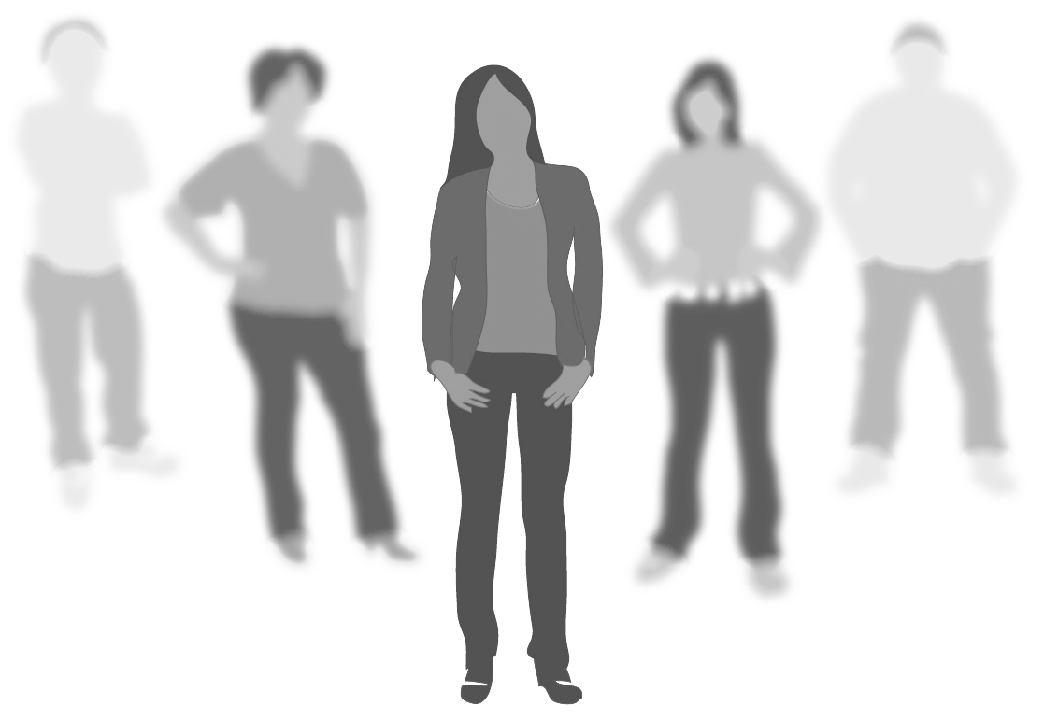
Important…
We all have choices. By choosing to live with the values we discussed, we can build respect and help prevent bullying.
Remember: Safety first!
Protect yourself and then others!
– Page 13
Notes:
The QR code on this page goes to the resources section of the project-hear.us website. It can give you an on-going source for ideas to help in your school.
This slide is a segue into the close and the Guard message on the back cover.
Remember – no matter what, stay safe as you witness or react to bullying. Protect yourself and then others.

Slide 38
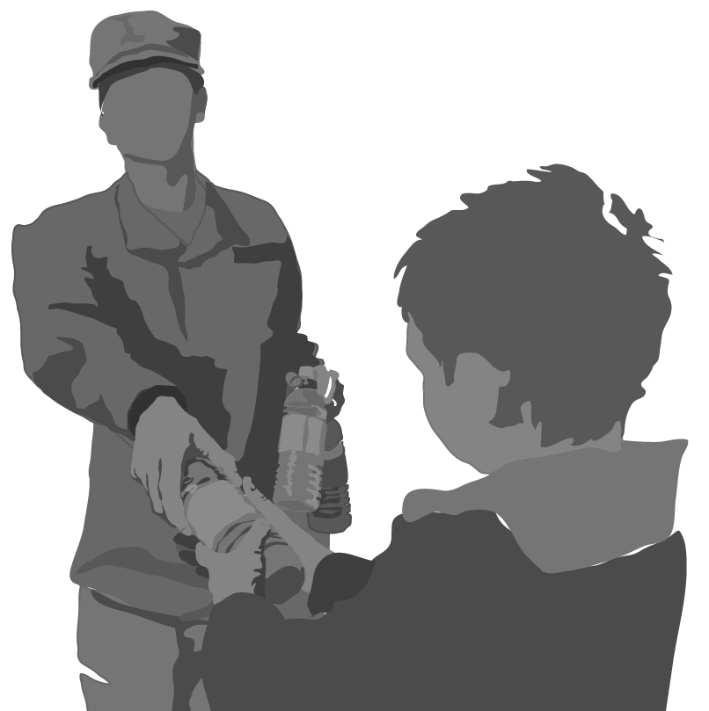
In the Guard –
we’ve made a solemn vow to protect and serve others.
What about you?
Notes:
Thank you once again for the privilege of presenting this information to you today. We believe it is entirely consistent with what the Guard is all about. If you look on the back cover of your workbook you’ll see what I mean.
In the Guard, we’ve made a solemn vow to protect and serve others.
What about you?
Will you be one of those that protects, serves, and helps others here in your school and community?
You can make a difference.
We all have the power to make a difference.
On behalf of the _____National Guard, thank you for the privilege of participating in this presentation today and for the respect you showed me. I need two things now…
1. I have a feedback sheet I need you to fill out. This helps gather research so I can ensure we do the best job we can in these presentations. It also creates an attendance record for your school to show who went through this class.
If you think the Guard values are important and want to know more, you can put that on the form, too.
Please fill it out and just hand it to me as your leave.
2. And this is really important as a first step… if you are willing to commit to respecting others, sign your name to this “I Respect Others” commitment banner before you leave. It stays in the school as a reminder to Respect!
Thanks again! I wish you the best!

Slide 39
Notes:
Please return the completed student surveys and cover sheet to CTC in the self-addressed envelope provided in the case of materials. Results are typically emailed to the RRNCO and educator in 7-10 business days. If you have any questions, please contact CTC at 888-326-9229.

Slide 40
This slide is hidden in the slide show mode. The information here is an appendix on studies on reporting of bullying.
– Appx 1
Notes:
Background Studies
Barboza, G. E., Schiamberg, L. B., Oehmke, J., Korzeniewski, S. J., Post, L. A., & Heraux, C. G. (2009). Individual characteristics and the multiple contexts of adolescent bullying: An ecological perspective. Journal of Youth and Adolescence, 38, 101-121. doi: 10.1007/s10964-008-9271-1 Prevalence estimates of bullying behaviors are affected by the type of measure used.
Using a sample of 7,946 students ages 11-14 years, a dichotomous variable of whether a student bullied (i.e., yes/no) revealed that 42.55% reported having bullied other students.
However, when frequency of bullying was taken into consideration, it was found that 25.71% reported bullying “once or twice,” 9.22% reported bullying “sometimes,” 2.77% reported bullying “about once a week,” and 4.85% reported bullying “several times a week.”
Thus, students’ reports of bullying behaviors may be overestimated when they are not asked about the frequency of bullying behaviors.
Cornell, D., & Limber, S. (2015). Law and policy on the concept of bullying at school. American Psychologist, 70, 333-343. doi: 10.1037/a0038558.
“Dear Colleague” letters from the office of the U.S. Department of Education to school authorities are giving schools clearer educational standards about bullying: http://www2.ed.gov/about/offices/list/ocr/letters/colleague-201010.pdf
Between 1990 and 2010, more than 120 bills were enacted by state legislatures that introduced or amended education or criminal justice statues addressing bullying.
Every state now requires schools to develop policies regarding bullying.
Most state laws include provisions regarding reporting incidents of bullying, disciplinary policies, prevention and support services, and, statutory definitions of bullying.
For comprehensive information on state laws and policies: www.stopbullying.gov

Slide 41
This slide is hidden in the slide show mode. The information here is an appendix on studies on reporting of bullying.
– Appx 2
Notes:
Background studies (continued)
Hymel, S., Swearer, S. M. (2015). Four decades of research on school bullying: An introduction. American Psychologist, 70, 293-299. doi: 10.1037/a0038928
Bullying is a subcategory of interpersonal aggression characterized by intentionality, repetition, and an imbalance of power.
There is no one best method for assessing bullying and victimization, and measurement issues persist.
Bullying often occurs in the peer group and in places with little adult supervision, making parent and teacher reports potentially unreliable.
Bullying prevalence rates vary across studies, ranging from 10% to 33% of students reporting victimization by peers and 5% to 13% reporting bullying others.
Boys tend to report more bullying and girls more victimization.
McDougall, P., & Vaillancourt, T. (2015). Long-term adult outcomes of peer victimization in childhood and adolescence: Pathways to adjustment and maladjustment. American Psychologist, 70(4), 300-310.
The lasting effects of childhood victimization can greatly differ depending on a variety of risk or protective factors.
Peer victimization shapes an environment in which school is seen as aversive by the target, negatively impacting their ability to learn and achieve academically.
Children who experience peer victimization are more likely to report somatic complaints (i.e., headaches, stomachaches) as well as have abnormal cortisol levels, which likely affects their mental and physical health.
Peer victimization tends to have a negative effect on popularity, peer acceptance, and maintaining friendships. Experiencing victimization can lead to decreased self-efficacy, social competence, and self-worth.
Peer victimization is related to a variety of mental health concerns such as depression, anxiety, aggression, attention problems, and suicidal ideation.
Studies show that victimization is indirectly related to negative outcomes; however, some studies have also shown a direct link between childhood victimization and poor long-term outcomes (e.g., anxiety, somatization, psychotic experiences, suicide, aggression and heavy smoking in men) in adulthood.

Slide 42
This slide is hidden in the slide show mode. The information here is an appendix on studies on reporting of bullying.
– Appx 2
Notes:
Background Studies (continued)
There are multiple variables (e.g., positive family supports, positive teacher and school supports, social skills, academic strengths, timing of victimization, biological makeup) that can interrupt the pathway of childhood victimization effects into adulthood.
Creating positive family support, positive teacher and school supports, teaching social skills, fostering academic inquiry and focusing on resilience training can help students cope with victimization.
Ryoo, J. H., Wang, C., & Swearer, S. M. (2014, August 11). Examination of the change in latent statuses in bullying behaviors across time. School Psychology Quarterly. Advance online publication. http://dx.doi.org/10.1037/spq0000082
Examines fifth through ninth graders experiences with bullying over three time points
Changes in bully status/membership, individual characteristics that moderate bully/victim transition
Frequent targets were the students who were bullied weekly and were physically harmed regularly (47%), their property was regularly taken or damaged (39%), verbally bullied (82%), and isolated from peers due to rumors (66%). However, they were less likely to be cyberbullied (25% weekly, 18% once or twice in the past two months, 58% never)
Occasional traditional targets were the students who were occasionally bullied physically, verbally, and relationally, but not electronically. They had high probabilities for being physically harmed once or twice in the past two months (36%), their property was taken or damaged once or twice (34%), they were verbally bullied once or twice (59%), and they were once or twice isolated from peers due to rumors (42%). However 99% were never involved with cyberbullying.
Occasional cyber and traditional targets were students who were occasionally verbally, relationally, and electronically targets to bullying. These students were once or twice verbally bullied (69%), isolated from peers due to rumors (69%), and cyberbullied (57%). However they were less likely to experience physical bullying (24%) and property damage (38%).
Students were less likely to be bullied after coming back to school from summer break
Fifth graders had the highest probabilities of being frequent targets, which was less with each increasing grade, although ninth graders reported higher probabilities of being in the occasional cyber and traditional target status than the other grades.

Slide 43
This slide is hidden in the slide show mode. The information here is an appendix on studies on reporting of bullying.
– Appx 2
Notes:
Background Studies (continued)
ELL students were less likely to be in the occasional target group, but more likely to be in the infrequent groups than English speaking students
It is likely that the groups will be partially based on frequency (not involved, sometimes involved, and frequently involved). It is unlikely that the groups will be based only on the type of bullying/victimization because students tend to engage in different types of bullying behaviors/victimization simultaneously, making it impossible to separate different groups only by the type of bullying/victimization.
Sawyer, A., Bradshaw, C., & O’Brennan, L. (2008). Examining ethnic, gender, and developmental differences in the way children report being a target of ‘bullying’ on self-report measures. Journal of Adolescent Health, 42(2), 106-114. doi: 10.1016/j.jadohealt.2007.12.011
Using a definition-based measure, White/Caucasian students (63.87%) were more likely to report victimization than students who identified as African-American (14.73%), Hispanic (3.99%), Asian/Pacific Islander (3.58%), or Other (7.82%).
Authors conclude that there may be cultural differences in the way students perceive the victimization they experience and/or in their beliefs about victimization, which may affect their tendency to report the bullying. For example, some students may perceive more of a cultural stigma surrounding the bullying they experienced.
Scheithauer, H., Hayer, T., Petermann, F., & Jugert, G. (2006). Physical, verbal, and relational forms of bullying among German students: Age trends, gender differences, and correlates. Aggressive Behavior, 32, 261-275. doi:10.1002/ab.20128
The younger students are, the more likely they report being frequently bullied. Reports of bullying behaviors decreased steadily across fifth (17.8%), sixth (15.7%), seventh (12%), eighth (7.1%), ninth (6.8%), and tenth grades (6.6%).
This may reflect a tendency to consider a broader range of behaviors as bullying when one is younger, more appropriately narrowing one’s definition of bullying with age.
Thus, it is likely that there is an inflated estimate of bullying among younger students.

Slide 44
This slide is hidden in the slide show mode. The information here is an appendix on studies on reporting of bullying.
– Appx 2
Notes:
Background Studies (continued)
Being bullied by being called gay has negative effects on boys’ psychosocial functioning.
Adults should intervene when they hear students saying homophobic slurs (i.e., “gay,” “faggot,” “dyke,” etc.).
Words DO hurt and have a negative impact on students.
Additional reading: Words wound by Justin W. Patchin and Sameer Hinduja (2014). Free Spirit Publishing. http://www.amazon.com/Words-Wound-Delete-Cyberbullying-Kindness/dp/1575424517/ref=sr_1_1?ie=UTF8&qid=1431881111&sr=8-1&keywords=words+wound
Centers for Disease Control and Prevention, 2011 Youth Risk Behavior Survey
Adolescents and adults are often unaware that teens experience dating violence. In a nationwide survey, 9.4 percent of high school students report being hit, slapped, or physically hurt on purpose by their boyfriend or girlfriend in the 12 months prior to the survey. http://www.cdc.gov/violenceprevention/intimatepartnerviolence/teen_dating_violence.html

